Slide 1
Lucid: A Language for Control in the Data Plane
John Sonchack, Devon Loehr, Jennifer Rexford, David Walker
SIGCOMM '21: Proceedings of the 2021 ACM SIGCOMM 2021 Conference, August 2021

Slide 2
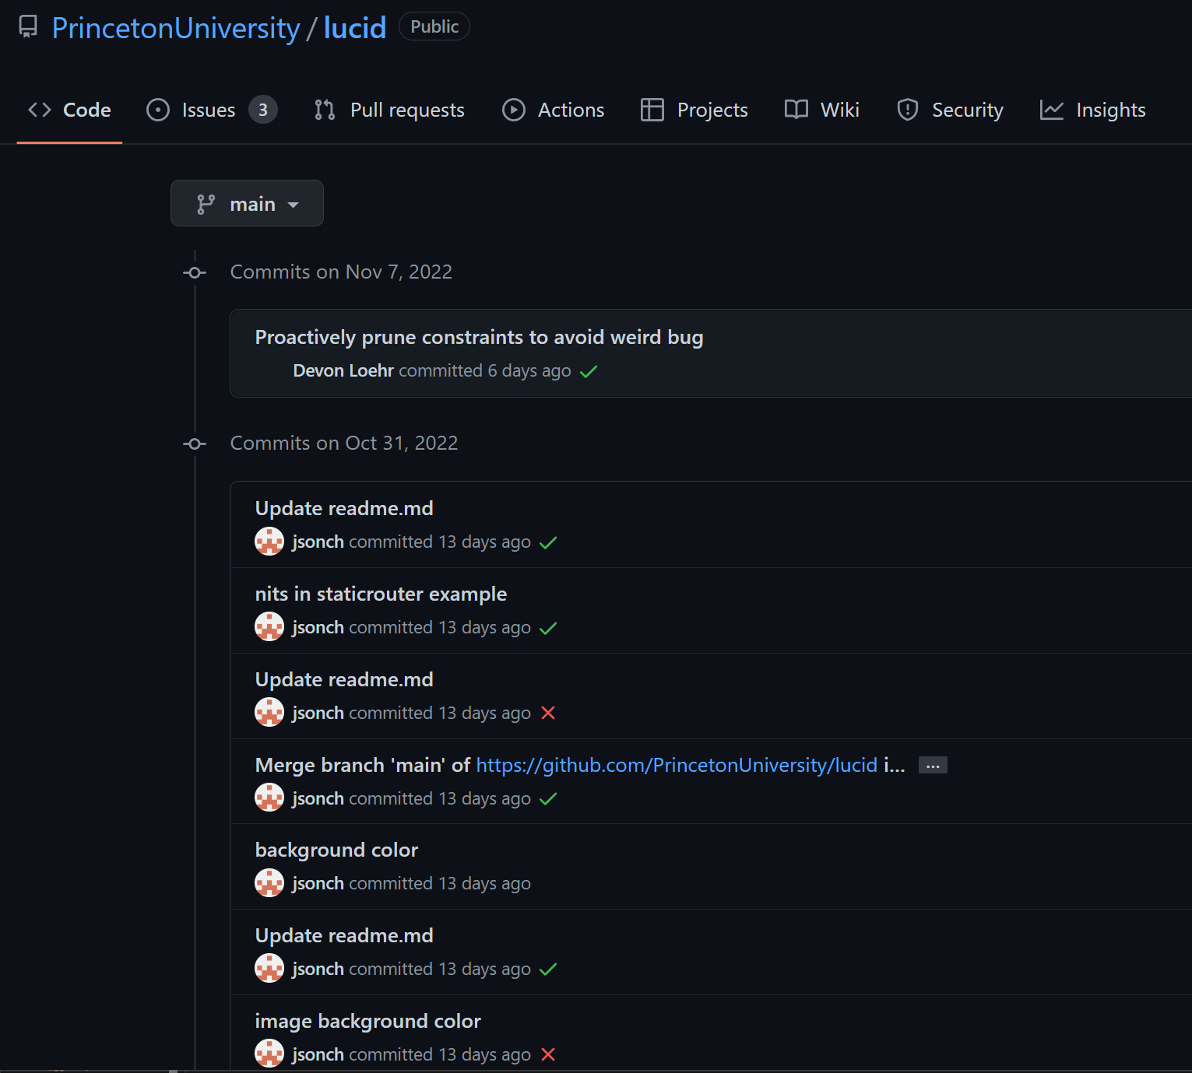
Lucid on GitHub
This is a very recent paper and active project.
Things presented in this paper may not reflect its current status.

Slide 3




Traditional switch architectures
Perform Actions
Add/Delete Flows
Check table for timeouts
Update switch tables
Table of authorized flows
Control Plane
PCIe, etc.
Data Plane
Table of authorized flows
Match/Action Forwarding Pipeline
WAN
LAN
Notes:
Have a review on the benefits.
Here we have a data-plane MA pipeline and a control plane server. The switch is acting as a stateful firewall, allowing only traffics that was initiated from LAN.

Slide 4
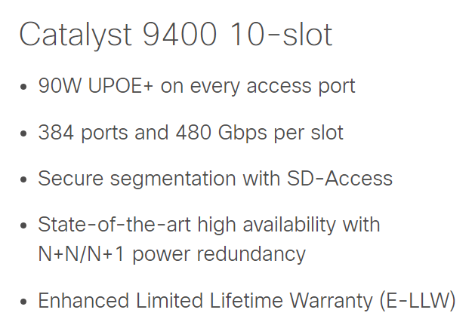
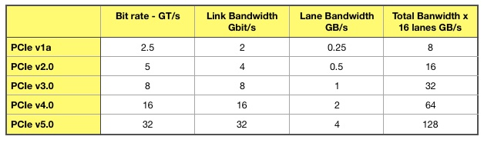
Problems
This PCIe link is a bottleneck in packet processing. It introduces latency in table updates.
We used stateful firewalls as an example, but such problem is prevalent in lots of applications.
PCIe, etc.
(And up to 9.6Tbps switch fabric!)

Slide 5
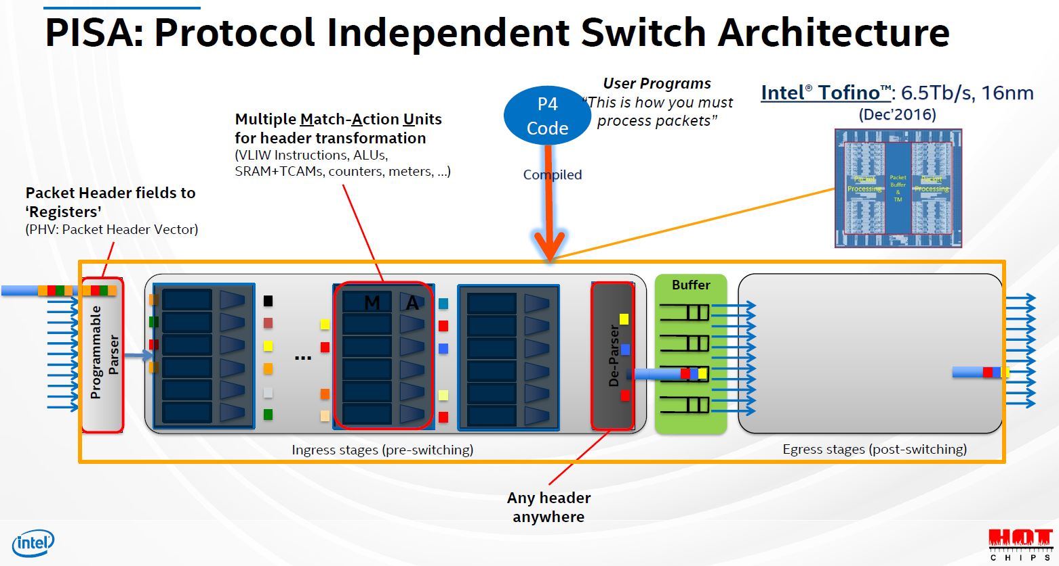
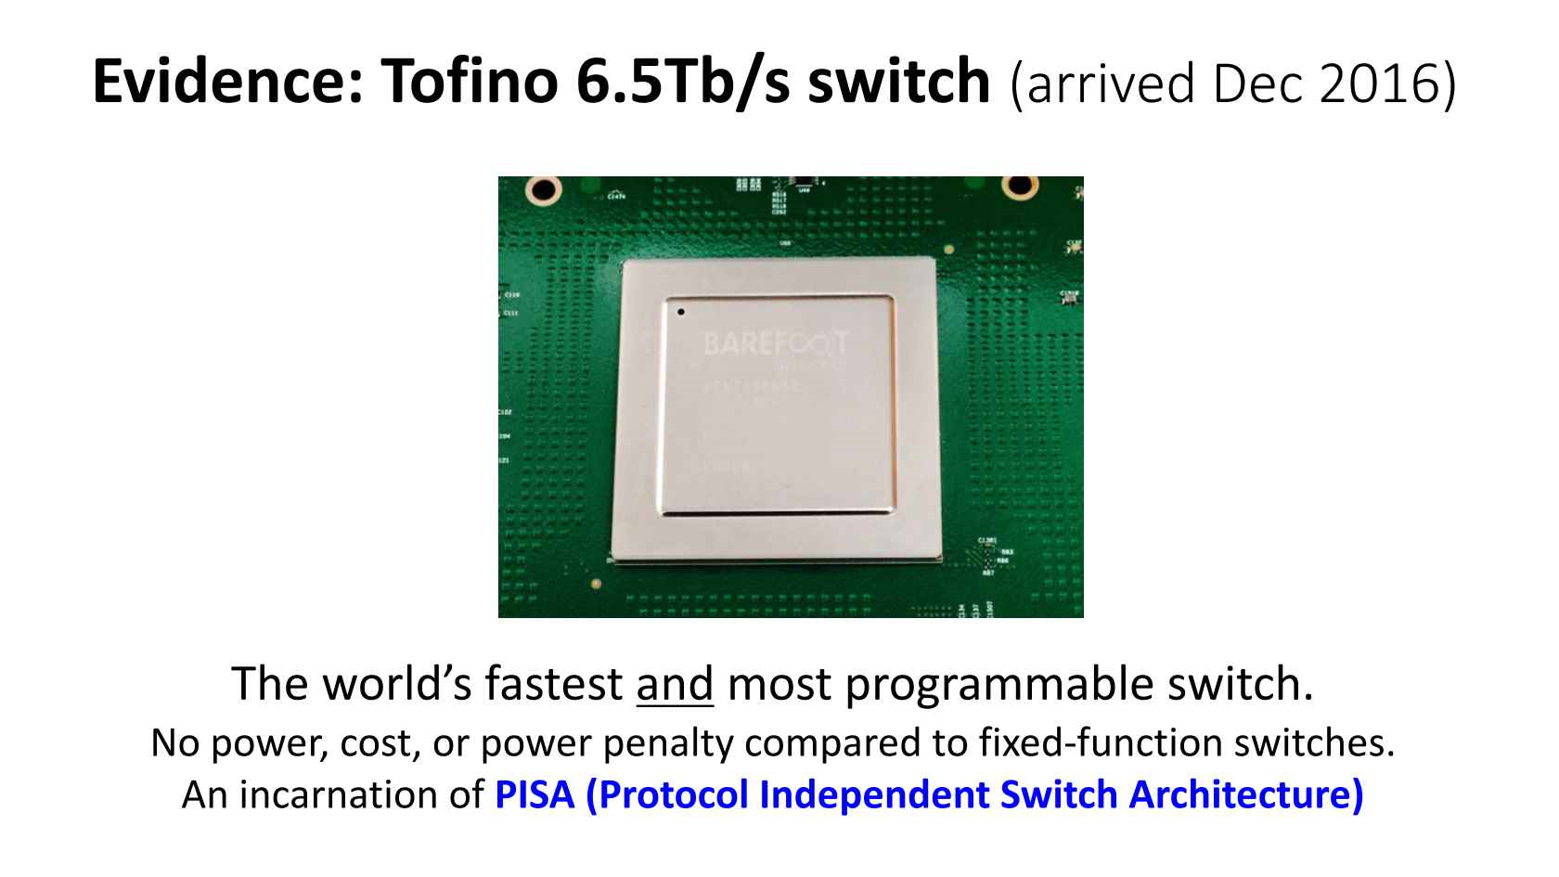
PISA Switches
PISA – Protocol Independent Switch Architecture.
P4 is a language for programming PISA switches.

Slide 6
PISA Power
Flexible parsing and manipulation of packets
Can update persistent states (register arrays)
…
We can now implement some control logic directly in the dataplane.
Notes:
So what does PISA give us?

Slide 7
PISA Stateful Firewall
On LAN packet ingress
Store the flow in SRAM/TCAM on switch.
On WAN packet ingress
Check SRAM/TCAM for corresponding flow.
Periodical packet generator to trigger timeout detection.
Data Plane
Table of authorized flows
Match/Action Forwarding Pipeline
WAN
LAN

Slide 8
New Problem
This programming model is weird!
Deal with the following concepts on P4:
  Match tables, Actions
  Packet parser
  Register Arrays
  Register Actions
  Packet generator
  Packet replication
  Packet recirculation
  Priority-Based Flow Control queues

Slide 9
New Problem
As a higher-level language, the primitives and programming model provided by P4 is tedious to work with.
  Express control logic in the language of packet processing logic, which consists of disjoint components such as parser, MAU and recirculation.
  Orchestrate other components (such as packet generators) for more sophisticated controls, such as state management.
Example: Implementing loops in P4 programs for applications such as fast rerouter.
Notes:
MAU: Match-Action Units

Slide 10
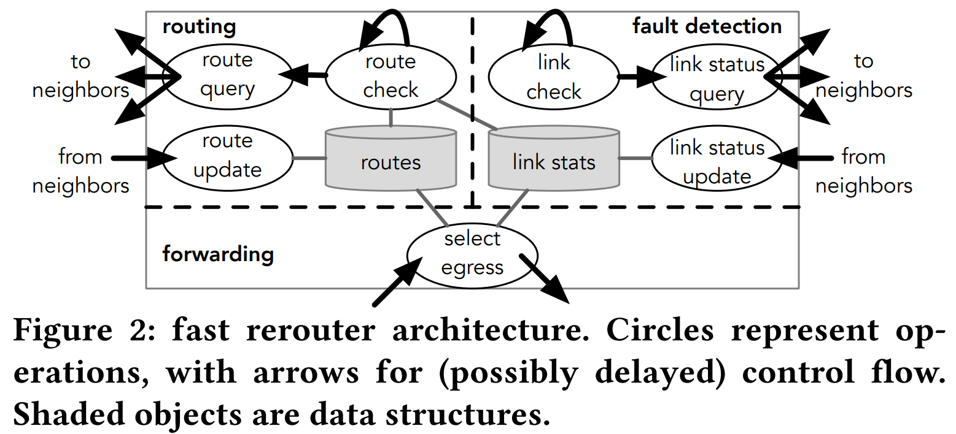
Case Study: Fast Rerouter
Periodically send packets that ping all neighbors.
Update link statuses.
Decide which link to go on egress.

Slide 11
Problem 1: Necessary Loops
P4 is designed that all operations on the dataplane go at line rate, and operations are expressed in MAU in pipelines.
No loops: The PISA architecture cannot loop in a single stage.
However in the fast rerouter, we need a loop that iterates through all links and send pinging packets.
  Generally, loops are needed for all maintenance tasks.

Slide 12
Problem 1: Necessary Loops
Solution: Use the recirculation path.
Design a packet with headers that represent this operation. Include a counter in the header.
Recirculate this packet with the recirculation path, ping a neighbor according to the counter when this packet is met.
Discard the packet after the counter meets the total number of links.

Slide 13
Problem 2: Scheduling
We do not want this pinging to happen all the time.
Use a packet generator to generate the aforementioned packet.
We want to tell our link to other switches.
Send the packet to someone else.

Slide 14
Problem 3: Unexposed Constraints
X = RegisterArray<32>(128);
Y = RegisterArray<32>(128);
ingress() {
if(foo) {
tmp = X[0];
Y[0] = tmp;
else {
tmp = Y[0];
X[0] = tmp;
}
}
This code will not compile to P4.
P4 programs store persistent state in RegisterArrays, and use RegisterActions with arbitrary blocks of C-like code to operate on those arrays.
However, not all RegisterActions can be actually implemented by Tofino.

Slide 15
Problem 3: Unexposed Constraints
X = RegisterArray<32>(128);
Y = RegisterArray<32>(128);
ingress() {
if(foo) {
tmp = X[0];
Y[0] = tmp;
else {
tmp = Y[0];
X[0] = tmp;
}
}
This code will not compile to P4.
Registers are associated with a single stage.
The first condition means X[0] must appear before Y in the pipeline.
The second conditions means Y[0] must appear before X[0] in the pipeline.
You’ll get a cryptic message: Table placement cannot make any more progress. Does not tell you what’s actually wrong.

Slide 16
P4 Complexity
From the discussion we can see that implementing a fast rerouter in P4 involved a lot of low-level programming.
In some cases, abstraction is broken: The underlying constraints gets propagated to the language level, and the developer is forced break the abstraction and inspect the details.
Enter Lucid, a high-level abstraction that simplifies this process.

Slide 17
Lucid
A high-level language that raises the level of abstraction and make programming easier.
Designed for Tofino, compiles to P4.

Slide 18
Abstractions
P4
Lucid
  Match tables
  Actions
  Packet parser
  Register Arrays
  Register Actions
  Packet generator
  Packet replication
  Packet recirculation
  Priority-Based Flow Control queues
Events
Handlers
Arrays

Slide 19
Abstraction: Events
Events can be both control operations and data packets.
  Also an abstraction of application-layer messages, such as the pings.
  Events can be sent to other switches, or a switch itself.
Four members: Name, data, time and place.
Constructs a “multithreading” programming model, since events can be handled in parallel.

Slide 20
Abstraction: Handlers
All computation happens in handlers. Specifies what happens when the switch receives an event.
Compiles to multiple primitives: Tables, ALUs, stateful ALUs.
Executes in a single-pass through the pipeline.

Slide 21
Abstraction: Arrays
Store persistent states.
Provides a functional interface for operations that can be done with a single pass of ALU.
Helps writing modular and reuseable code.
Notes:
Arrays include 1) the data strcuture itself. 2) The operations on these data structures.

Slide 22
Fast-Rerouter Events & Handler
global pathlens = new Array<<32>>(table_size);
memop incr(int stored, int added) {
return stored+added;
}
fun int get_pathlen(int dst) {
return Array.get(pathlens, dst, incr, x);
}
Returns incr(pathlens[dst], x)

Slide 23
Fast-Rerouter Events & Handler
event route_query(int sender_id, int dst);
event route_reply(int sender_it, int dst, int pathlen);
event check_route(int dst);
# Replies to a route query from sender_id
handle route_query(int sender_id, int dst) {
int pathlen = get_pathlen(dst);
event reply = route_reply(SELF, dst, pathlen);
generate Event.locate(reply, sender_id);
}
Schedules a reply event to run on sender_id. Lucid’s way of sending response.
route_reply function on the sender will handle this event and update registers.
Notes:
END: So here we saw generate Event.locate, which is Lucid’s way of generating events.

Slide 24
Event Generation
There are two event compositors in Lucid:
  Event.locate() schedules an event on some switch.
  Event.delay() schedules an event to delay until being handled.
  Two combinators can be used together.
Allows a control operation to be broken into a series of events.
Allows scheduling events after some time or on other switches.
  Loops can be easily implemented by starting another event at the end of handler.
  Allows easier implementation of distributed systems.

Slide 25
Event Dispatching
Local, immediate events:
  The event is “processable.” It is sent into the pipeline, and the match-action tables are executed.
Local, non-immediate events:
  The packet stays in a special delay queue at recirculation egress until time is up.
  The delay queue is paused most of the time, and gets unpaused periodically.
Remote events:
  The event packet gets sent to a port or a multicast group.

Slide 26
Memops
memop incr(int stored, int added) {
return stored+added;
}
A special type of function that carries some simple operation to be completed in one ALU.
Compiler will throw an error if the operation is too complex.
  Either a simple return statement, or an if statement with a return statement in each branch.
  Each variable used at most once per expression.
  ALU-supported operators only
Prevents developers unknowingly writing unimplementable complex operations.

Slide 27
Ordered Data Access
X = RegisterArray<32>(128);
Y = RegisterArray<32>(128);
ingress() {
if(foo) {
tmp = X[0];
Y[0] = tmp;
else {
tmp = Y[0];
X[0] = tmp;
}
}
Constraint: Persistent data must be partitioned across the stages of a feed-forward pipeline. Operations that happens in later stages cannot read/modify data in previous stages.
Lucid treat declarations as high-level intentions of how the developer want the data to be placed.

Slide 28
Ordered Data Access
A program is well-ordered if all data access follows the declaration order.
This is generalizable to any PISA switch, since the constraint is universal.
Lucid will throw a source-level error if the order is violated.

Slide 29
Compilation & Optimizations
Lucid is compiled to P4_16 for Tofino.
  Events map to packet headers.
  Event scheduler is static code (library)
  Handlers are translated to atomic P4 tables, and control flow is optimized.

Slide 30
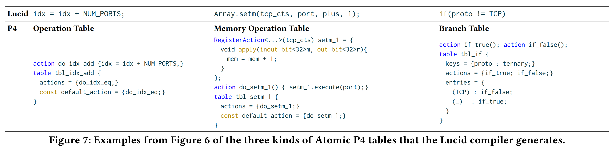
Handler Compilation
The handler body is broken into a graph of execution. Each statement is implementable in a single ALU.
Three types of tables

Slide 31
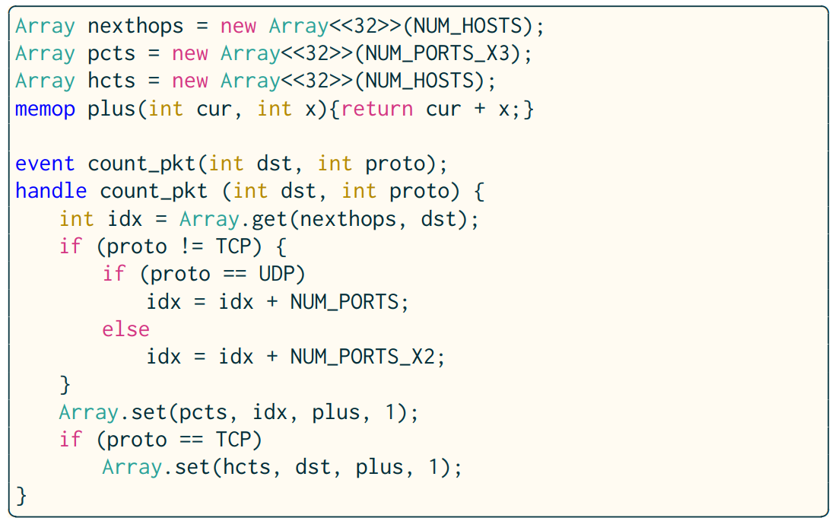
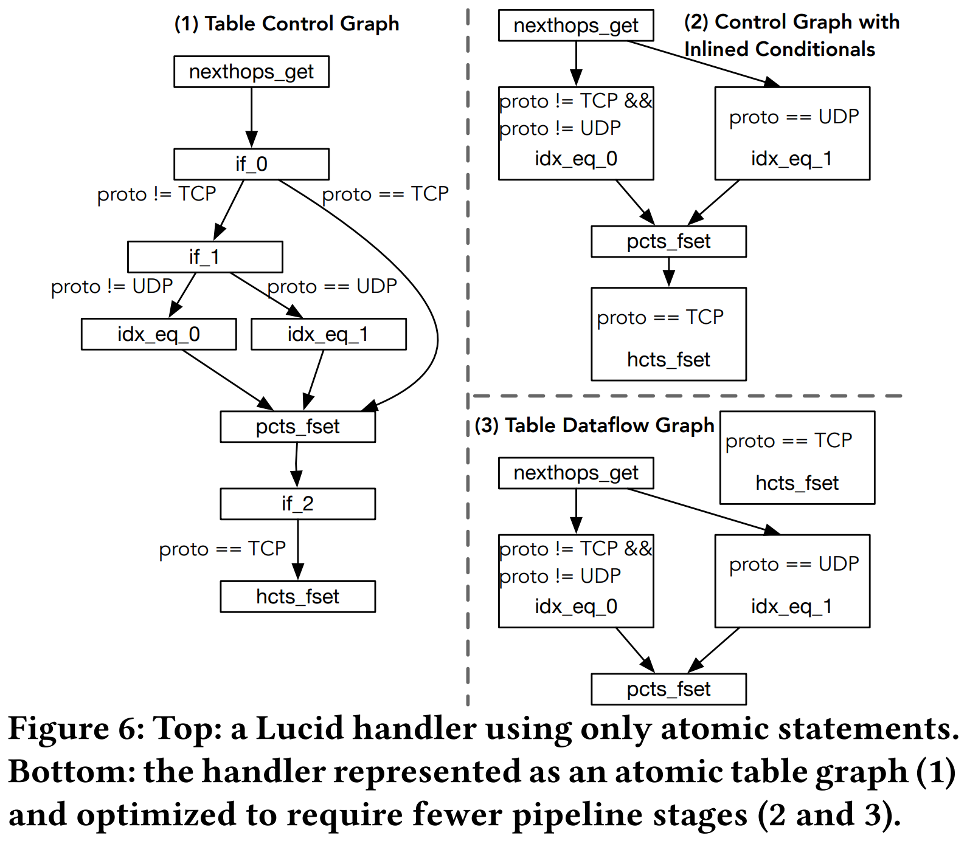
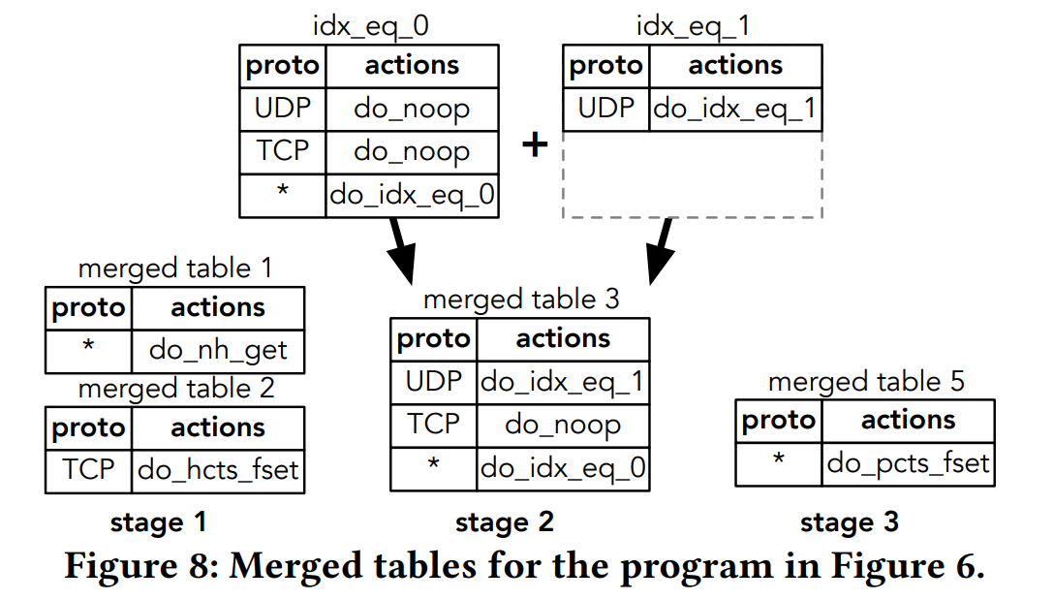
Optimizing Control Flow
Inlining branch operations (1->2)
  Eliminate branch tables by placing the conditions in non-branch tables.
Rearranging tables(2->3)
Merging tables and actions.

Slide 32
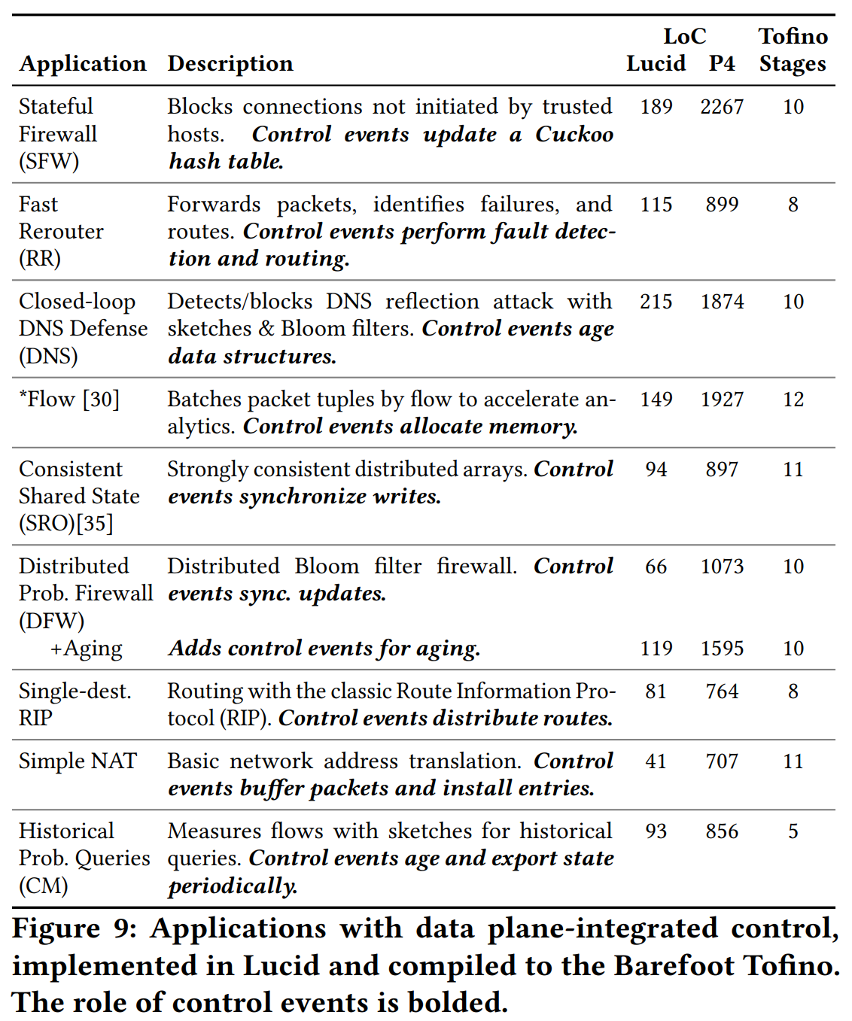
Evaluation: LoC
Estimated 10 ~ 15% of P4 code length, based on *Flow.
Shown to the right: Lucid program lines & generated P4 lines.
A PhD student new to P4 wrote a non-trivial Lucid program in less than an hour.
Notes:
*Flow is 1559 in P4 when handwritten.

Slide 33
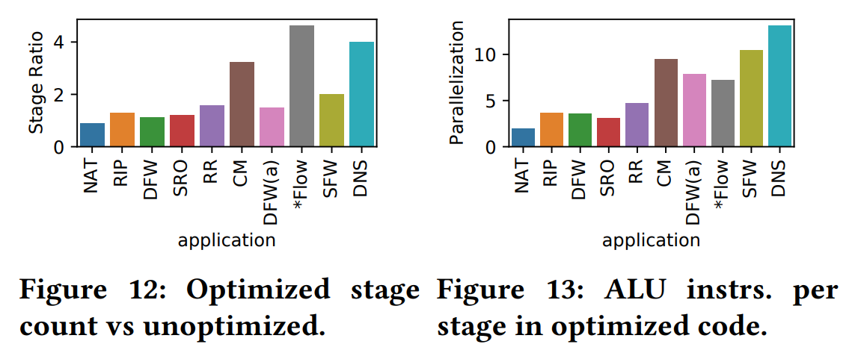
Evaluation: Optimization effectiveness
Greater benefit to complex applications.
High ALU instruction per stage, good parallelism exploitation.

Slide 34
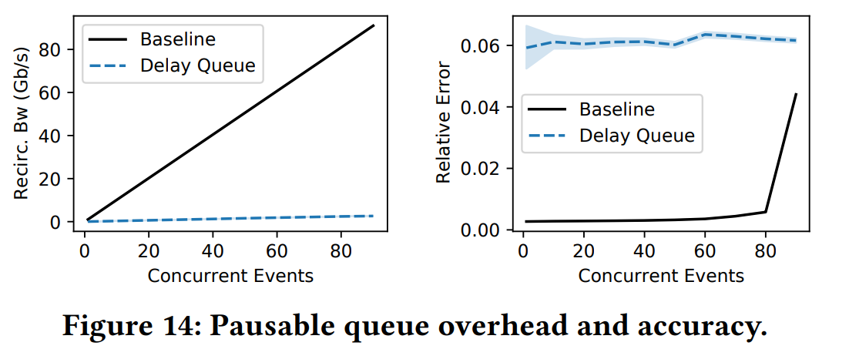
Evaluation: Event Scheduler
The effectiveness of using pausable queues in the event scheduler.
Increased buffer utilization and error in timing.

Slide 35
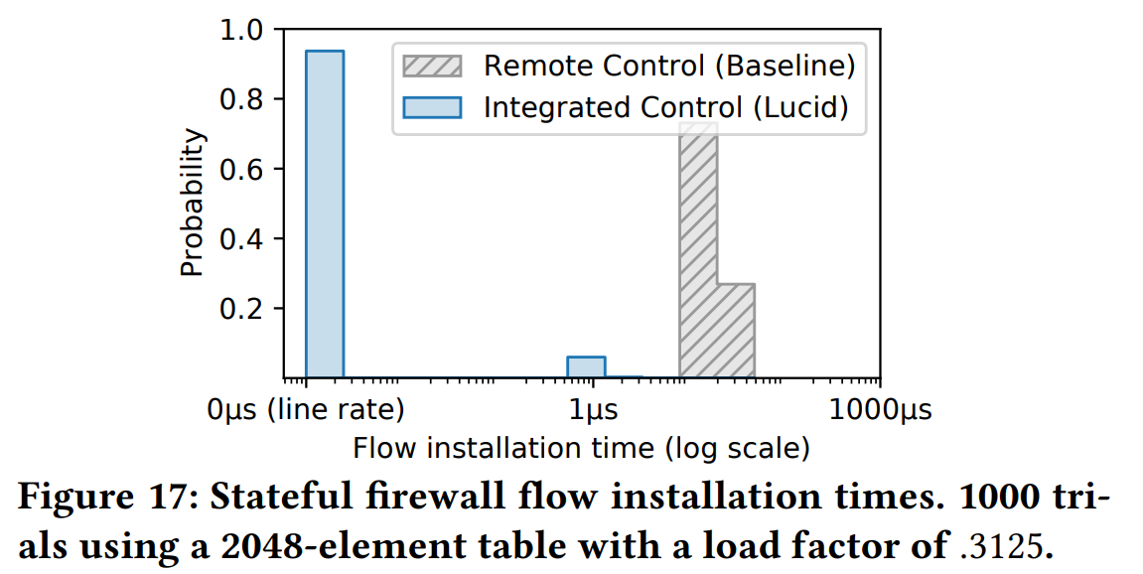
Evaluation: Stateful firewall
Flow installation time is 300-400x times better.

