Slide 1
Rowhammer:
A Retrospective
Onur Mutlu, Jeremie S. Kim

Slide 2
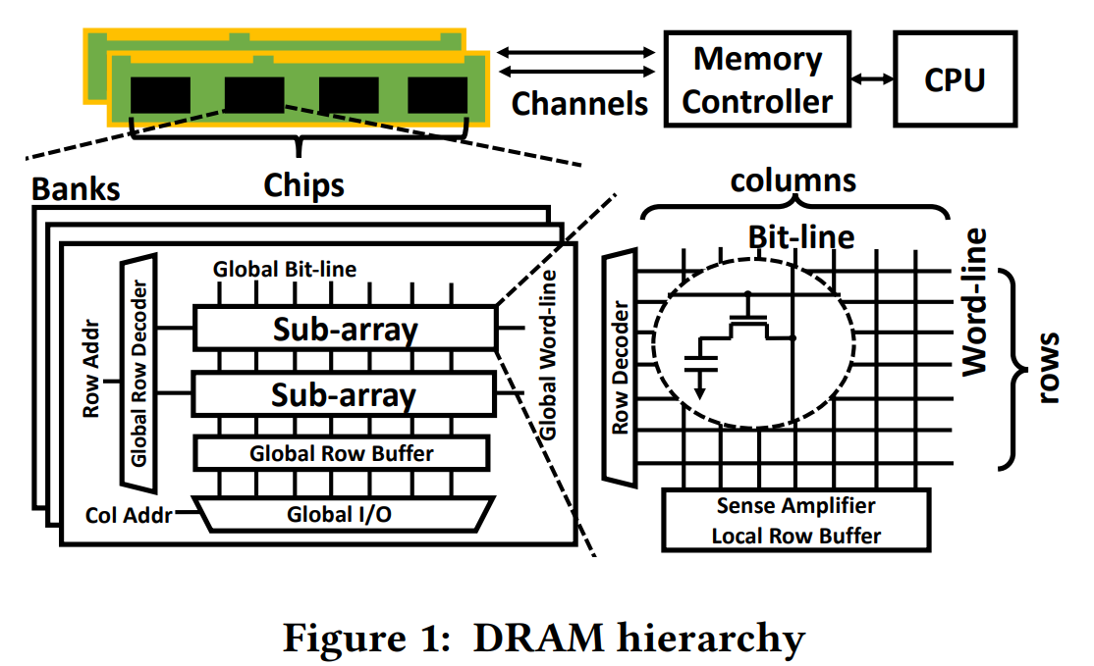
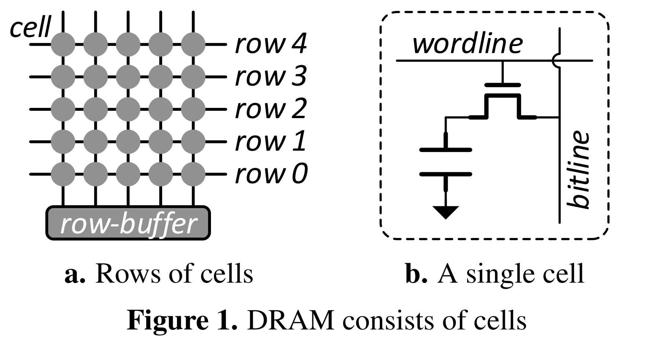
Background: DRAM Cells
Figure taken from Y. Kim et al., "Flipping bits in memory without accessing them: An experimental study of DRAM disturbance errors," ISCA 2014
Figure taken from Fei Gao, Georgios Tziantzioulis, and David Wentzlaff. 2019. ComputeDRAM: In-Memory Compute Using Off-the-Shelf DRAMs. MICRO '52
“For example, in an x86 machine with a single DIMM, each row contains 1,048,576 cells that can store 128 kB of data.”

Slide 3
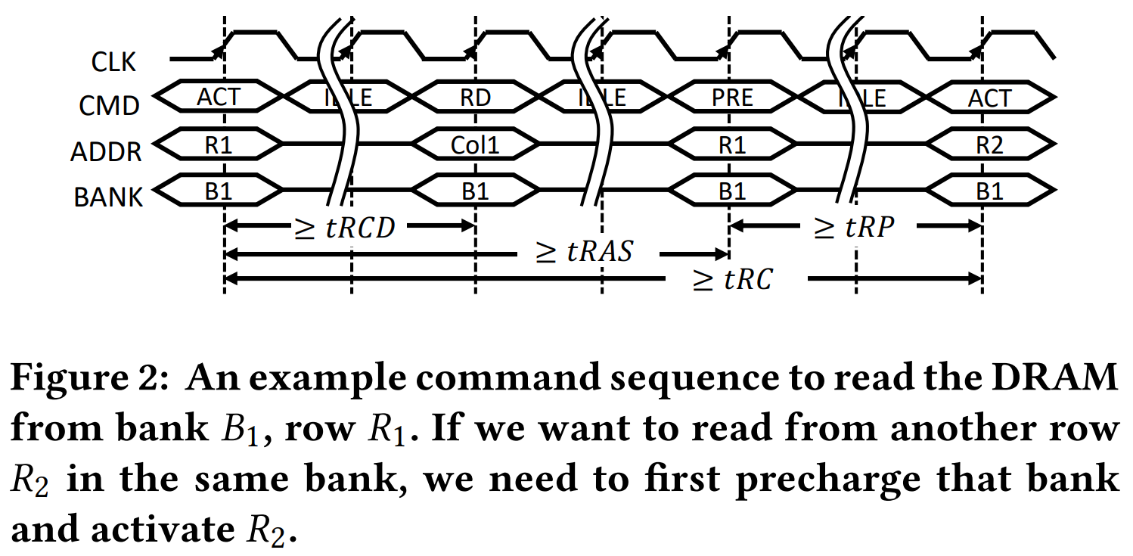
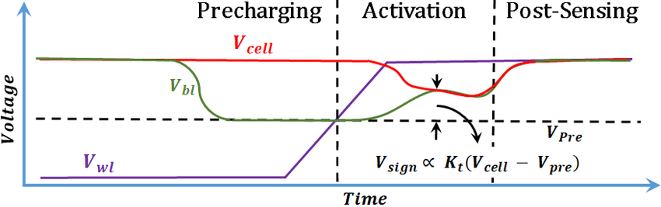
Background: DRAM Cells
The PRECHARGE command applies to a whole bank. It first closes the currently opened row by zeroing all word-lines in the target bank, and subsequently drives all bit-lines to Vdd/2 as an initial value.
The ACTIVATE command targets a specific row. The word-line of the addressed row is raised high, which connects the cells of that row directly to the bit-lines. Charge sharing then occurs between the storage cell and the bit-line.
The READ/WRITE commands apply to four or eight consecutive columns according to the burst mode. Based on the starting column address, the corresponding columns of data in the global row buffer are read out to or written from the I/O pins.
Figure taken from Fei Gao, Georgios Tziantzioulis, and David Wentzlaff. 2019. ComputeDRAM: In-Memory Compute Using Off-the-Shelf DRAMs. MICRO '52
Figure taken from Bahar Talukder, Bashir Mohammad Sabquat & Ray, Biswajit & Forte, Domenic & Rahman, Md Tauhidur. (2019). PreLatPUF: Exploiting DRAM Latency Variations for Generating Robust Device Signatures. IEEE Access

Slide 4
Motivation
Bit cells in DRAMs are getting smaller; frequencies are getting faster
  Each cell has lower capacitance, more prone to leakage.
  Cells got closer to each other due to the high density.
  Higher frequency means more reads/write can get executed during each refresh period.
Rowhammer exploits the analog volatility of DRAM.
Notes:
Therefore this structure looks exceptionally weak from analog perspective.

Slide 5
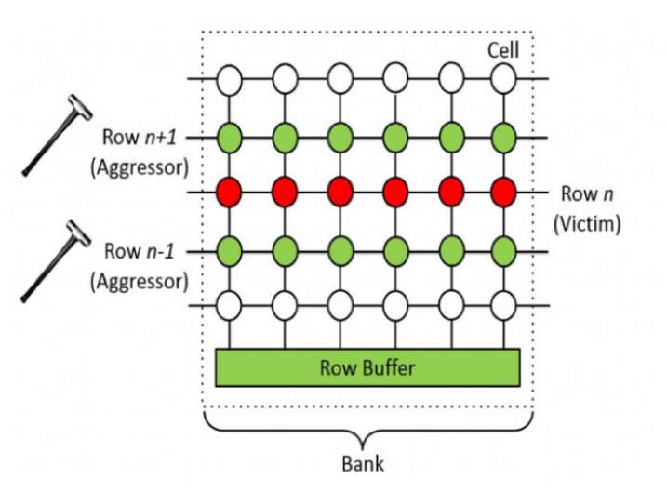
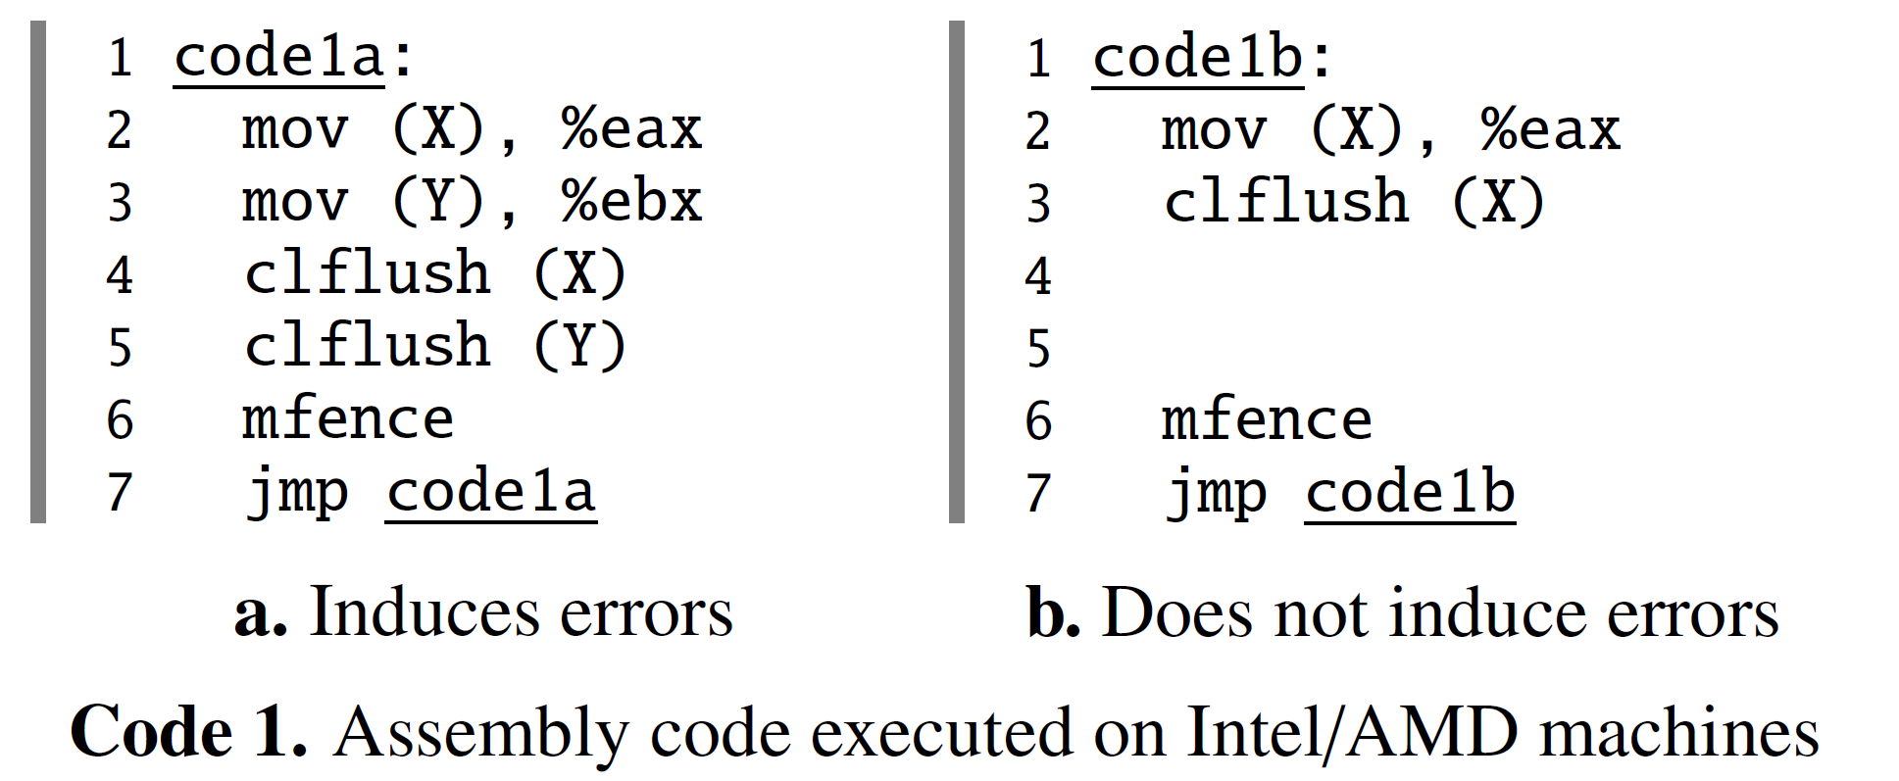
Method
In the original ISCA 2014 Paper, the authors found that repeatedly accessing adjacent rows of the victim row can occasionally cause the bit to flip.
Original paper used FPGA to directly hammer the DRAM modules. Follow-up works use CPU commands instead.
Notes:
Not much theory, straightforward approach.
Just jump to evaluation.

Slide 6
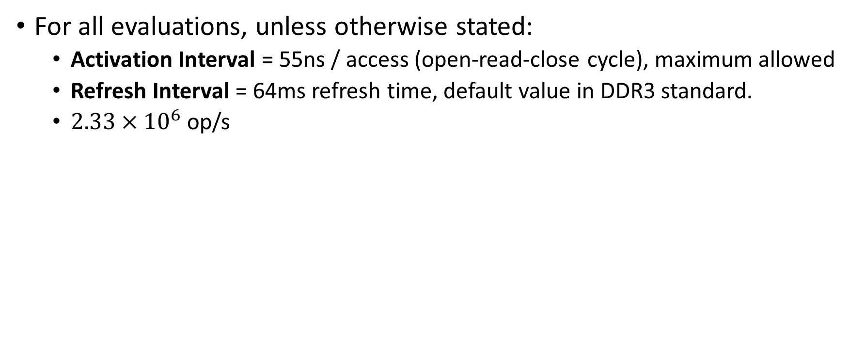
RowHammer – Evaluation
For all evaluations, unless otherwise stated:
  Activation Interval = 55ns / access (open-read-close cycle), maximum allowed
  Refresh Interval = 64ms refresh time, default value in DDR3 standard.
  $2.33×{10}^{6}$ op/s

Slide 7

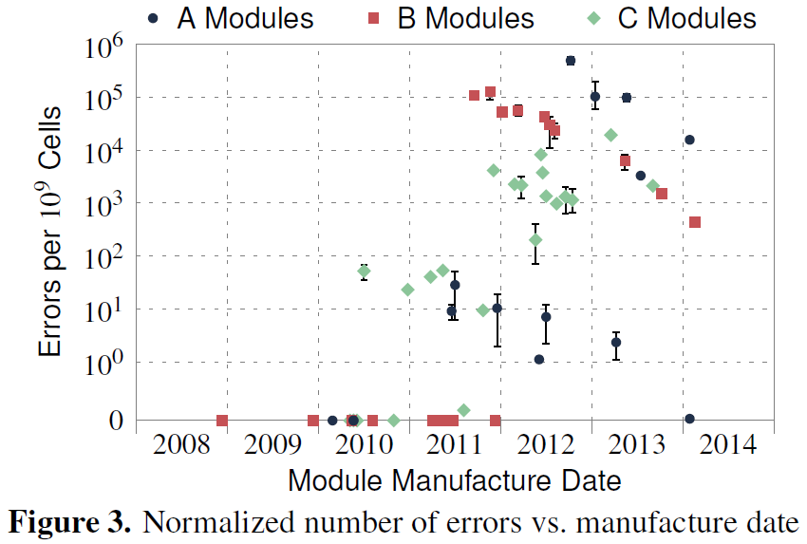


RowHammer – Error Rate
2Gb/Chip
1Gb/Chip
Notes:
So they tested a lot of modules from three different companies, manufactured at different times.
Low error rate at older processes. High error rate at the beginning of a new process, then gradually falls down.

Slide 8
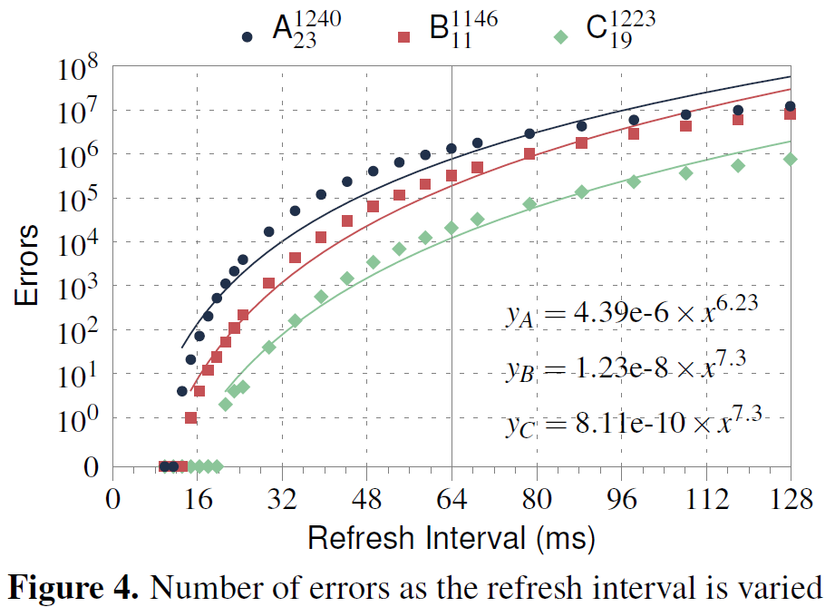
RowHammer – Effect on refresh time
Notes:
Naturally, lower the refresh time brings lower error rate.

Slide 9
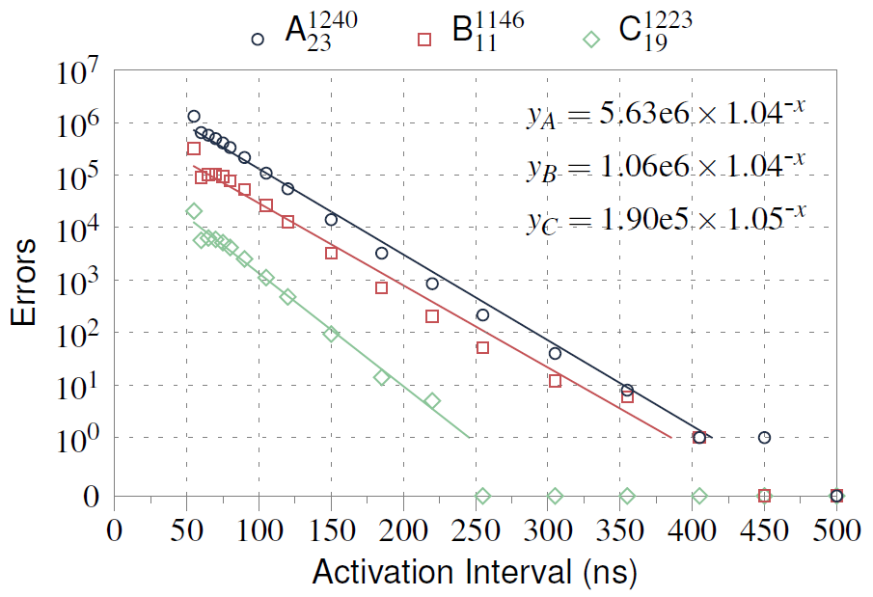
RowHammer – Activation Interval

Slide 10
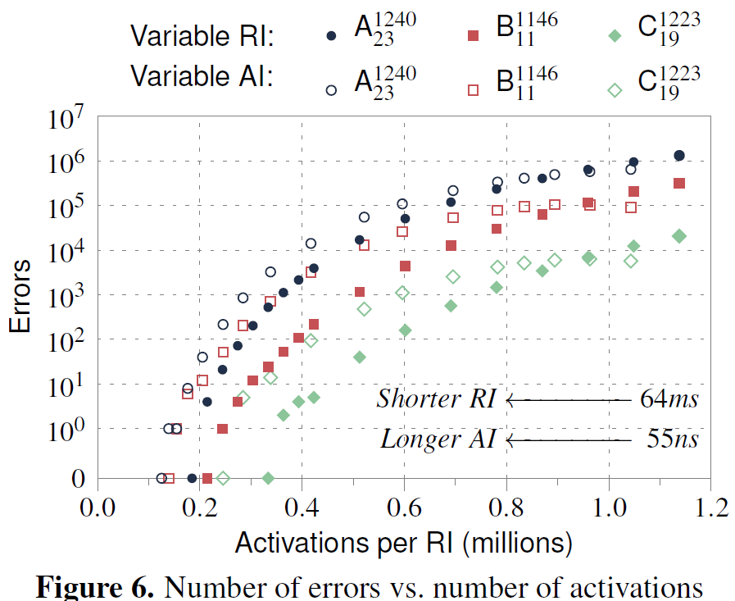
RowHammer – Activation per RI

Slide 11
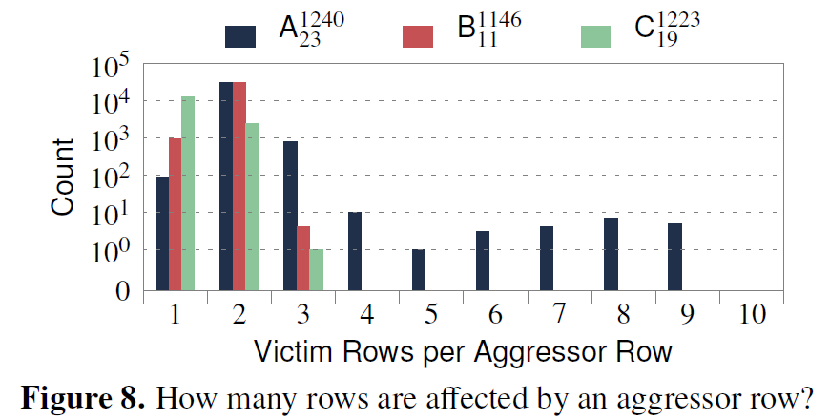
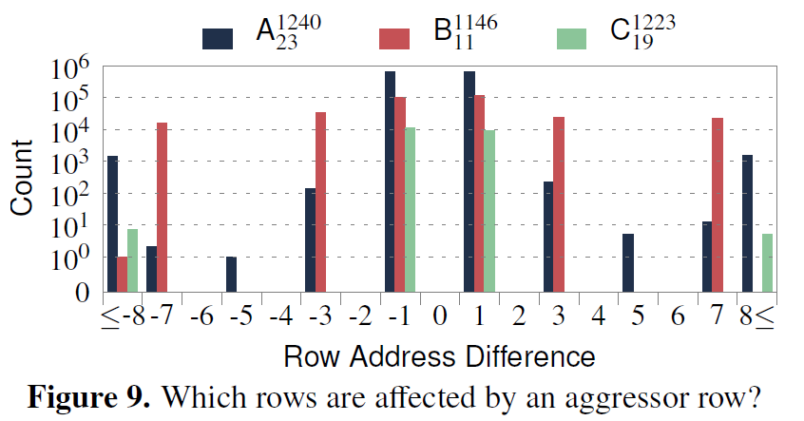
RowHammer – Affected rows
Notes:
Difference more likely to be odd numbers. Potentially due to Gray coding.

Slide 12
RowHammer – Victim Cells
Spatial location of victim cells do not show any pattern, locality or skew.
  Some cells may end up near each other, by chance.
  Can cause multi-bit levels, making the error uncorrectable by ECC.
Errors are Mostly Repeatable
  Number of errors vary ±0.25% from the average value.
  Over 70% cells are constant offenders. i.e. They are prone to RH attacks.
Weak Cells (Cells with low retention times) has nothing to do with RH vulnerability.
Not related to temperature.

Slide 13
Causes
Proposed causes of RowHammer
  Electromagnetic coupling: Changing the voltage of a wordline could inject noise into an adjacent wordline.
  Bridge (DRAM manufacturing fault): Accelerate the flow of charge between two bridged cells.
  Hot-carrier injection: Permanently damage the wordline by hot-carrier injection. Modify the amount of charge in cells or alter its characteristic.

Slide 14
Exploting RowHammer
RowHammer errors violate two invariants that memory should provide:
  1) a read access should not modify data at any address
  2) a write access should modify data only at the address that it is supposed to write to.
Thus, modifying memory by RowHammer breaches memory isolation and circumvents every memory protection mechanism.
RowHammer-induced errors are predictably repeatable.

Slide 15
Exploting RowHammer
Case Study #1: Flip Feng Shui
Attack one VM from another VM.
Virtualization Host
Victim VM
Attacker VM

Slide 16
Flip Feng Shui
Hypervisors provide the illusion of full isolation:
  Isolated Hardware Environment.
  Isolated Software Environment.
  Isolated data
Virtualization Host
Victim VM
Attacker VM
Physical Memory

Slide 17
Flip Feng Shui
Memory deduplication is frequently used to reduce resource consumption.
  Deduplication: Pages with the same content are mapped to the same physical page.
  Copy-On-Write: The deduplicated page will be copied and separated if some VM wrote to it.
Virtualization Host
Victim VM
Attacker VM
Physical Memory

Slide 18


Flip Feng Shui
What happens if Attacker VM writes to shared page?
Copy-On-Write: The content will be copied and relinked. No Attack!
Virtualization Host
Victim VM
Attacker VM
Physical Memory

Slide 19
Flip Feng Shui
What happens if Attacker VM hammers a shared page?
Attack is possible! Breaks Copy-On-Write.
Virtualization Host
Victim VM
Attacker VM
Physical Memory

Slide 20
Flip Feng Shui
Memory templating: identifying physical memory locations in which an attacker can induce a bit flip using a given hardware vulnerability.
Memory massaging: steering targeted sensitive data towards the vulnerable physical memory locations.
Exploitation: triggering the hardware vulnerability to corrupt the intended data for exploitation.

Slide 21
Flip Feng Shui – Memory Templating
Finding available “templates” for flipping bits.
  When using RowHammer, equivalent to finding bits that are prone to RH.

Slide 22
Flip Feng Shui – Memory Massaging
The attacker need to know the victim’s data.
  For example, a public key held by the attacker.
The attacker keeps the same data in its own virtual memory space at a RH-prone address, wait for deduplication to scan and merge.
  To guarantee the row stays in the address allocated by the attacker, the attacker VM need to be started before the victim VM.
Hammer the row.

Slide 23
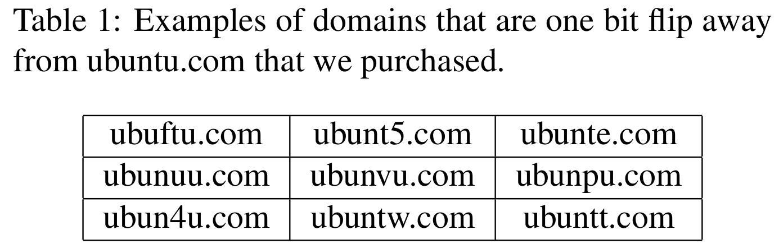
Flip Feng Shui – Exploitation
Flip a bit in RSA public key to make it factorizable
Flip a bit in APT repository to feed malicious packages.

Slide 24
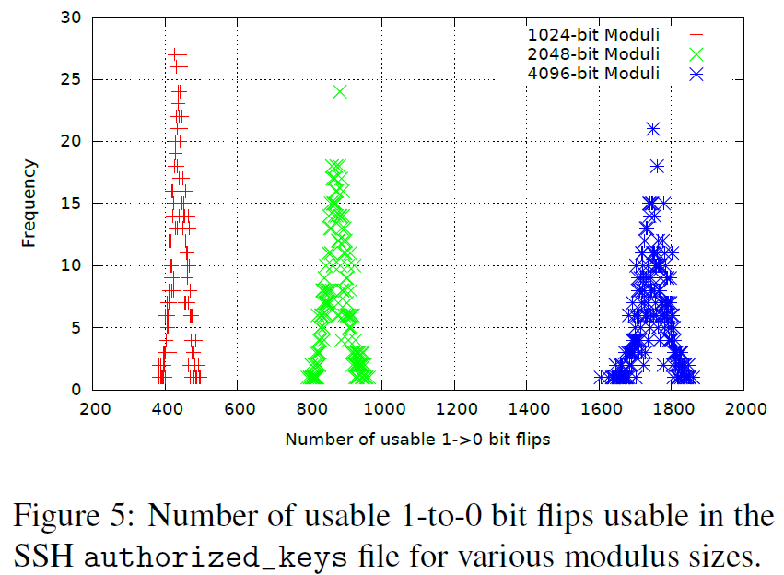
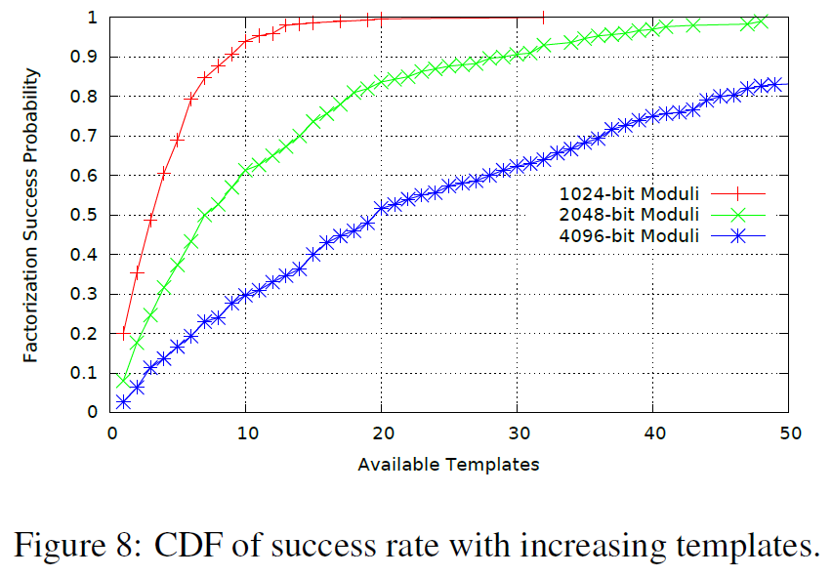
Flip Feng Shui – SSH Evaluation
Notes:
Figure 8 shows the probability of factorizing the key within an hour with the given amount of templates.

Slide 25
Case Study #2 – Google Project Zero
Published on GPZ blog, NOT PEER REVIEWED, NO ARTIFACT
NaCl sandbox escape
  Native Client is a sandboxing system that only allows running a subset of x86/64 instructions.
  Developed by Google. Deprecated. Destaffed. Replaced with WebAssembly.
Kernel privilege escalation

Slide 26
Case Study #2 – NaCl sandbox escape
Native Client
  NaCl distributed as LLVM IR, then compiled in web browser.
  Sets up x86 segments to restrict the memory range that the sandboxed code can access.
  A code verifier to prevent use of unsafe instructions such as those that perform system calls.
  Requires all jumps to be indirect jumps to 32-byte aligned address
  Instruction must not cross the 32-byte address boundary
NaCl assumes that the hardware behaves correctly. It assumes that memory locations don’t change without being written to!

Slide 27
Case Study #2 – NaCl sandbox escape
A bit flip in validated code can turn a safe instruction sequence into an unsafe one.
jmp *%rax -> jmp *%rcx. The address in RCX in unchecked.
48 b8 0f 05 eb 0c f4 f4 f4 f4
Modifying the OPCODE is also possible.
movabs $0xf4f4f4f40ceb050f,%rax
syscall
jmp 0x10
hlt
hlt
hlt
hlt

Slide 28
Case Study #2 – NaCl sandbox escape
Fills the sandbox’s dynamic code area with 250MB of NaClized indirect jump instruction sequences using NaCl’s dyncode_create() API.
In a loop:
  Row-hammers the dynamic code area using CLFLUSH, picking random pairs of addresses.
  Searches the dynamic code area for bit flips. If it sees an exploitable bit flip, it uses it to jump to shell code hidden inside NaCl-validated instructions. Otherwise, if the bit flip isn’t exploitable, it continues.
Mitigation: Disallow CLFLUSH in NaCl code.

Slide 29
Case Study #2 – Kernel Privilege Escalation
Use RH to induce a bit flip in a page table entry (PTE) that causes the PTE to point to a physical page containing a page table of the attacking process.
  So the attacker process can write its own page table!
  And can therefore access the entire physical memory

Slide 30
Case Study #2 – Kernel Privilege Escalation
Find locations where a bit flip is useful.
  Bit 51 in a 64-bit word is the top bit of the physical page number in a PTE on x86-64. Not useful.
  Bit 12 is the bottom bit of the PTE's physical page number. Useful.
Spray most of physical memory with page tables. When a PTE's physical page number changes, there's a high probability that it will point to a page table for our process.
  Repeatedly mmap()files to memory.

Slide 31
Case Study #2 – Kernel Privilege Escalation
Create a file in /dev/shm for mapping. Write a marker at the start of each 4K page so we can identify these pages.
mmap()a large block of memory.
Search this block for aggressor/victim addresses. Record the useful victim pages.
munmap()all but the aggressor and victim pages and begin the exploit attempt.

Slide 32
Case Study #2 – Kernel Privilege Escalation
First, deliberately fragment physical memory.
  Allocate a large portion of available physical memory.
  Deallocate a page whenever we will cause the kernel to allocate a page.
mmap()the data file repeatedly at 2MB-aligned virtual address.
Cause the kernel to populate some of the PTEs by accessing their corresponding pages. Only one PTE per table needed since we know where the vulnerable rows are.
In the middle of this, we munmap()the victim page. With a high probability, the kernel will reuse this physical page as a page table.
  We cannot read this page anymore, but we can RH it.
  We won’t be able to observe the bit flip directly.
Scan the mapped memory region, see if any region no longer maps to the marked file we created.
Check if the region contains a page table, a PTE.
Check which virtual address this PTE is referring to by writing and scanning.

Slide 33
Exploting RowHammer – What has been hacked?
Escape from the x86-64 sandbox environment – Google Project Zero
Exploiting the DRAM rowhammer bug to gain kernel privileges – Google Project Zero
Takeover of a victim VM by another attacker VM running on the same system
  Compromises OpenSSH by modifying the public keys in a victim VM
  Flips APT Ubuntu Archive Signing Keys to something more easily hackable
Notes:
kernel privileges – hammer the page table entry (PTE)
VM – deduplication & CoW
Drammer -

Slide 34
Exploting RowHammer – What else has been hacked?
Drammer - mobile device user-space program
  Force a victim process to allocate its PTE in a RowHammer-vulnerable region of memory
Remote takeover of a server via JavaScript code execution
Takeover a mobile system by triggering RowHammer using the WebGL interface on a mobile GPU
Takeover a remote system by triggering RowHammer through RDMA
Researchers and practitioners will develop different types of attacks to exploit RowHammer in various contexts and in many more creative ways.

Slide 35
Utilizing RowHammer (Again )
PUF (Physical Unclonable Function)
  The location of RowHammer-prone cells are fixed!
  Generate bit flips in the region whose locations are unique to the device and can be used to identify the device
  But - Hammering on rows surrounding the region reserved by the RowHammer-based PUF causes the rows at the edges of the reserved DRAM region to have an increased number of bit flips.

Slide 36
RowHammer in Broader Context
The emergence of RowHammer is not surprising at all.
Fundamental problem: cell-to-cell interference
All memory technologies exhibited such disturbance problems
  SRAM, FLASH and hard disk drives
  PCM, STT-MRAM and ReRAM
This problem will accompany us into the future.

Slide 37
Responses to RowHammer
Apple increased memory refresh rates
Memtest86 included a RowHammer test
A lot of other research and patents developed solutions to RowHammer

Slide 38
Defending RowHammer
We need both immediate and long-term solutions to the RowHammer problem
  Immediate: Utilize things that are already present in current systems.
  Long-term: Revise hardware.

Slide 39
Defending RowHammer - Immediate
Increase DRAM refresh rate in the memory controller
  Apple, HP, Cisco, Lenovo, and IBM.
  “Might be” practical and effective in reducing the vulnerability
  Increased energy/power consumption, reduced system performance.
  Total elimination as tested requires 7.8× increase in the refresh rate.
ANVIL: Software-based detection of RowHammer attacks
  Detect RowHammer with hardware counters
Intelligently allocating and physically isolating pages
  So RowHammer cannot hit anything important
Prevented DMA-based attacks by isolating DMA buffers with additional buffer rows
Analyze code, identify code segments that are probably RowHammer attacks and prevents them prior to execution
ZebRAM – Identify odd rows as safe and even rows as unsafe

Slide 40
Defending RowHammer - Authors
Making better DRAM chips that are not vulnerable
Using (strong) ECCs to correct RowHammer-induced errors
Increasing the refresh rate for all of memory.
Statically remapping/retiring RowHammer-prone cells via a one-time post-manufacturing analysis
Dynamically remapping/retiring RowHammer-prone cells during system operation
Accurately identifying hammered rows during runtime and refreshing their neighbors

Slide 41
Defending RowHammer - PARA
Probabilistic Adjacent Row Activation
  Every time a row is opened and closed, one of its adjacent rows is also opened (refreshed) with some low probability
  Stateless : No expensive hardware data structures required
  Performance and power consumption overheads are very low due to the infrequent activation (probability of refresh : 0.001 to 0.005)
Need better cooperation between DRAM chip and memory controller due to remapping.

Slide 42
Defending RowHammer – Long-term
A small stack for maintaining access history information and decide to refresh
Counter-based defences
Notes:
Other long-term solutions other than PARA.

Slide 43
Circuit-Level Studies
RowHammer effect is governed by the charge pumping process.
  Root cause: Charge recombination of the victim cell with electrons from the current channels between neighboring cells and their corresponding bitlines.
Feature size aggravates the RowHammer effect
Gamma Rays increase susceptibility to RowHammer
  Low data retention time is not related to RowHammer susceptibility
Temperature annealing can “repair” retention-weak cells, but not RowHammer-prone cells
Hydrogen annealing can improve DRAM reliability against crosstalk, mitigate RowHammer attacks.

Slide 44
Current status
RowHammer failure is still observed in state-of-the art DRAM devices.
  DDR4
  ECC DRAM
  LPDDR3
  LPDDR2
DDR5 introduced RFM (Refresh Management)
  MC will issue a refresh to a bank periodically, based on the ACTs it received.
  RFM enables the separation of the tasks for RH-protection to both MC and DRAM by having the former generate an RFM command at a specific activation frequency and the latter take proper RH-protection measures within a given time window.
  (M. J. Kim et al., "Mithril: Cooperative Row Hammer Protection on Commodity DRAM Leveraging Managed Refresh,“ HPCA 2022)
  No literature of successful RowHammer attack on DDR5 modules

Slide 45
Future Concerns
Data Retention Failures
DRAM Retention Failures
  New failure patterns, such as variable retention time caused by trap-assisted gate-induced drain leakage, complicates things.
NAND flash data retention issues
Other vulnerabilities to NAND Flash Memory
  Cell-to-cell interference; variation.
  Exploit vulnerabilities in flash memory programming operations on existing SSDs to cause malicious data corruption.

Slide 46
Analog/Mixed Signal Information Flow Tracking

Slide 47
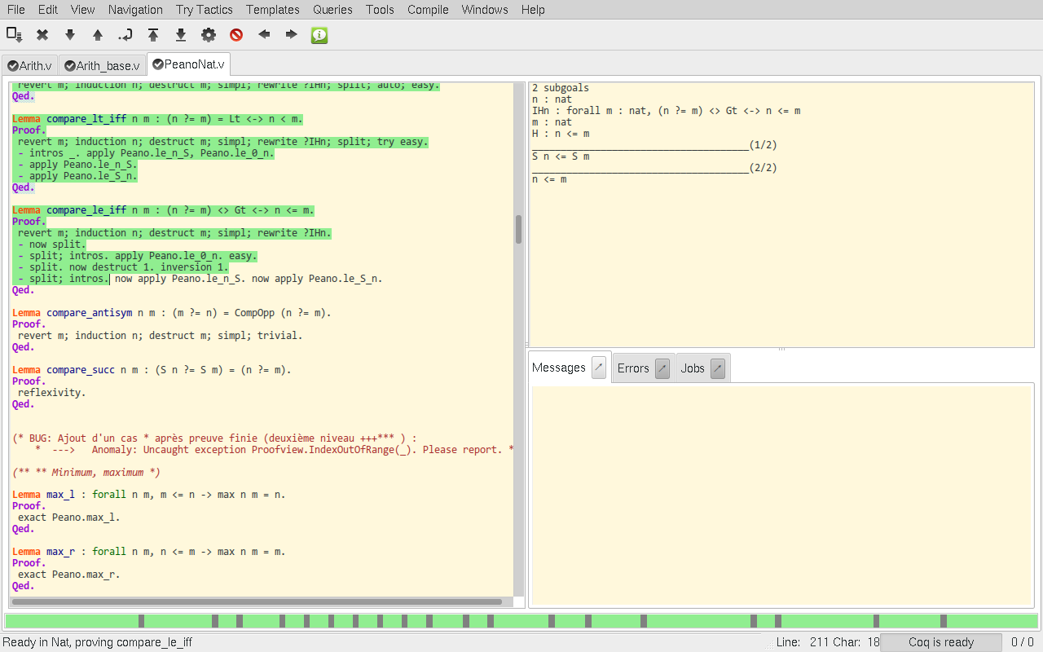
Background
Coq is an interactive theorem prover. It lets you formalize mathematical concepts and then helps you interactively generate machine-checked proofs of theorems.

Slide 48
VeriCoq: A Verilog-to-Coq Converter
Signals are defined as lo/hi/x values.
Top-level module is converted into an axiom that defines the behavior of this module. Internal states are converted to parameters.

Slide 49
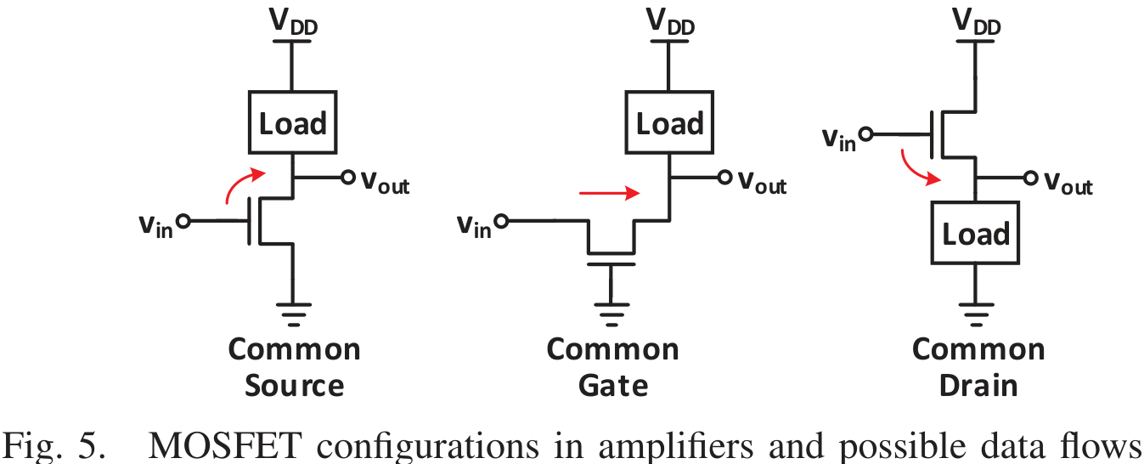
VeriCoq-Analog
Analog designs are commonly handcrafted at the transistor level.
Solutions
  Perform IFT at the transistor level
  Extract high-level analog modules (e.g. amplifiers, mixers, etc.) from the transistor level design and perform IFT at the analog module level.
Considerations
  In analog circuits, information may be carried not only through voltage but also through current.
  Analog circuits involve transistors in various configurations.
  The voltage on the bulk terminal of a transistor may also be manipulated to leak information to the source or drain terminals.
  Other components, such as capacitors, resistors, etc. should also be considered for information flow.

Slide 50
VeriCoq-Analog Model
MOSFETs:
  Any sensitive value on the gate is transferred to the drain and the source.
  Any sensitive value on the bulk is transferred to the drain and the source.
  Any sensitive value on the source is transferred to the drain and vice versa.
BJTs:
  Any sensitive value on the base is transferred to the emitter and the collector.
  Any sensitive value on the emitter is transferred to the collector and vice versa
Capacitors, inductors and resistors: Transparent
Diodes: Also transparent, since voltage at both terminal can change current.
… Then, create Verilog models for these devices.

Slide 51
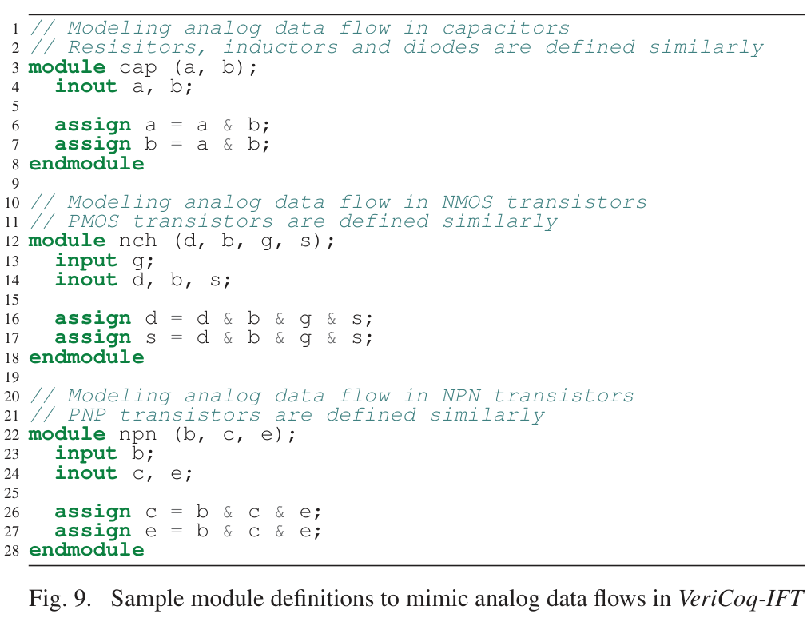
VeriCoq-Analog Model
High-sensitivity signals are expressed as a “1”. Nonsensitive values are expressed as a “0”.

Slide 52
VeriCoq-Analog Model
High false-positive rate, as it basically models “Everything is connected to everything else.”
Requires the developer to accurately mark components as sensitivity reducers, or no path.

