Slide 1
LUCIE: A Universal
Chiplet-Interposer Design Framework for Plug-and-Play Integration
Zixi Li, David Wentzlaff
Princeton University
Notes:
Hello everyone, thank you for staying for my talk. In this talk I’m going to present my work on formulating a chiplet ecosystem for plug-and-play level integration.

Slide 2
00
Background
Notes:
First of all, let’s review some background on chiplets.

Slide 3
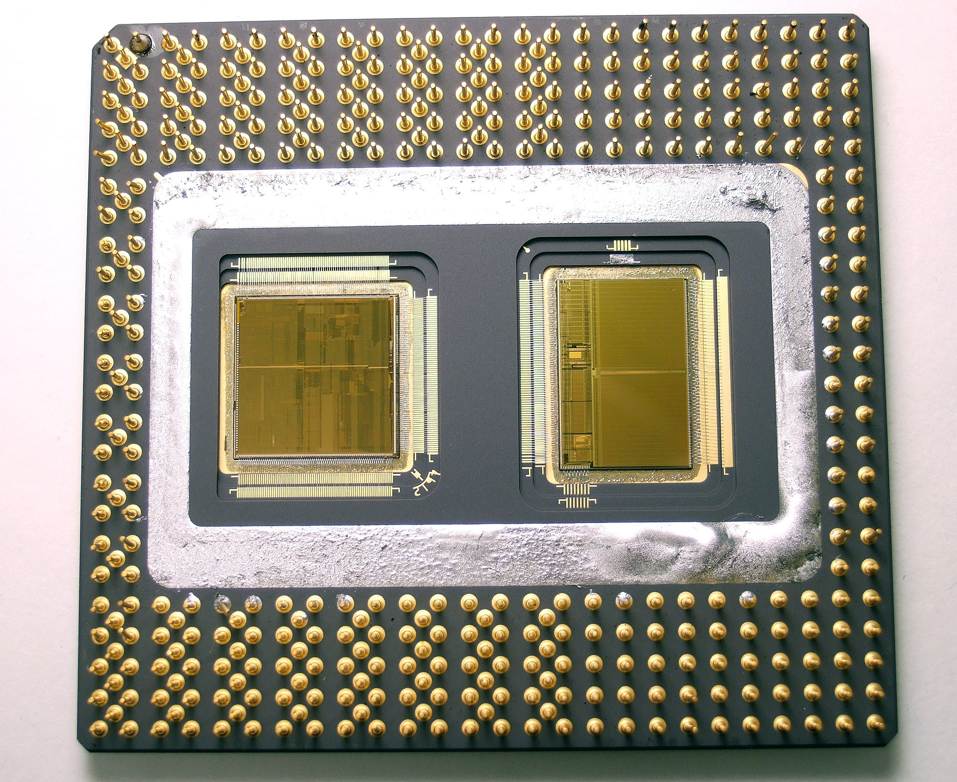
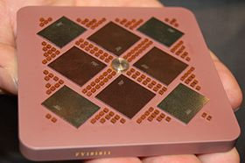
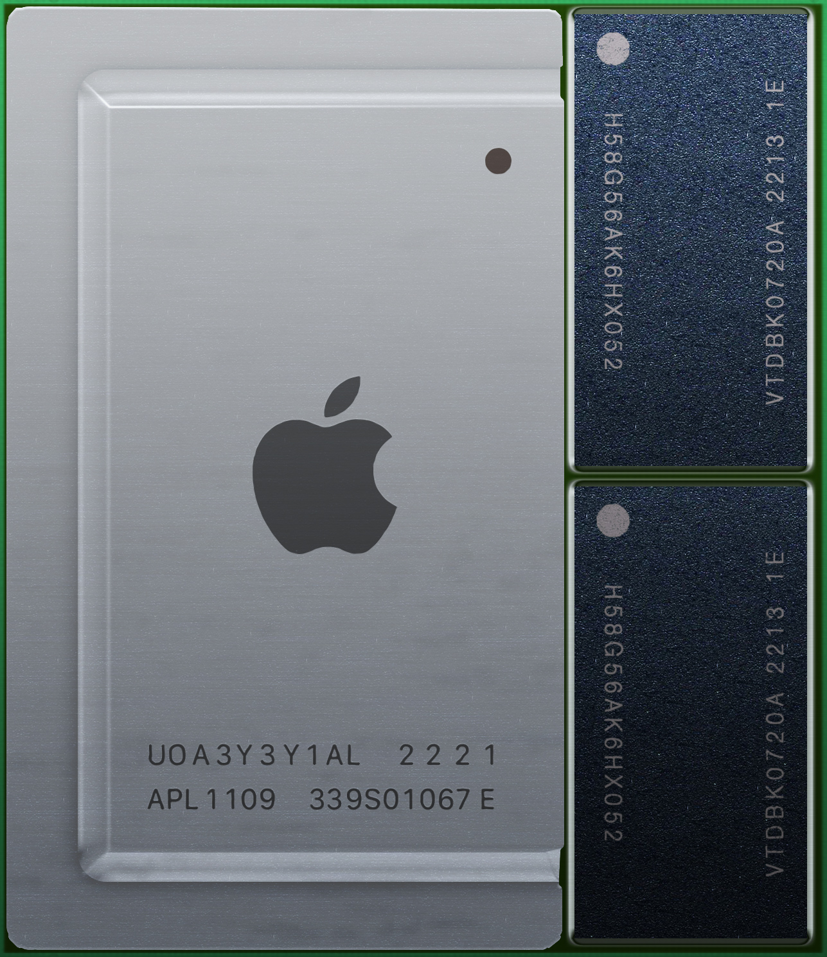
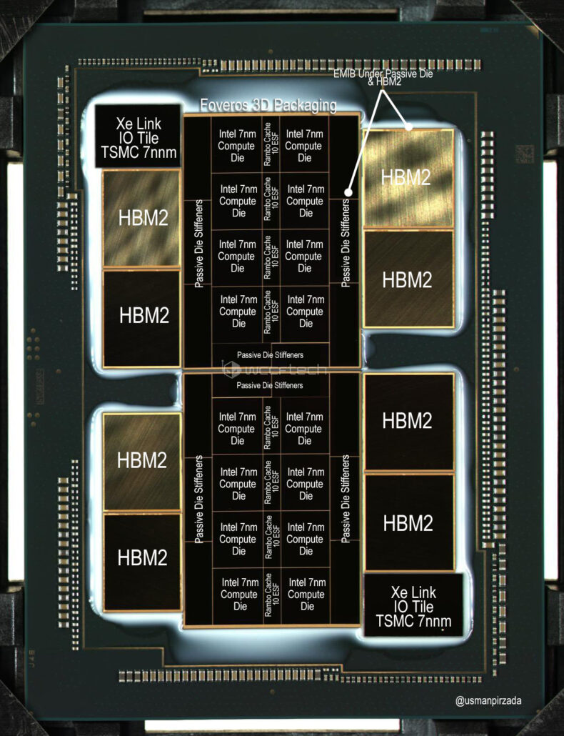
What are Chiplets?
A type of Multi-Chip Modules (MCM)
Instead of building the entire system on a single monolithic chip, use multiple smaller chips to form a larger integrated circuit.
Intel Pentium Pro
IBM Power 5 and L3$
Apple M2
Intel Ponte Vecchio
Notes:
Chiplets are a type of Multi-Chip Modules.
Compared to monolithic SoCs which puts everything onto one silicon chip, MCMs use multiple smaller chips and combine them into one big package.
------------------------
Early examples include Intel Pentium Pro and IBM Power 5, which separated CPU and cache into two separate dies.
Recent chiplet designs like Apple M2 and Intel Ponte Vecchio integrated computation chiplets, cache and RAM into the same package.

Slide 4
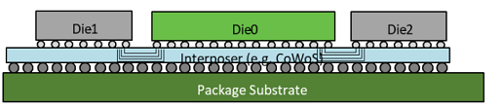
Chiplet Systems
Instead of building the entire system on a single monolithic chip, use multiple smaller chips to form a larger integrated circuit.
Generally consists of chiplets and interposer.
Chiplets are similar to normal chips, except they may have finer bump pitches (micro-bumps).
Interposers have contacts configured on both sides and come in lots of flavors.
D. Das Sharma, G. Pasdast, Z. Qian, and K. Aygun, “Universal Chiplet Interconnect Express (UCIe): An Open Industry Standard for Innovations With Chiplets at Package Level,” IEEE Trans. Compon., Packag. Manufact. Technol., vol. 12, no. 9, pp. 1423–1431, Sep. 2022, doi: 10.1109/TCPMT.2022.3207195.
Notes:
The term of using chiplets means that instead of building an entire system on a single chip, we divide them into multiple smaller dies
Most 2.5D chiplet we see nowadays consists of chiplets and interposers.
Chiplets are similar to normal dies, except that the bumps under the bottom of them (the electrical pins) may be packed denser, so they can achieve higher communication bandwidth with other chips. These are also called microbumps.
Interposer is an intermediate layer between the dies and package substrate. On one side they have dense, small bumps to connect to chiplet dies. On the other side they have large bumps to connect to the package, usually something like a PCB, which then connects to the outside world.

Slide 5
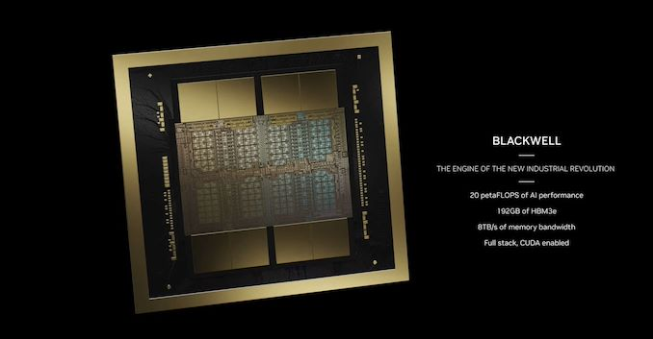
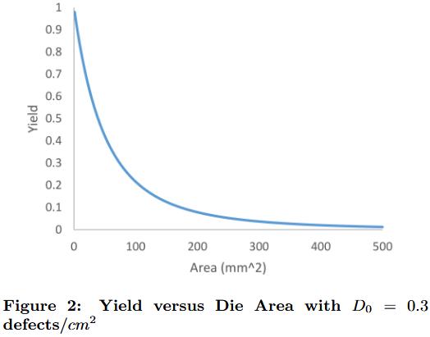
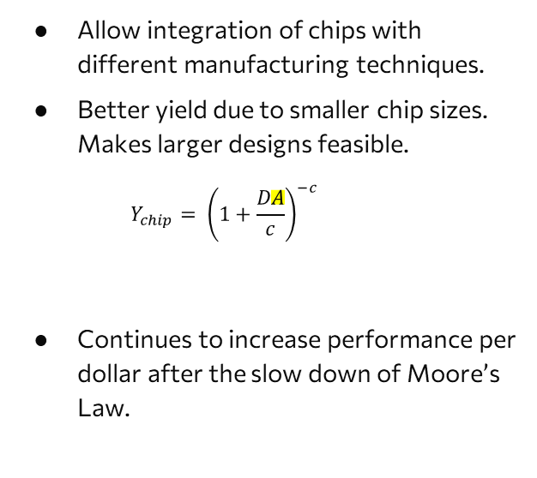
Benefit of Chiplets
Allow integration of chips with different manufacturing techniques.
Better yield due to smaller chip sizes. Makes larger designs feasible.
  $$Y_{chip}= {\left(1+\frac{DA}{c}\right)}^{−c}$$
Continues to increase performance per dollar after the slow down of Moore’s Law.
HBM (DRAM)
GaN?
MRAM?
SiFET
NAND FLASH?
D. Stow, I. Akgun, R. Barnes, P. Gu, and Y. Xie, “Cost analysis and cost-driven IP reuse methodology for SoC design based on 2.5D/3D integration,” in 2016 IEEE/ACM International Conference on Computer-Aided Design (ICCAD), Nov. 2016, pp. 1–6. doi: 10.1145/2966986.2980095.
Notes:
Chiplets bring us a couple of benefits.
We can combine chips with different manufacturing nodes or techniques, such as different lithography nodes, HBM, Gallium Nitride, NAND flash, etc.
We can get better yield due to smaller die sizes, thus lower cost for the entire syste,
And it can be seen as a way to chase more transistors per dollar circumventing the slowing of Moore’s Law
----------------Old. Redundant and tonguetwister.
Firstly, it allows us to integrate chips with different manufacturing techniques that cannot be implemented on the same wafer. For example, different lithography nodes, HBM, Gallium Nitride or NAND Flash.
Secondly, it gives us better yield since each die is now smaller. According to the commonly used negative binomial model, the yield of dies due to wafer defects is inversely proportional to die size. Dividing designs into smaller units brings a cost benefit.
Using chiplets is also seen as a way to get around the slowing of Moore’s Law. To continue providing more performance per dollar by cramming more transistors into a single package at a cheaper price.

Slide 6
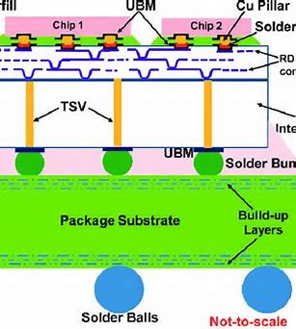
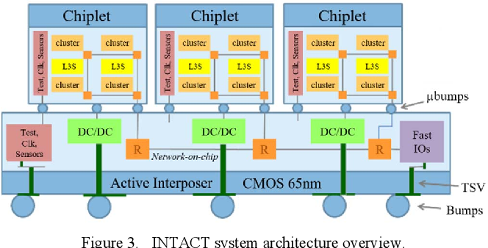
Interposers
Active | Passive
Can contain transistors/logic | Copper wires only
SiFET, expensive | SiFET among others, cheap
Less scalable due to manufacturing difficulties and wafer defects | Scalable above reticle size
Coudrain, Perceval et al. “Active Interposer Technology for Chiplet-Based Advanced 3D System Architectures.” 2019 IEEE 69th ECTC (2019): 569-578.
Lau, John & Tzeng, Pei-Jer. Et al. (2013). Redistribution layers (RDLs) for 2.5D/3D IC integration. International Symposium on Microelectronics. 2013. 000434-000441. 10.4071/isom-2013-WA12.
Notes:
There are mainly two types of interposers.
Active Interposers can contain transistors or logic, but they can only be made on traditional silicon nodes. They are very expensive to make, and they are limited by reticle size, which is around 800 mm^2.
Passive Interposers contains only copper wires, but they are cheaper. Though silicon interposer is still the most common, they can be manufactured in many ways, such as glass interposers or silicon bridges. They can scale beyond reticle sizes.

Slide 7
01
Motivation
Notes:
First, let’s talk about the motivations for this work.

Slide 8
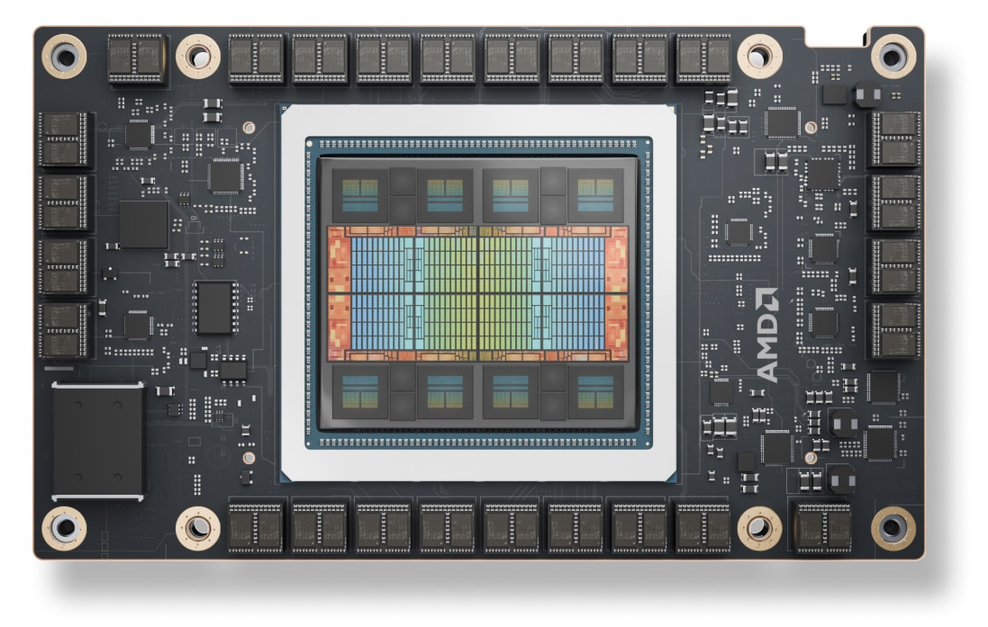


Intel Ponte Vecchio
[ISSCC’ 22]
Nvidia Blackwell
(https://resources.nvidia.com/l/en-us-blackwell-architecture)
AMD Instinct™ MI325X
(https://www.amd.com/en/products/accelerators/instinct/mi300/mi325x.html)
Reuse
Interop
Upgrade
Notes:
All the big silicon companies are making chips using chiplets now.
However, some great potentials of building with chiplets is still being left on the table, and that is reusability, interoperability and upgradeability.

Slide 9
Challenges
Chiplets come in different shapes and sizes.
Chiplets prefer different communication protocols.
  Small accelerators can go by with slower signals and small PHY.
  Large accelerators may want higher GT/s with large PHY dedicated to signaling.
  Components may prefer NoP for easy remote communication, or direct die-to-die for less protocol overhead and faster speed.
Chiplet systems come in all different types of topologies.
  CPU-centric
  Bus
  2D-Mesh

Slide 10
How can we build Chiplet ASICs like we build PCs?
Notes:
VERB

Slide 11


Our Vision
CPU
CPU
CPU
PCIe Gen 4 PHY
PCIe Gen 5 PHY
DDR 4 PHY
Accelerator v1
Accelerator v2

Slide 12
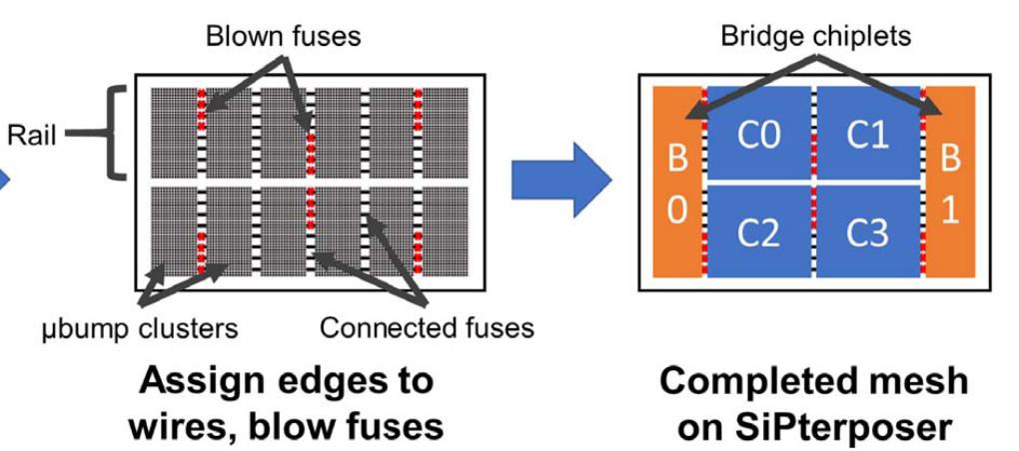
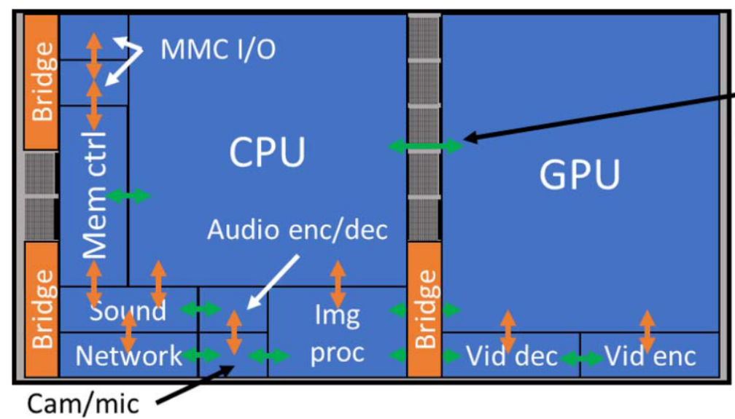
Previous Approaches
SiPterposer – Passive Interposer Design [DATE ‘19]
Passive Interposer
  512 uBumps in a cluster
  Horizontal Wires only, “buses”
  Chips may span multiple grids.
  Blow fuses to create dedicated channels for die-to-die communication.
Downsides:
  Not versatile.
  Complex Assembly.
P. Ehrett, T. Austin, and V. Bertacco, “SiPterposer: A Fault-Tolerant Substrate for Flexible System-in-Package Design,” in 2019 Design, Automation & Test in Europe Conference & Exhibition (DATE), Mar. 2019, pp. 510–515. doi: 10.23919/DATE.2019.8714998.
Notes:
Let’s first take a look at some previous approaches at designing universal interposers.
SiPterposer is a universal interposer framework that uses a passive interposer. Micro-bumps are grouped into clusters, each with 512 bumps.
Horizontal clusters are connected with a long wire to form a long bus, and there are no electrical connections vertically.
Vertical connections must be implemented with a bridging chiplet.
Chips may span multiple grids.
Individual communication channels are created by blowing some fuses.
This approach has some obvious downsides.
First of all it is not versatile, as it is obviously not idea for a 2D mesh.
Secondly, the configuration and assembly of this system requires fuse configuration, which requires additional tooling like high-power lasers, and is time-consuming, increasing assembly cost.

Slide 13
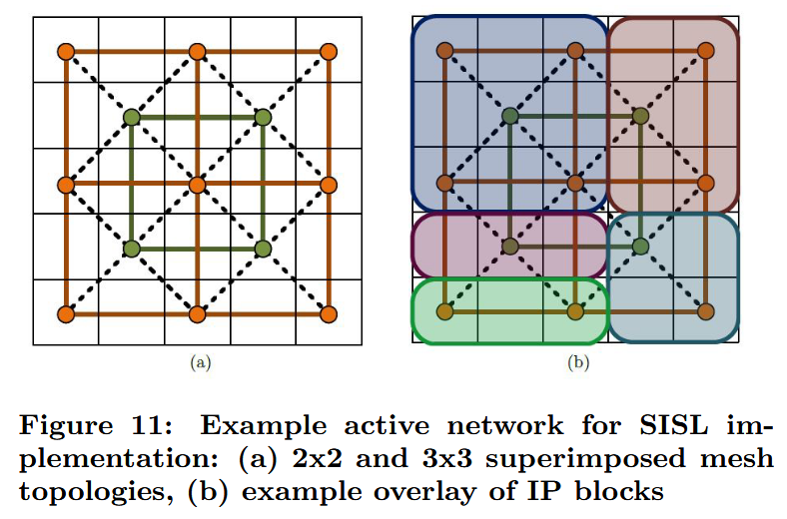
Previous Approaches
ZeroASIC/SISL [ICCAD ’16] – Active NoP-based
Active Interposer
  Use Network-on-Package for all communication between chiplets.
  Easy configuration – anything anywhere
Downsides
  Higher latency, lower bandwidth.
  No freedom on protocol
  Expensive & Not scalable
D. Stow, I. Akgun, R. Barnes, P. Gu, and Y. Xie, “Cost analysis and cost-driven IP reuse methodology for SoC design based on 2.5D/3D integration,” in 2016 IEEE/ACM International Conference on Computer-Aided Design (ICCAD), Nov. 2016, pp. 1–6. doi: 10.1145/2966986.2980095.
Notes:
Then we have the pure active interposer approach, notable designs include SISL and ZeroASIC.
Both designs depend on NoP for all chip-to-chip communication, but they proposed slightly different patterns.
The downside of this kind of approach is that it does not feature any kind of direct die-to-die communication, so there’s higher latency.
And it is expensive and not scalable due to using active interposers.

Slide 14
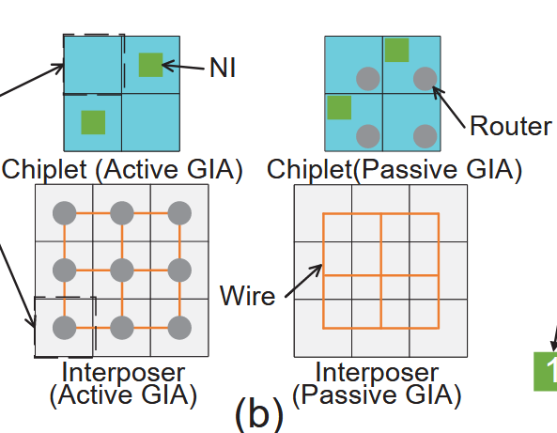
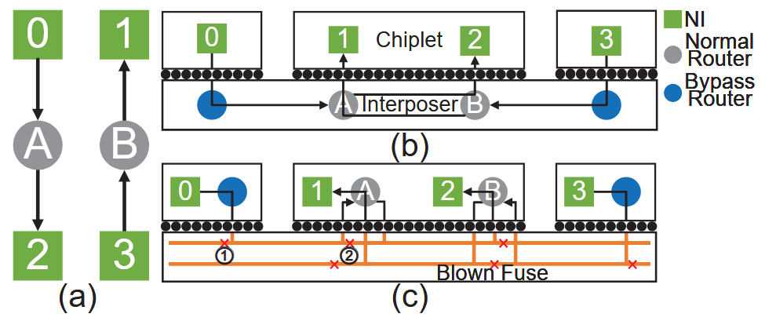
Previous Approaches
GIA-Generic Interposer Architecture [ICCAD ‘22]
“Active” Interposer
  Use Network-on-Package for all traffic
  Long wire buses on the interposer.
  Defuse wires to bypass some routers and reduce latency
Downsides
  Complex Assembly
  Either requires NoP on chiplets, or use
  active interposer
F. Li et al., “GIA: A Reusable General Interposer Architecture for Agile Chiplet Integration,” in 2022 IEEE/ACM International Conference On Computer Aided Design (ICCAD), Oct. 2022, pp. 1–9. Accessed: Apr. 10, 2024. [Online]. Available: https://ieeexplore.ieee.org/document/10069926
Notes:
There is also this GIA, which works like an active interposer system, using fuses and bypass routers to shorten NoP latency.
It also requires defusing for assembly, and there are no direct die-to-die communications.
---------------------------------------------------------------------------------------------------
Another previous approach we’ve seen is called GIA, the General Interposer Architecture.
GIA can be passive or active. The only different is that the passive version moved its NoP router to the chiplet.
It still depends on NoP for all traffic.
Long 2D-mesh wires run through the interposer.
In the active version, some routers are configured to route or bypass.
In the passive version, some fuses are blown to create individual channels.
The downsides of this design is that, the passive version has complicated assembly and it requires NoPs to be implemented on chips. // Their approach of splitting router lanes into normal and bypass lowers latency and increases energy efficiency
The active version use active interposers, which is expensive and non-scalable.
Finally, some placements may cause more congestion on a link and be worse than others. They have a placement tool to mitigate this problem.

Slide 15
Goal
Design a “motherboard” of chiplets
and a standard for compatible chiplet components
to allow effortless integration.
Notes:
VERB

Slide 16
02
LUCIE Framework
Lightweight Universal Chiplet-Interposer Ecosystem
An ecosystem framework for
Plug-and-Play integration of chiplets
Notes:
- Let’s talk about the solution we came up with: the LUCIE Framework, a Lightweight Universal Chiplet-Interposer Ecosystem.
With this ecosystem, we are going to achieve plug-and-play integration for chiplets.

Slide 17
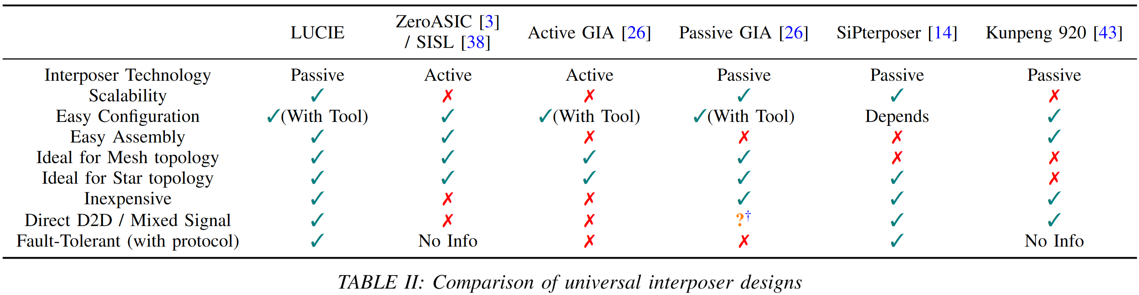
Compared to previous active universal interposers,
  LUCIE is inexpensive, more scalable, gives chiplet designers more freedom.
Compared to previous passive universal interposers,
  LUCIE is more flexible and easier to assemble.

Slide 18
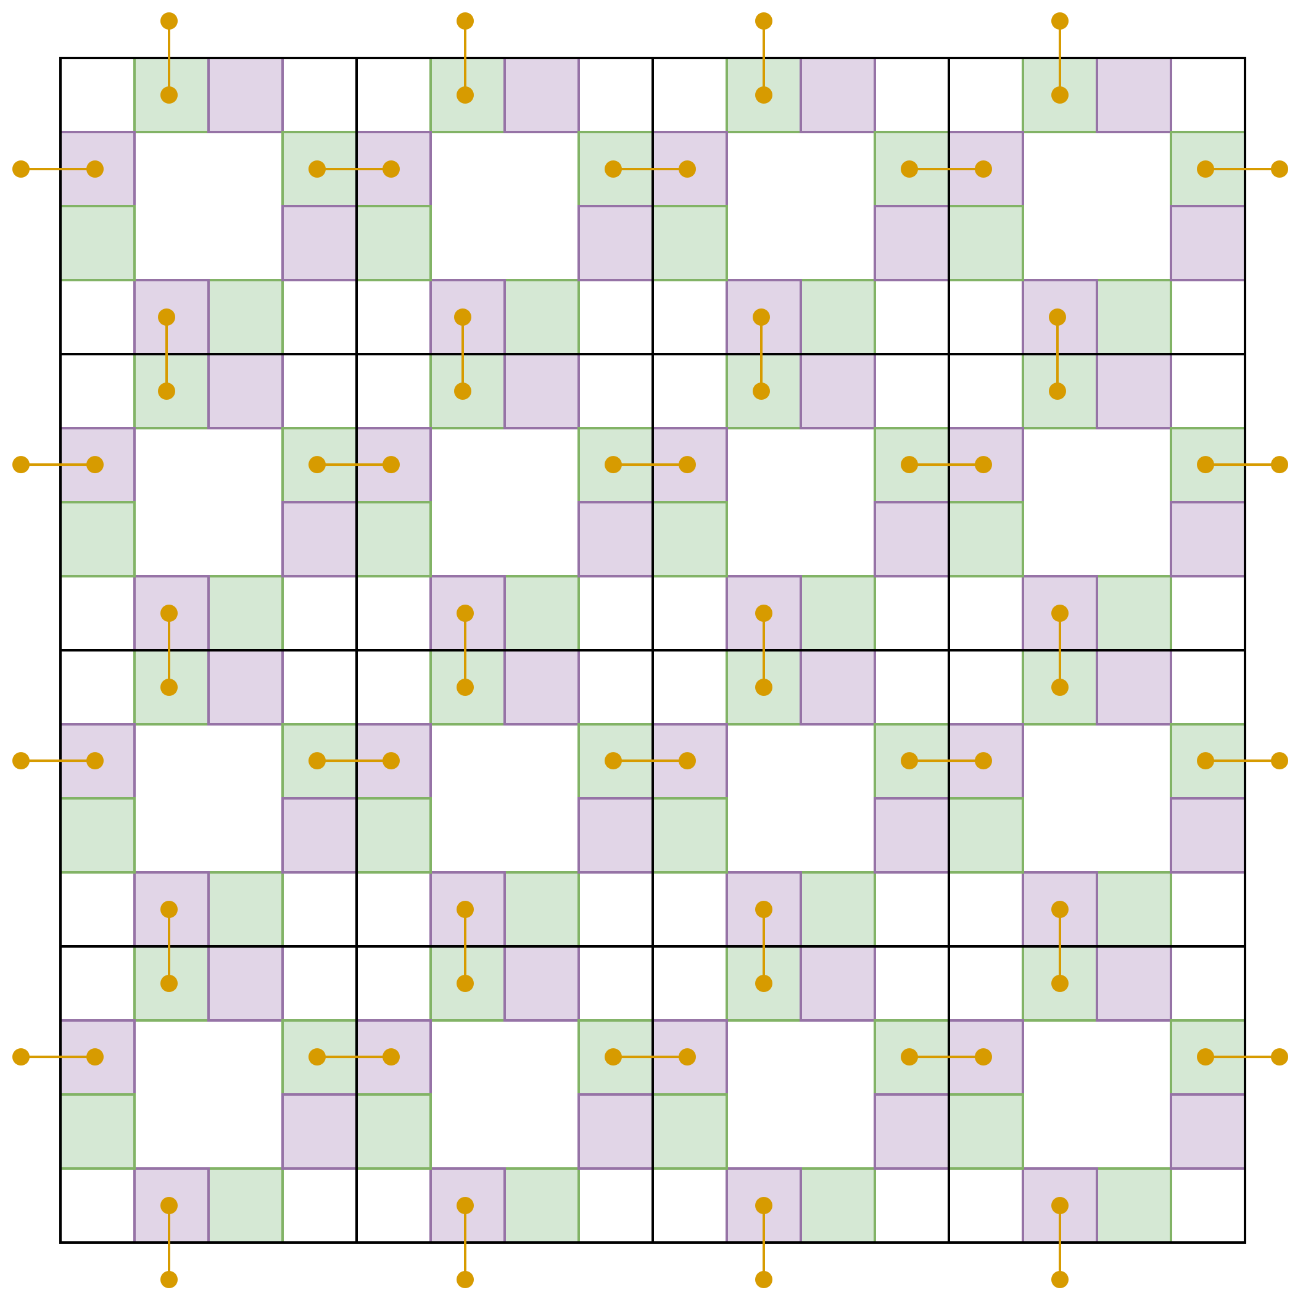
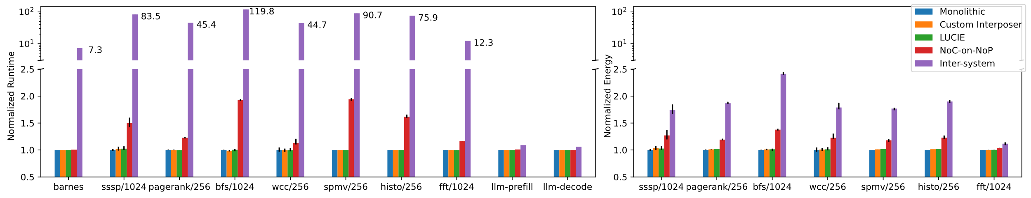
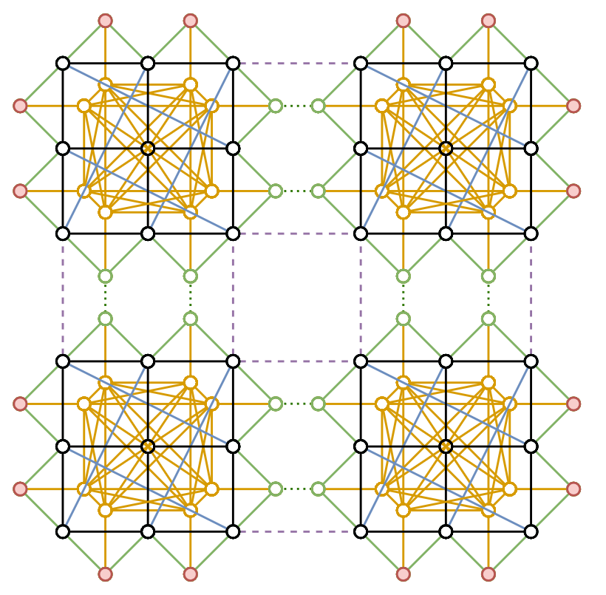
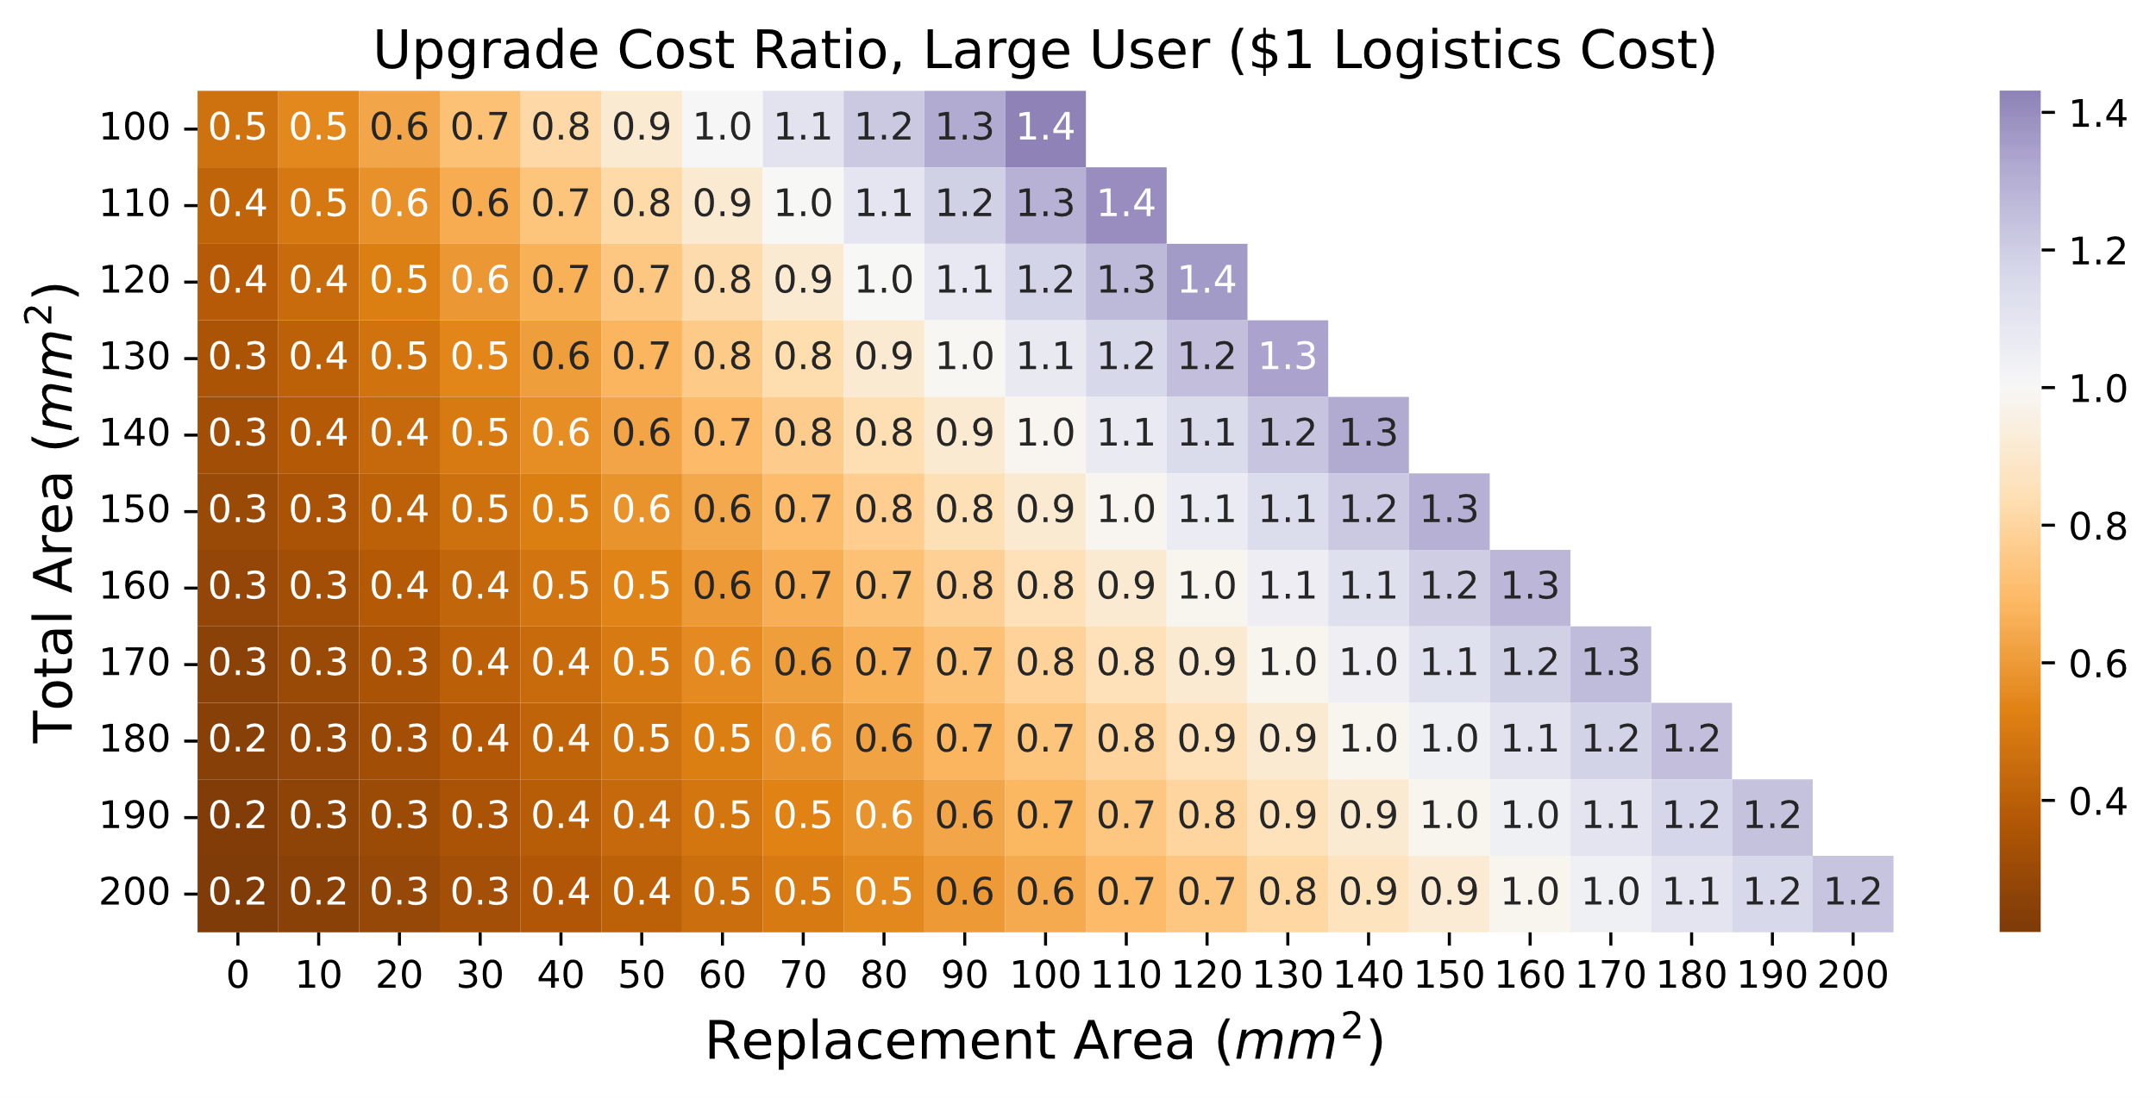
Contributions
Design Exploration
Performance Analysis
LUCIE has a versatile layout
LUCIE is on par with custom interposers
Placement Tool
Cost & TTM Evaluation
Offsets configuration flexibility
LUCIE is agile and inexpensive

Slide 19
The LUCIE Interposer
Passive Interposer
A Square 2-D Grid with two transceivers on each edge.
Allow chiplets to rotate
Chiplet
Slot
Chiplet
Slot
Chiplet
Slot
Chiplet
Slot
Chiplet
Slot
Chiplet
Slot
Chiplet
Slot
Chiplet
Slot
Chiplet
Slot
Chiplet
Slot
Chiplet
Slot
Chiplet
Slot
Chiplet
Slot
Chiplet
Slot
Chiplet
Slot
Chiplet
Slot
Notes:
Here is the design of LUCIE. A 2D grid with two transceivers on each edge, and eight transceiver per grid.
One transceiver is always connected to its neighbor to ensure connectivity. Another transceiver can be used to implement other patterns, we will refer to it as the remote transceiver.
Shown to the right is a 4-by-4 interposer with 16 chiplet slots. Chiplets may be placed like this.

Slide 20
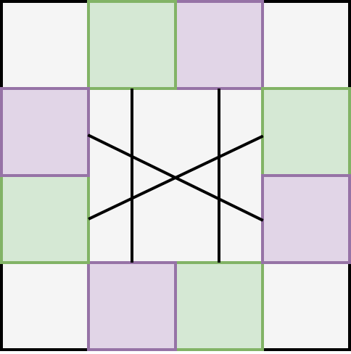
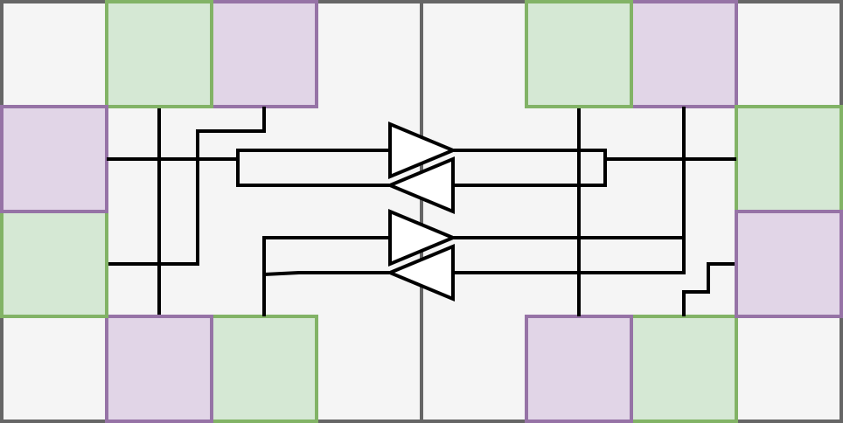
Connection Chiplets
A special type of chiplets
Serve as wires
May be implemented as repeaters, MUXes, etc.
Helps achieve more diverse connection patterns.

Slide 21
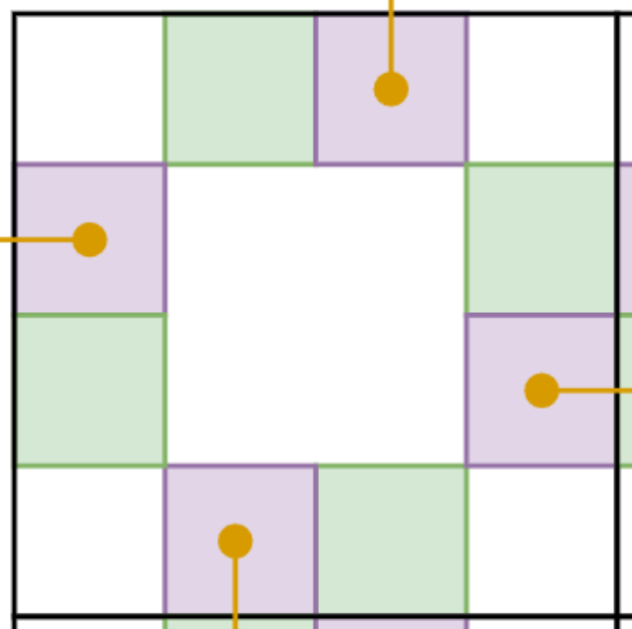
The LUCIE Interposer
Passive Interposer
A Square 2-D Grid with two transceivers on each edge.
Allow chiplets to rotate
High-density, length-matched wires for high-speed communication
Low-density, large bumps for power and clock distribution
Chiplet (Dead Bug View)
Low-density, length-unmatched wires for slow sideband
Notes:
In each grid there are three main regions.
These regions on the edges is for high-bandwidth communication. It has high-density bumps with length-matched wires to another transceiver
This region at the center is for power and clock delivery. There will also be pins for encoding the chiplet’s location on the interposer
These regions at the corners are for low-density, length-unmatched wires

Slide 22
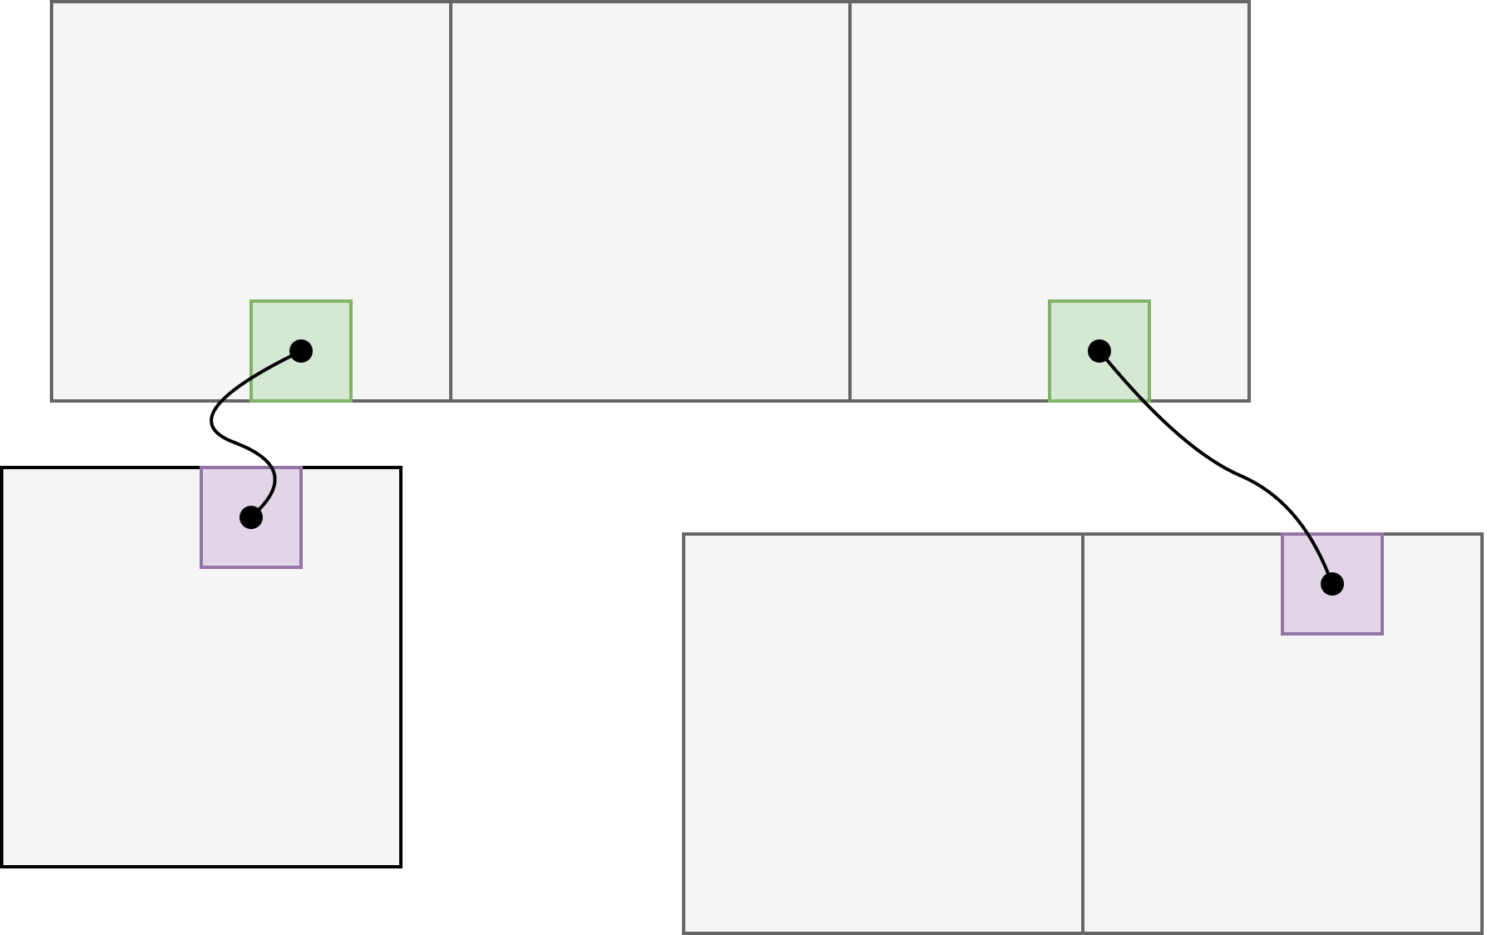
LUCIE Connection Patterns
Transceivers in one group will never rotationally map onto a bump in another group.
Adjacent chiplets can only connect with transceivers in different groups.
Mitigations:
  Use different connection patterns within the same group
  Host-Device protocols should use Group 1, 2 respectively.
  Equal P2P protocols should use both groups.
Group 1
Group 2
Notes:
One important thing to note is that transceivers can be seen as two groups, and we have two problems.
Firstly, transceivers in one group will never rotationally map onto another group. It will stay in the same group no matter how you rotate the chiplet.
Secondly, two chiplets can only connect with transceivers in different groups. A green transceiver on one chip is always connected to a purple transceiver on another chiplet.
Here are ways to mitigate this:
Firstly, to get more configuration flexibility, it’s better not to keep the same connection pattern on the same group.
Then, we observe that most communication protocols nowadays follow a Host-Device relationship.
Therefore, hosts should use group 1, and devices should implement the link on group 2 to ensure maximum compatibility.
Equal P2P protocols should be able to work on either one.

Slide 23
The LUCIE Interposer
Passive Interposer
A Square 2-D Grid with two transceivers on each edge.
Allow chiplets to rotate
Chip may span multiple grids, or not occupy an entire grid.
Chiplet
Chiplet
Chiplet
Chiplet
Square Shape =
Less Bandwidth,
better power and heat distribution
Chiplet
Chiplet
No need to cover the entire tile area if some bumps are not needed
Slender Shape =
More Bandwidth,
worse power and heat distribution
Notes:
Chiplets can take one slot, can span multiple slots, or do not cover an entire slot.
VERB

Slide 24
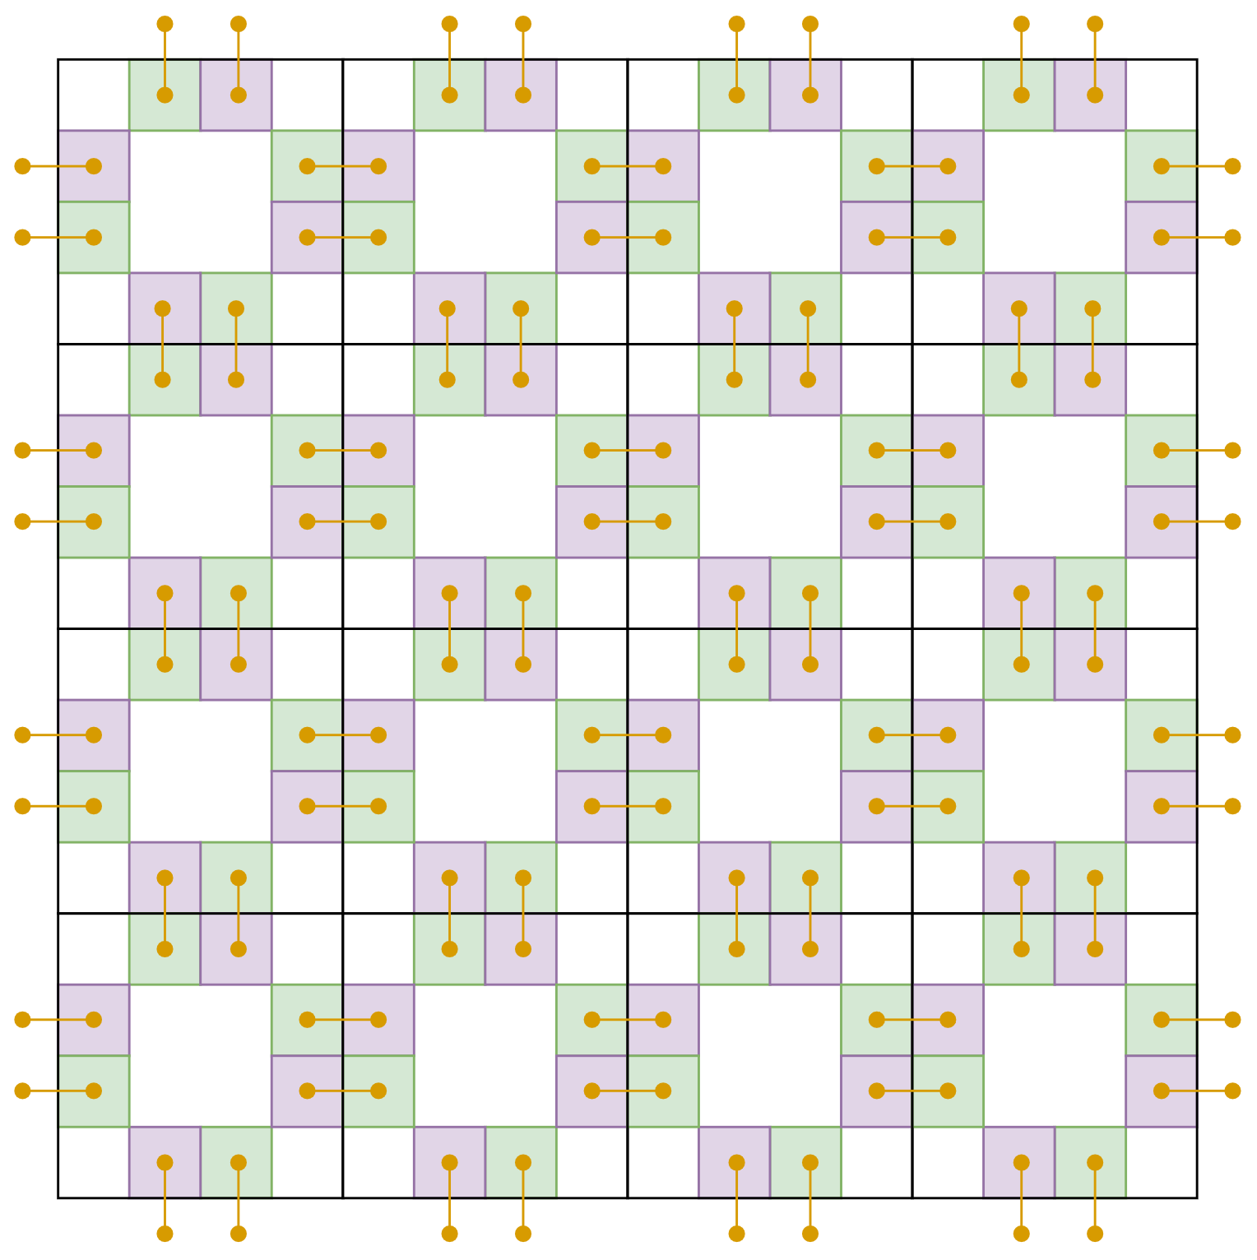
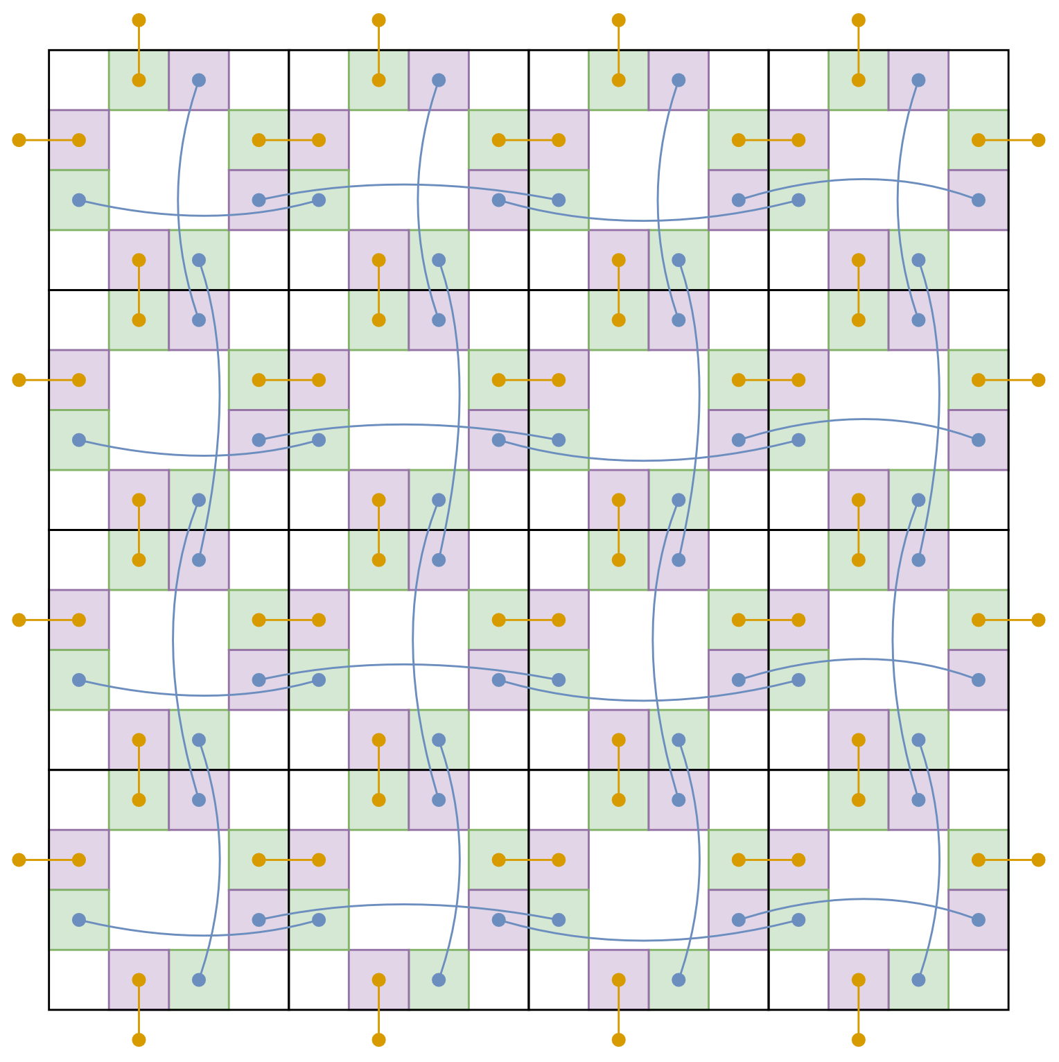
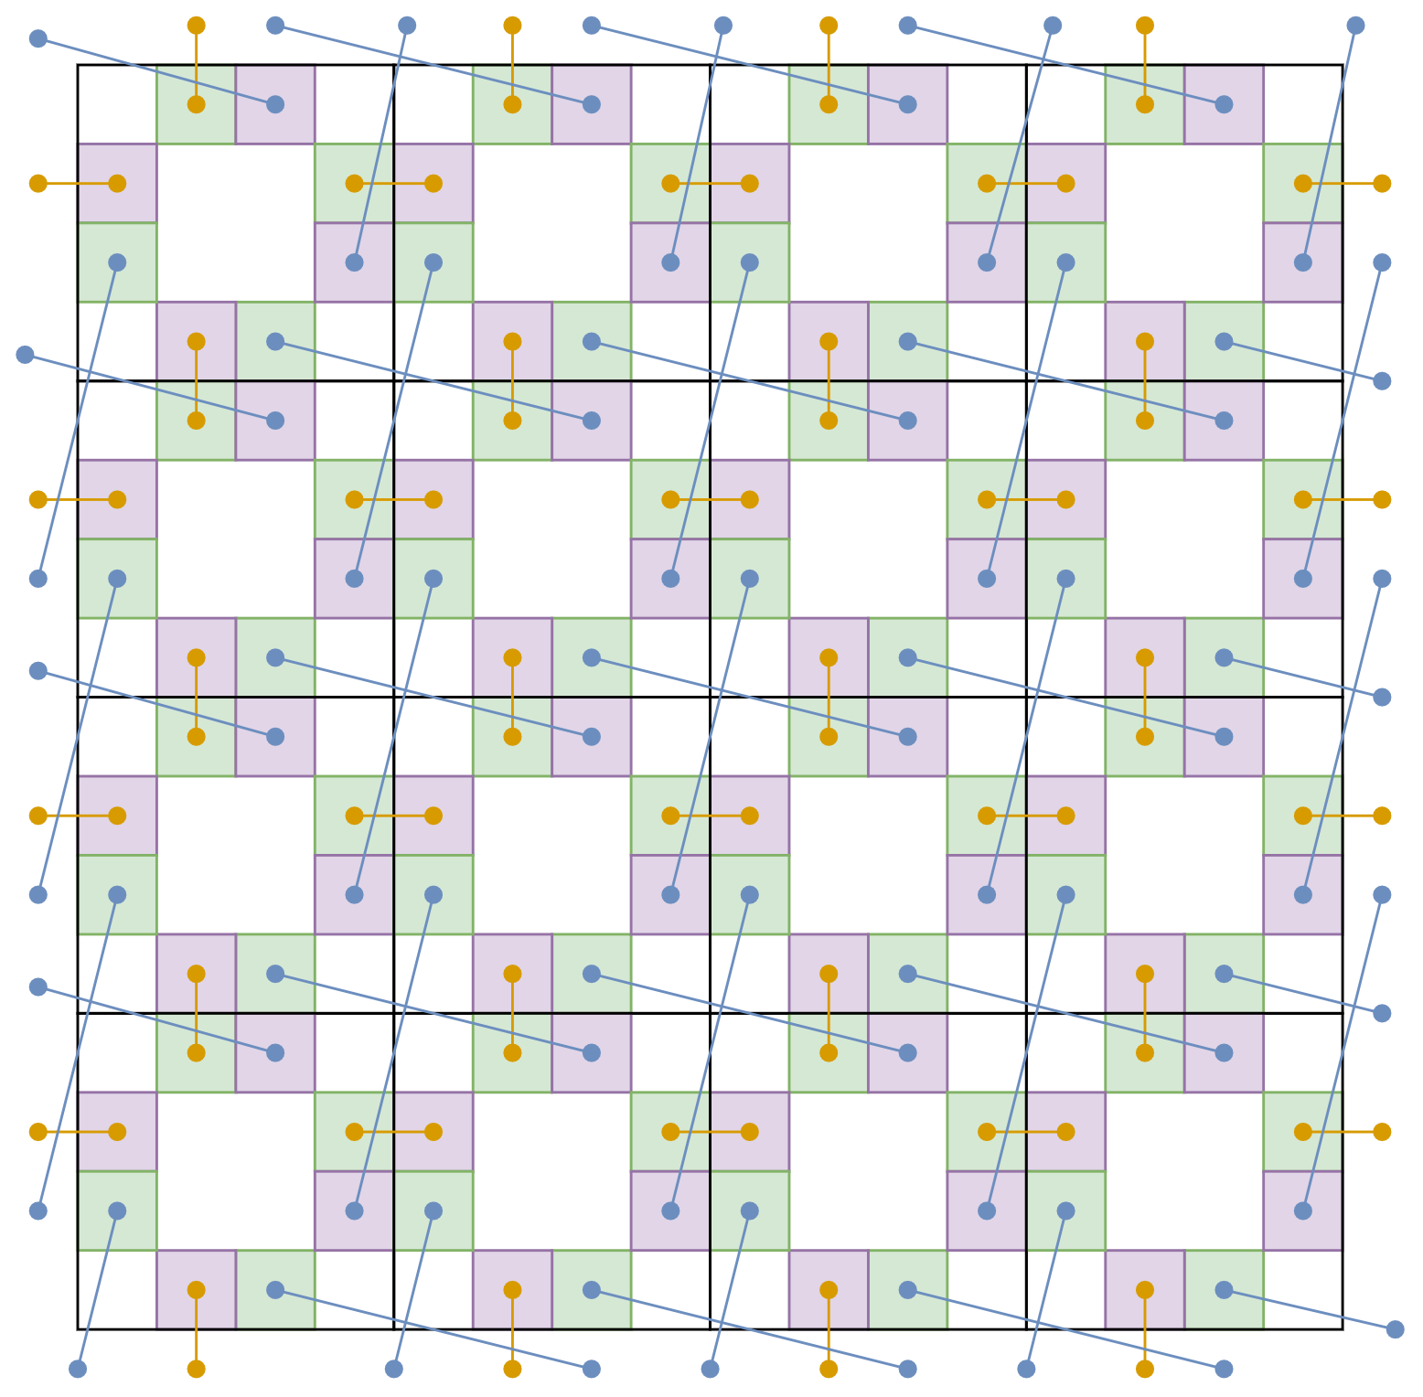
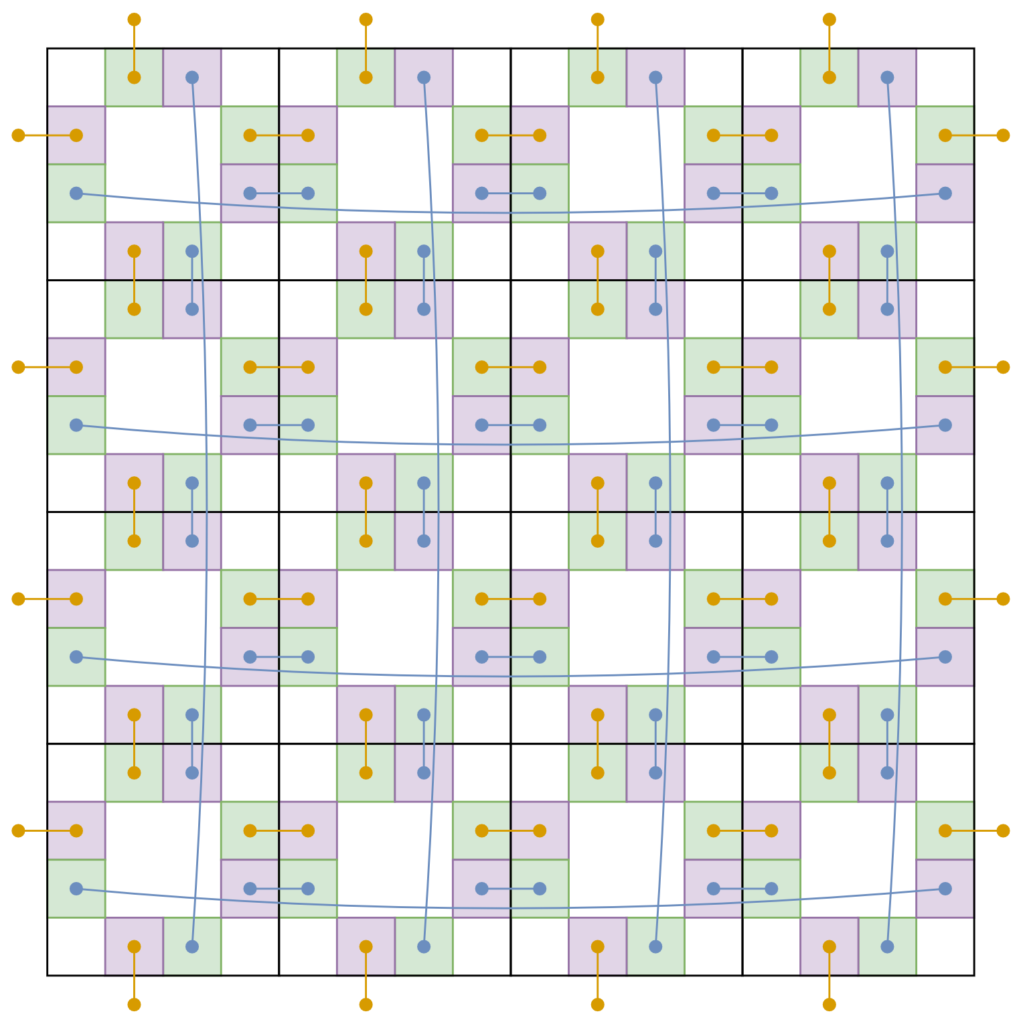
LUCIE Connection Patterns
Passive Interposer
A Square 2-D Grid with two transceivers on each edge.
The other transceiver is used to implement other patterns of communication.
Other connection patterns can also be implemented with connection chiplets.
All connection patterns are compatible due to same bump layout
Not reconfigurable after manufacturing.
Allows Direct D2D communication.
Allows more complex patterns than what could be achieved with fuses.
Notes:
Here we can see some examples of how other connection patterns can be implemented.
For example, we can get more neighboring connections for higher bandwidth
We can get a 2D torus
We can get a folded 2D torus
Or we can get diagonal connections, allowing each slot to talk with all eight surrounding slots.
The choice of substrate ultimately goes down to the user. What they want to implement.

Slide 25
LUCIE Design Summary
Passive 2D Grid
Central Symmetric allows rotation for configuration options.
Versatile communication patterns, easy configuration.
Direct Die-to-Die communication allows Peer-to-Peer or NoP, depending on what the chiplets want.
Some layouts can be made with Silicon Bridges, allowing even cheaper manufacturing and better scalability.
Notes:
Let’s recap on the design of the LUCIE interposer
Each grid is central symmetric, allowing chiplets to rotate, have more flexibility in placement and realize different types of connections.
Our layout is good for either peer-to-peer connection or network-on-package, depending on what the chiplets believe is better suited.
Finally, some layouts, such as all-neighbouring connections, can be implemented with alternative manufacturing techniques such as silicon bridges. This can lead to cheaper manufacturing and better scalability.

Slide 26
A new problem
We have too many choices and flexibility!
Different, potentially complex wiring patterns on the interposer make it difficult to choose the best interposer and design where to place the chips.
Notes:
But now we created a problem for ourselves! We’ve got too much flexibility!
The user have to choose an interposer with the most suitable layout, and come up with a placement on chips on the interposer with respect to the potentially complex wiring patterns.

Slide 27
Placement Tool
Features:
  A constraint solver that generates chiplet placements.
  Automatically generate connection chiplets if unsatisfiable
  Flexible. Can be used on all kinds of wiring patterns and bump maps.
Notes:
That is why we introduce a placement tool. It takes a description of high-level connections between chiplets, and it will give you a floorplan for where to place the chiplets and how to rotate them.
If the layout cannot be directly satisfied, the placement tool will also generate additional connection chiplets, with wires, repeaters or retimers on them, to help realize the connections.
Our placement tool is also flexible enough to accommodate all kinds of designs and connection patterns.

Slide 28
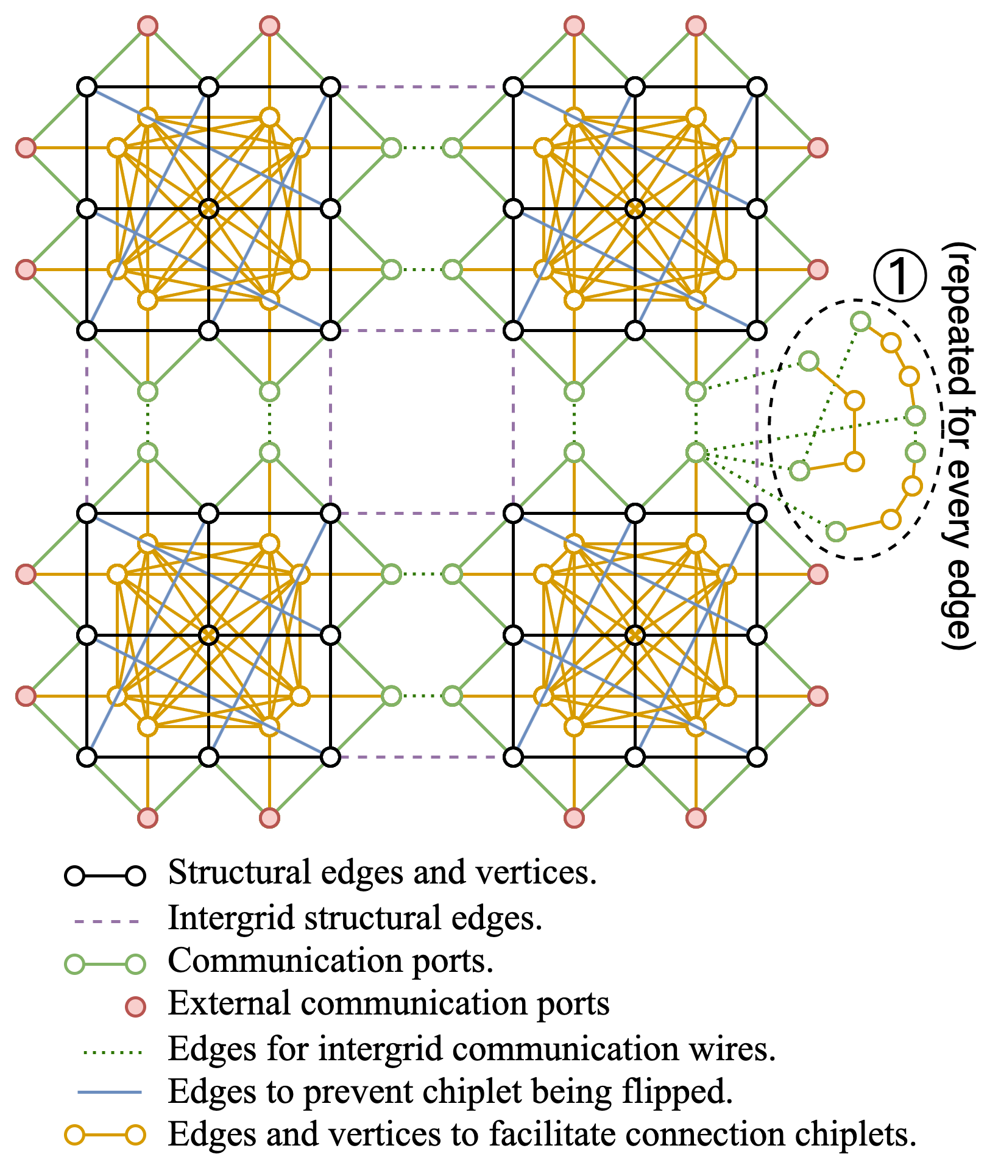
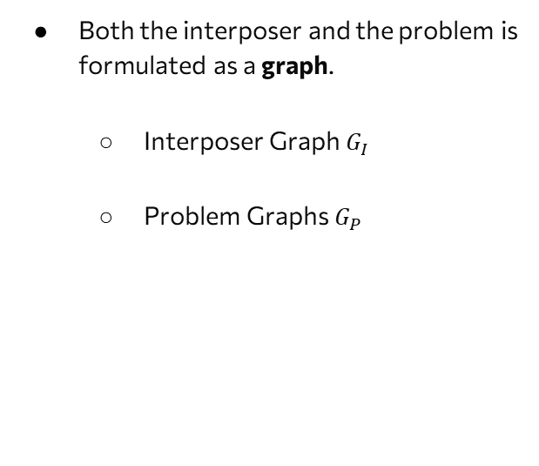
Graph Construction
Both the interposer and the problem is formulated as a graph.
  Interposer Graph $G_{I}$
  Problem Graphs $G_{P}$
Notes:
The placement tool use a graph-based algorithm. The problem is abstracted to an interposer graph and a problem graph. Possible placement are found using subgraph monomorphism

Slide 29
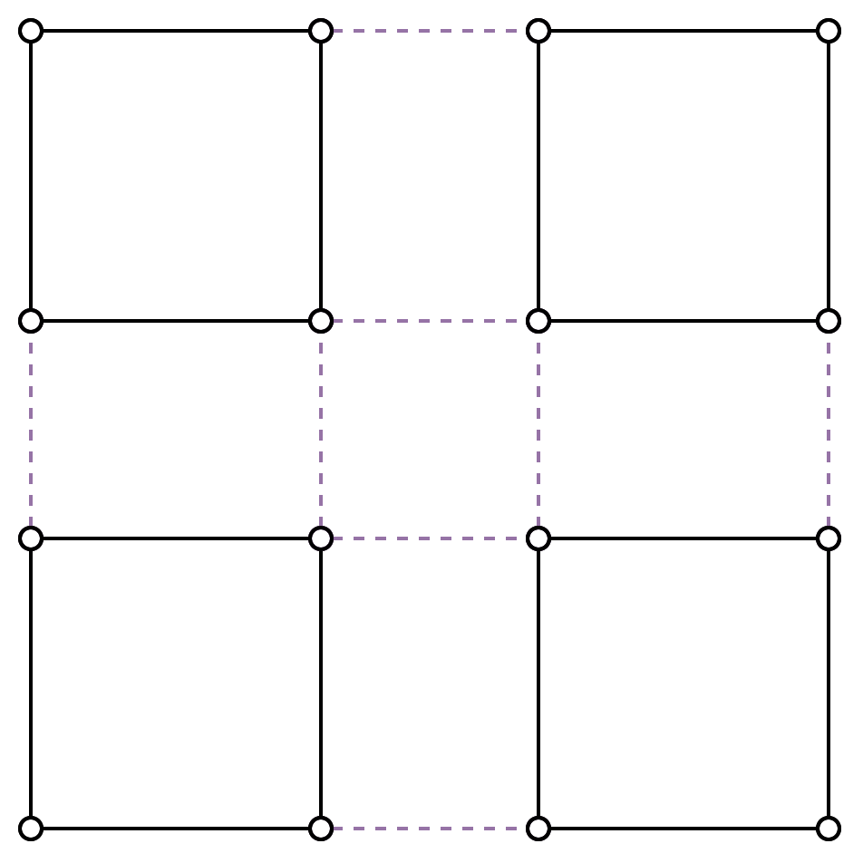

Interposer Graph ($G_{I}$)
Basic Skeleton (2x2)
Notes:
First we have a basic skeleton representing the grids. Shown here is a 2x2 interposer.

Slide 30
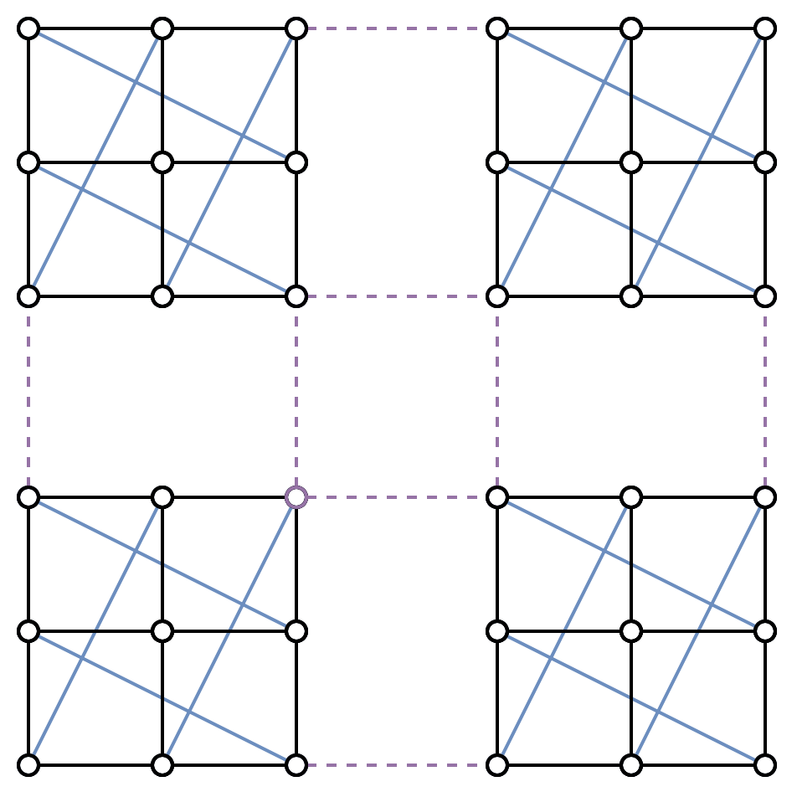
Interposer Graph ($G_{I}$)
Basic Skeleton (2x2)
Add edges to prevent chiplets being flipped.
Notes:
Chiplets cannot be flipped. Therefore we add some diagonal edges like this that would prevent flipping but still allow rotation.

Slide 31
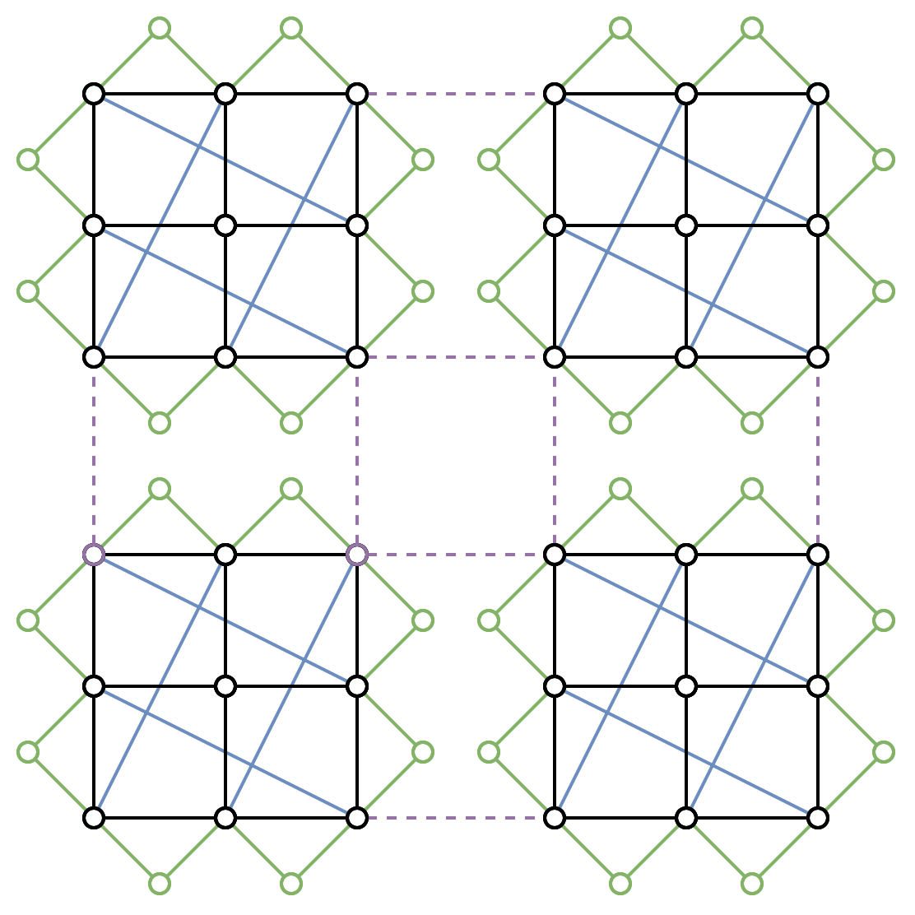
Interposer Graph ($G_{I}$)
Basic Skeleton (2x2)
Add edges to prevent chiplets being flipped.
Add ports that represent transceivers
Notes:
Then we add some vertices and edges that represent communication ports.

Slide 32
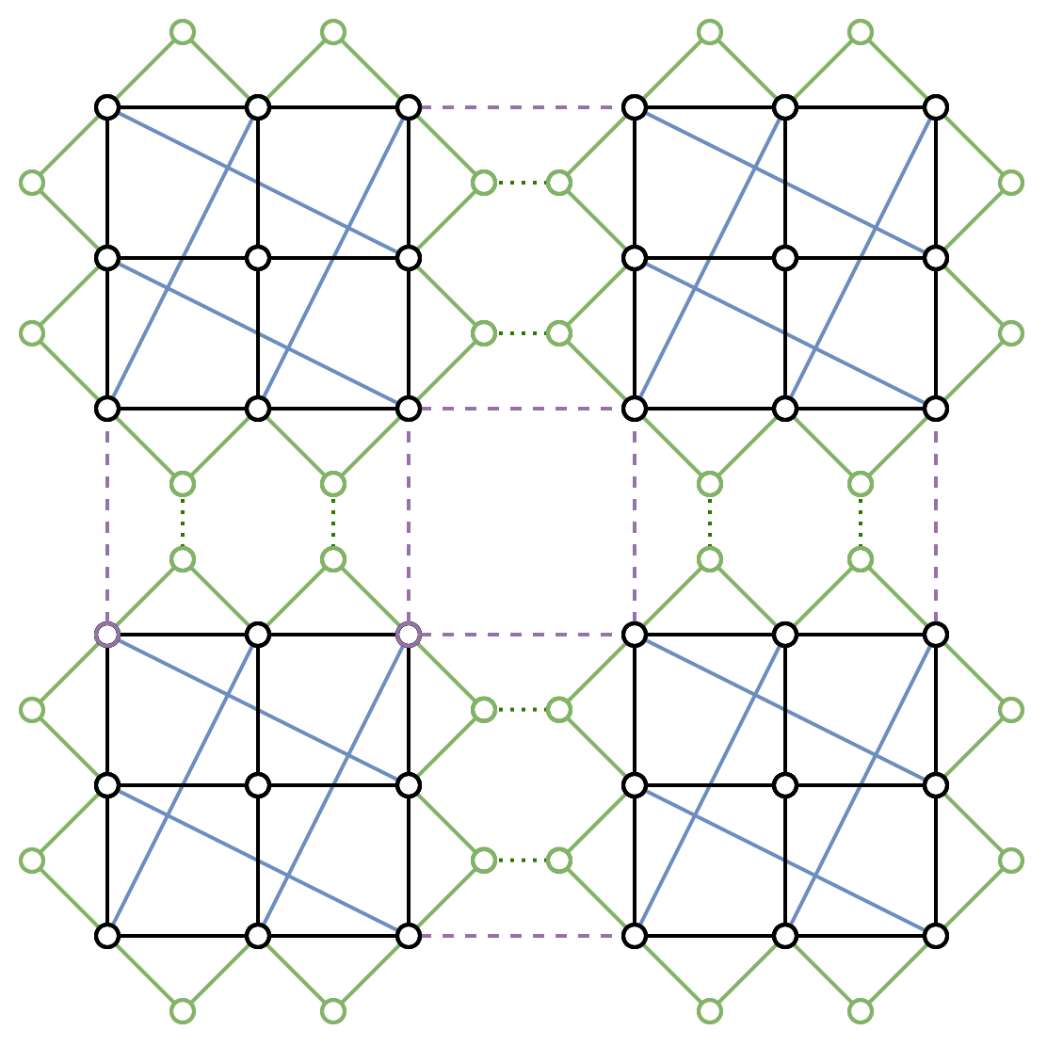
Interposer Graph ($G_{I}$)
Basic Skeleton (2x2)
Add edges to prevent chiplets being flipped.
Add ports that represent transceivers
Add edges that represent interconnect (neighbor shown here)
Notes:
Then we add some edges that represent the interconnect pattern of the interposer. Shown here is the double link between neighbors configuration.
If the interposer is different, just rewire these edges

Slide 33
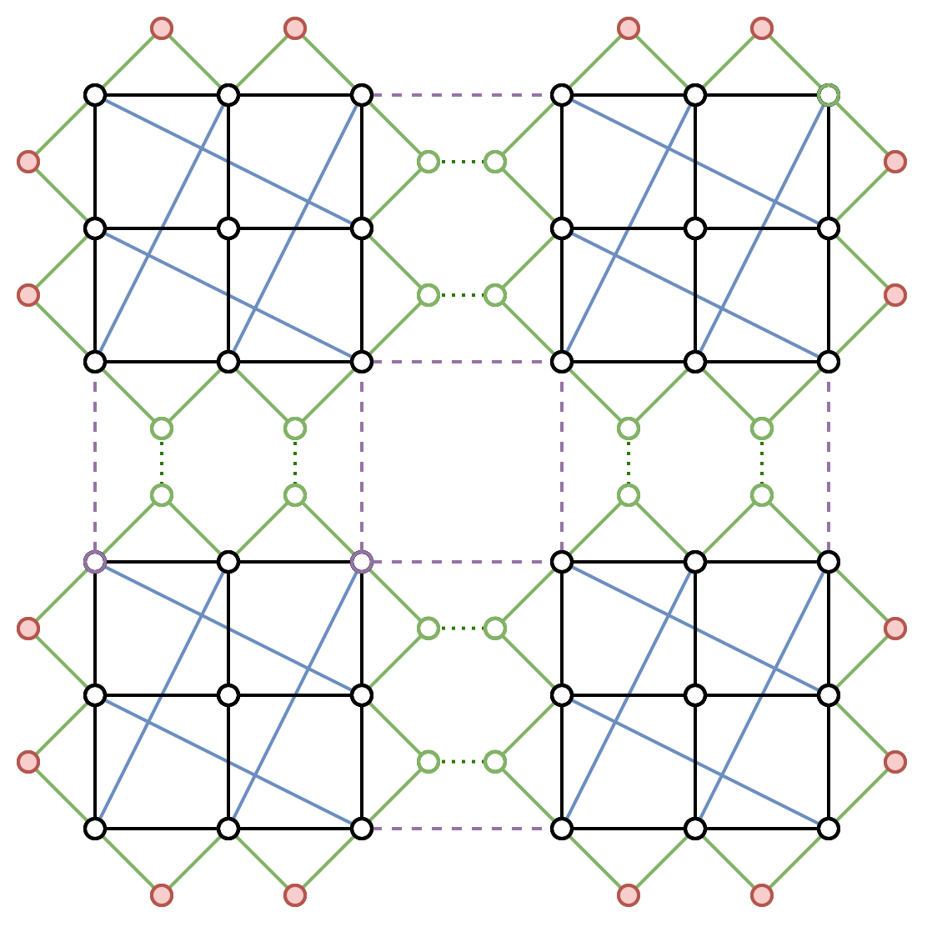
Interposer Graph ($G_{I}$)
Basic Skeleton (2x2)
Add edges to prevent chiplets being flipped.
Add ports that represent transceivers
Add edges that represent interconnect (neighbor shown here)
Tag the vertices that represent ports with external connections
Notes:
Ports at the outer rim is connected to the external world. We give these vertices a different tag.
Chiplets that is designed to communicate with the outside world will also
tag those transceivers accordingly.

Slide 34
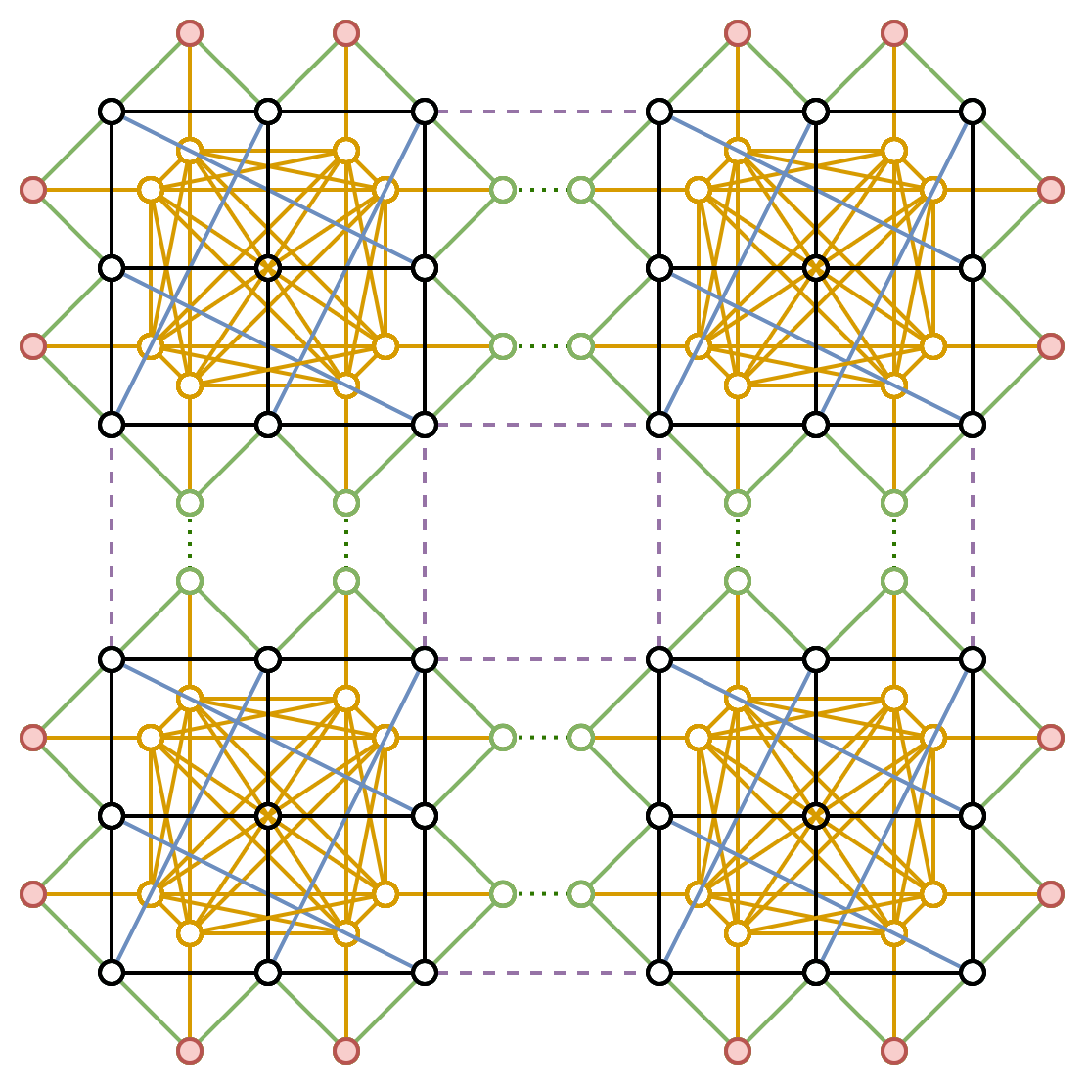
Interposer Graph ($G_{I}$)
Basic Skeleton (2x2)
Add edges to prevent chiplets being flipped.
Add ports that represent transceivers
Add edges that represent interconnect (neighbor shown here)
Tag the vertices that represent ports with external connections
Add the edges and vertices for connection chiplet generation
Notes:
Finally we add the edges and vertices for generating connection chiplets.
This is kinda crazy. We will get back to this later.

Slide 35
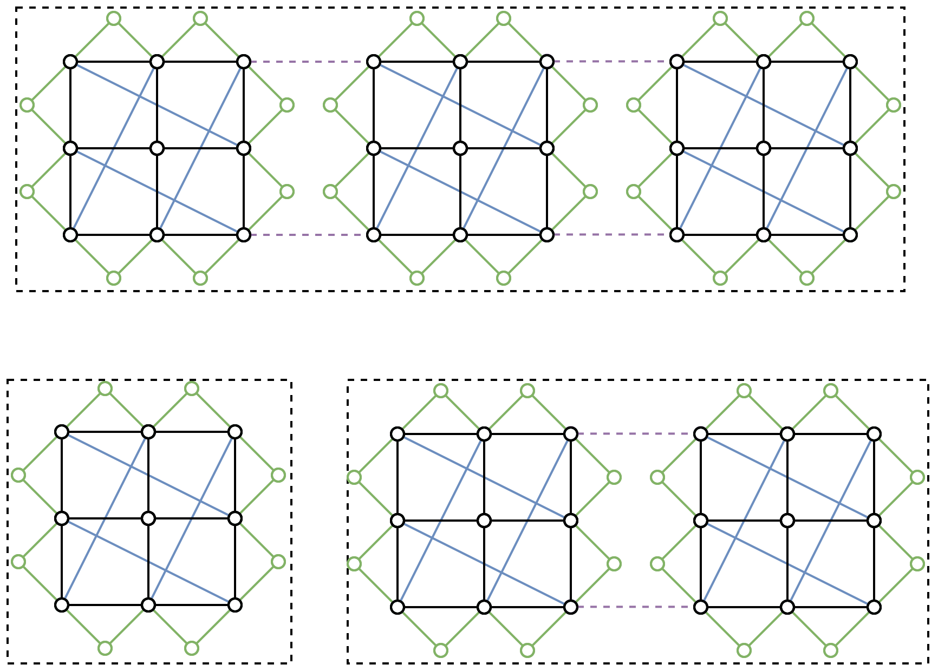

Problem Graph ($G_{P}$)
Add chiplet representations to the problem graph
  Connection chiplet edges are not needed for problem graph
Notes:
Then let’s talk about the problem graph.
Here is an example topology we would try to represent.
Firstly we put corresponding graph representations of the chiplets onto the plane. The problem graph is constructed similarly to the interposer graph, except that we do not need connection chiplet edges for them.

Slide 36
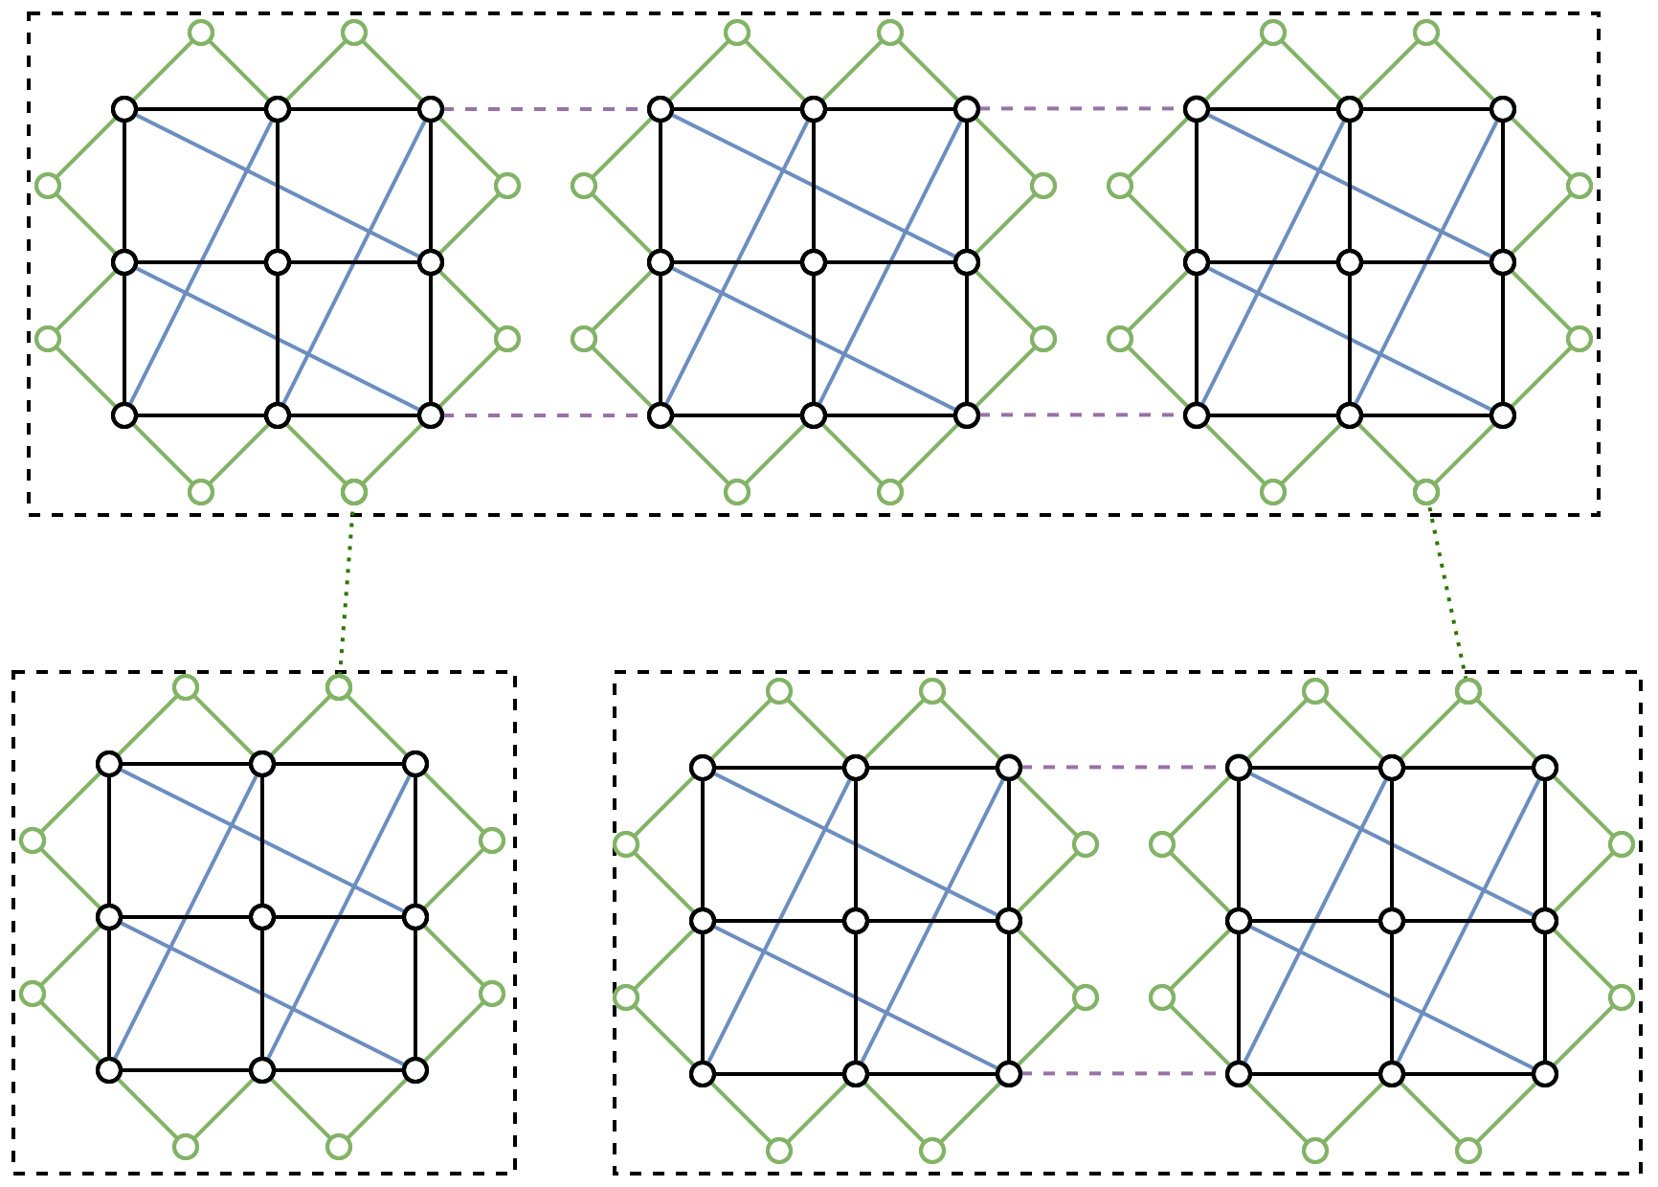
Problem Graph ($G_{P}$)
Add chiplet representations to the problem graph
  Connection chiplet edges are not needed for problem graph
Add the communication links between chiplets
Notes:
Then we add the edges that represents communication links

Slide 37
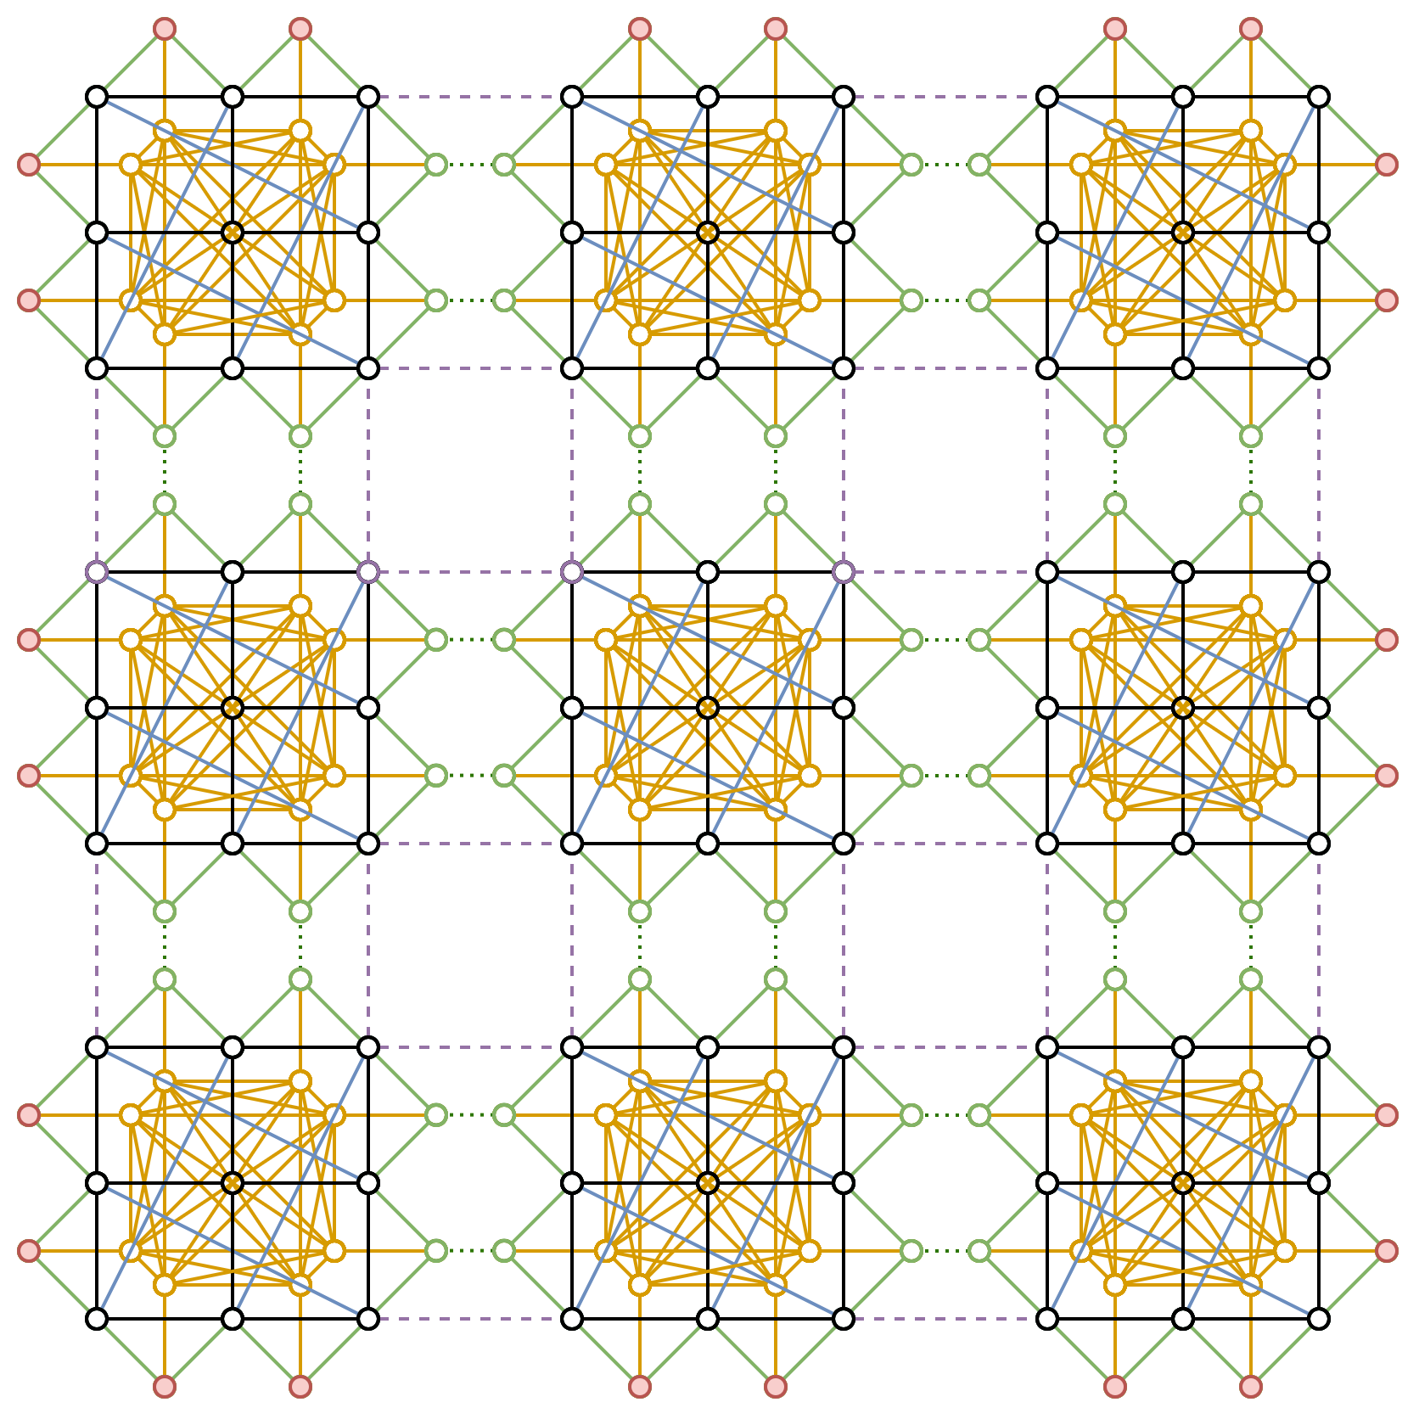
Problem Graph ($G_{P}$)
Add chiplet representations to the problem graph
  Connection chiplet edges are not needed for problem graph
Add the communication links between chiplets
Run subgraph monomorphism
Notes:
Then we run subgraph monomorphism to check if the problem graph is a subgraph of the interposer graph.
If it is, then we will get a mapping, from which we can derive the coordinates and rotation of each chiplet.

Slide 38
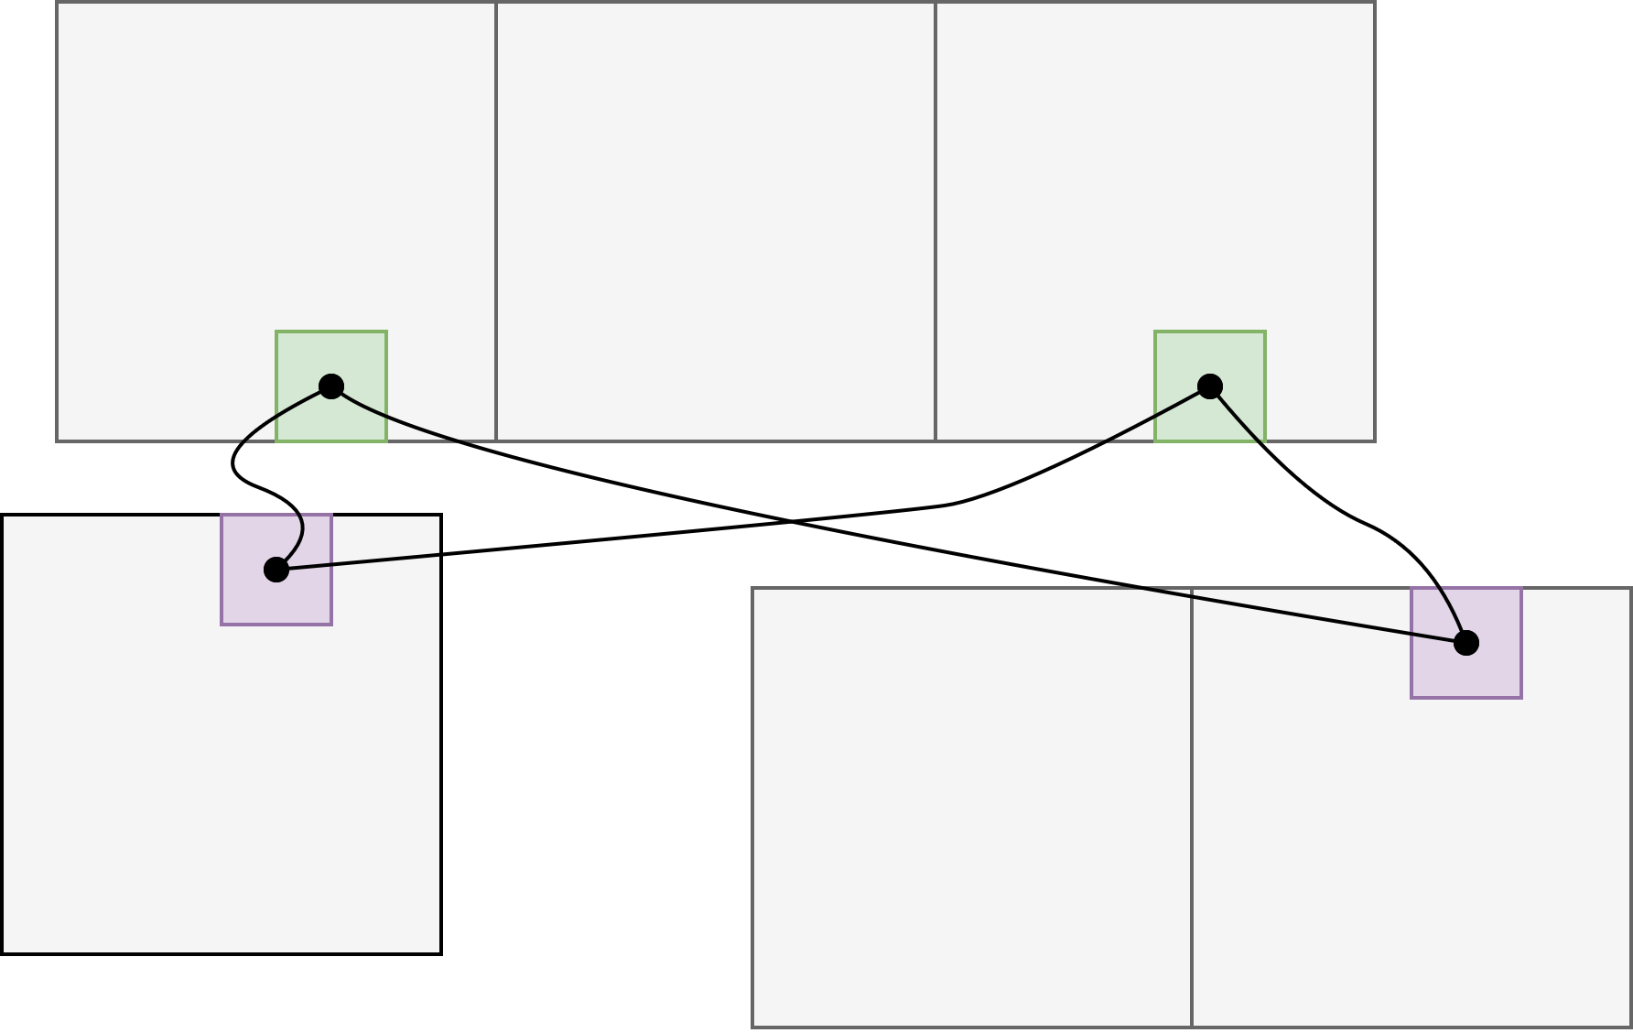
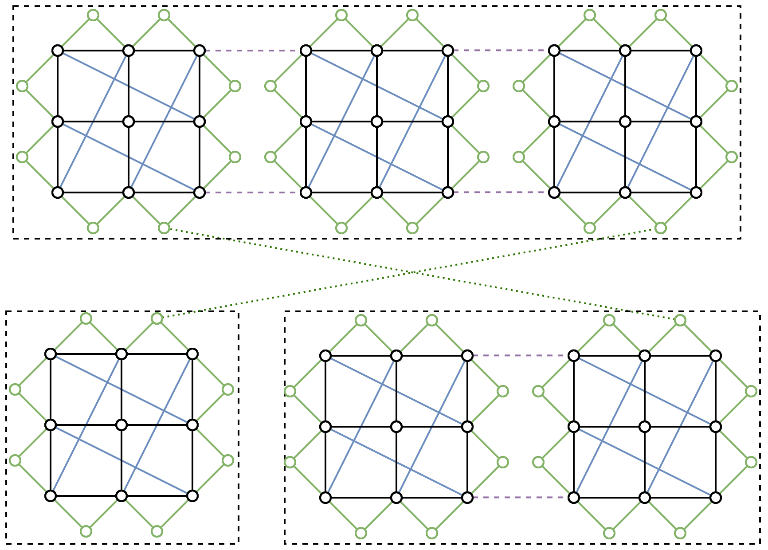
Mapping Procedure
If some ports serve the same function, a many-to-many mapping can be established, and multiple problem graphs will be created
Notes:
In many cases, some ports on a chiplet serve the same function
In which case a many-to-many mapping can be established
And multiple variations of problem graph will be created.

Slide 39
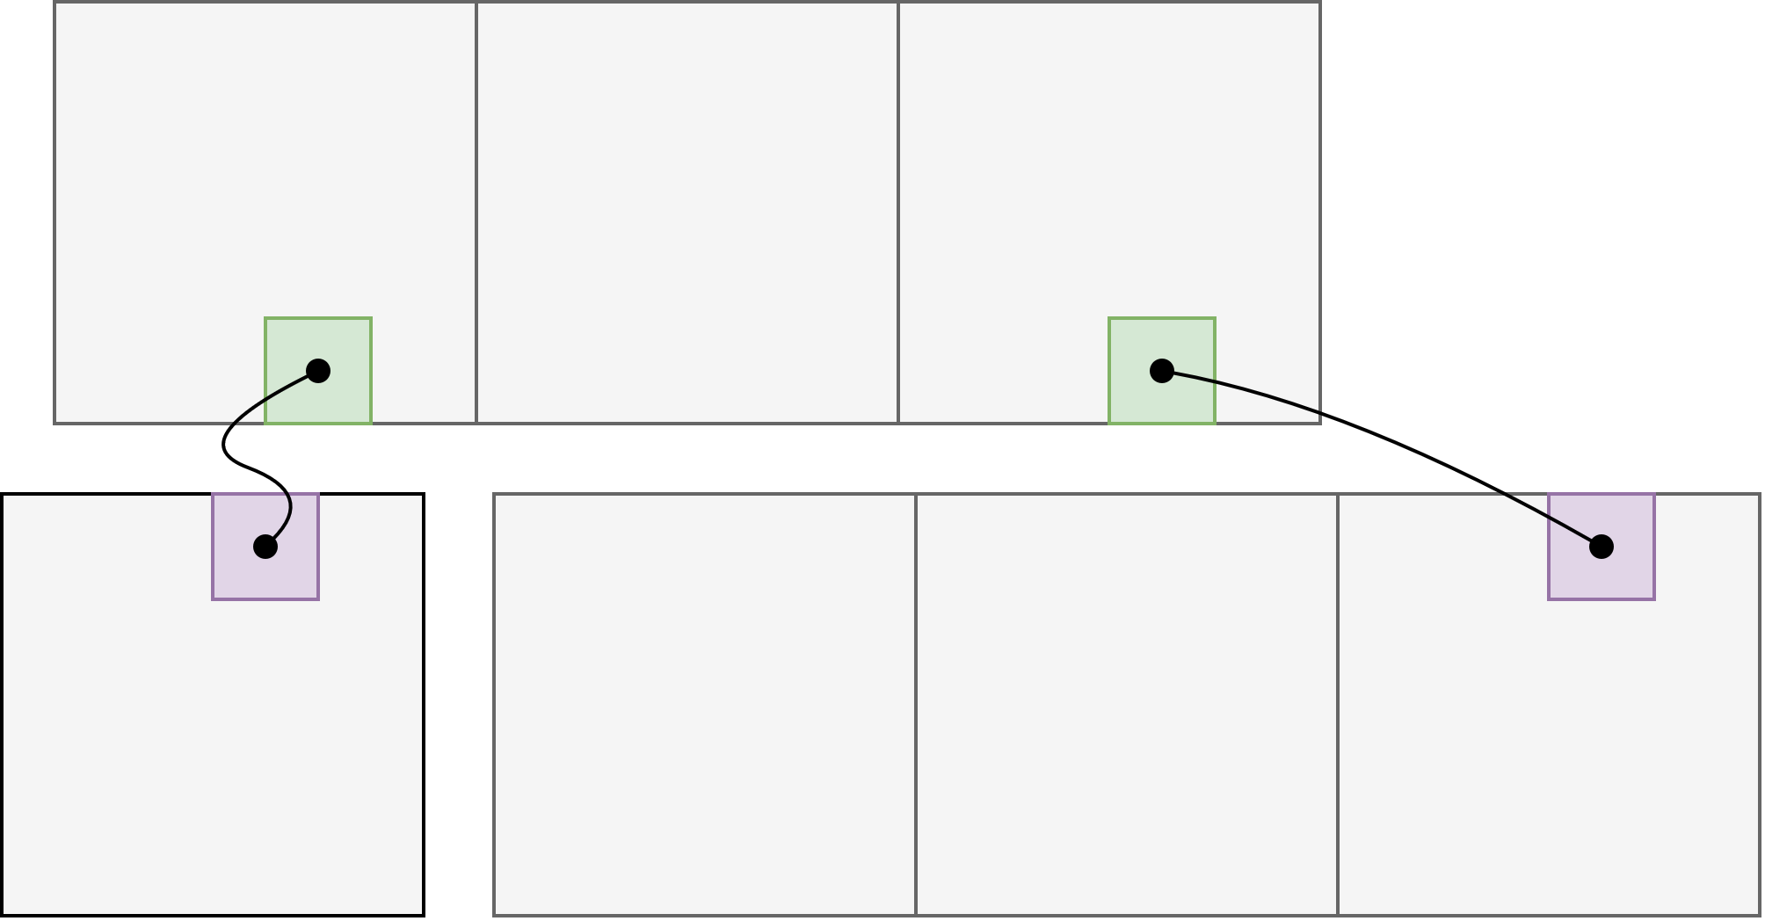
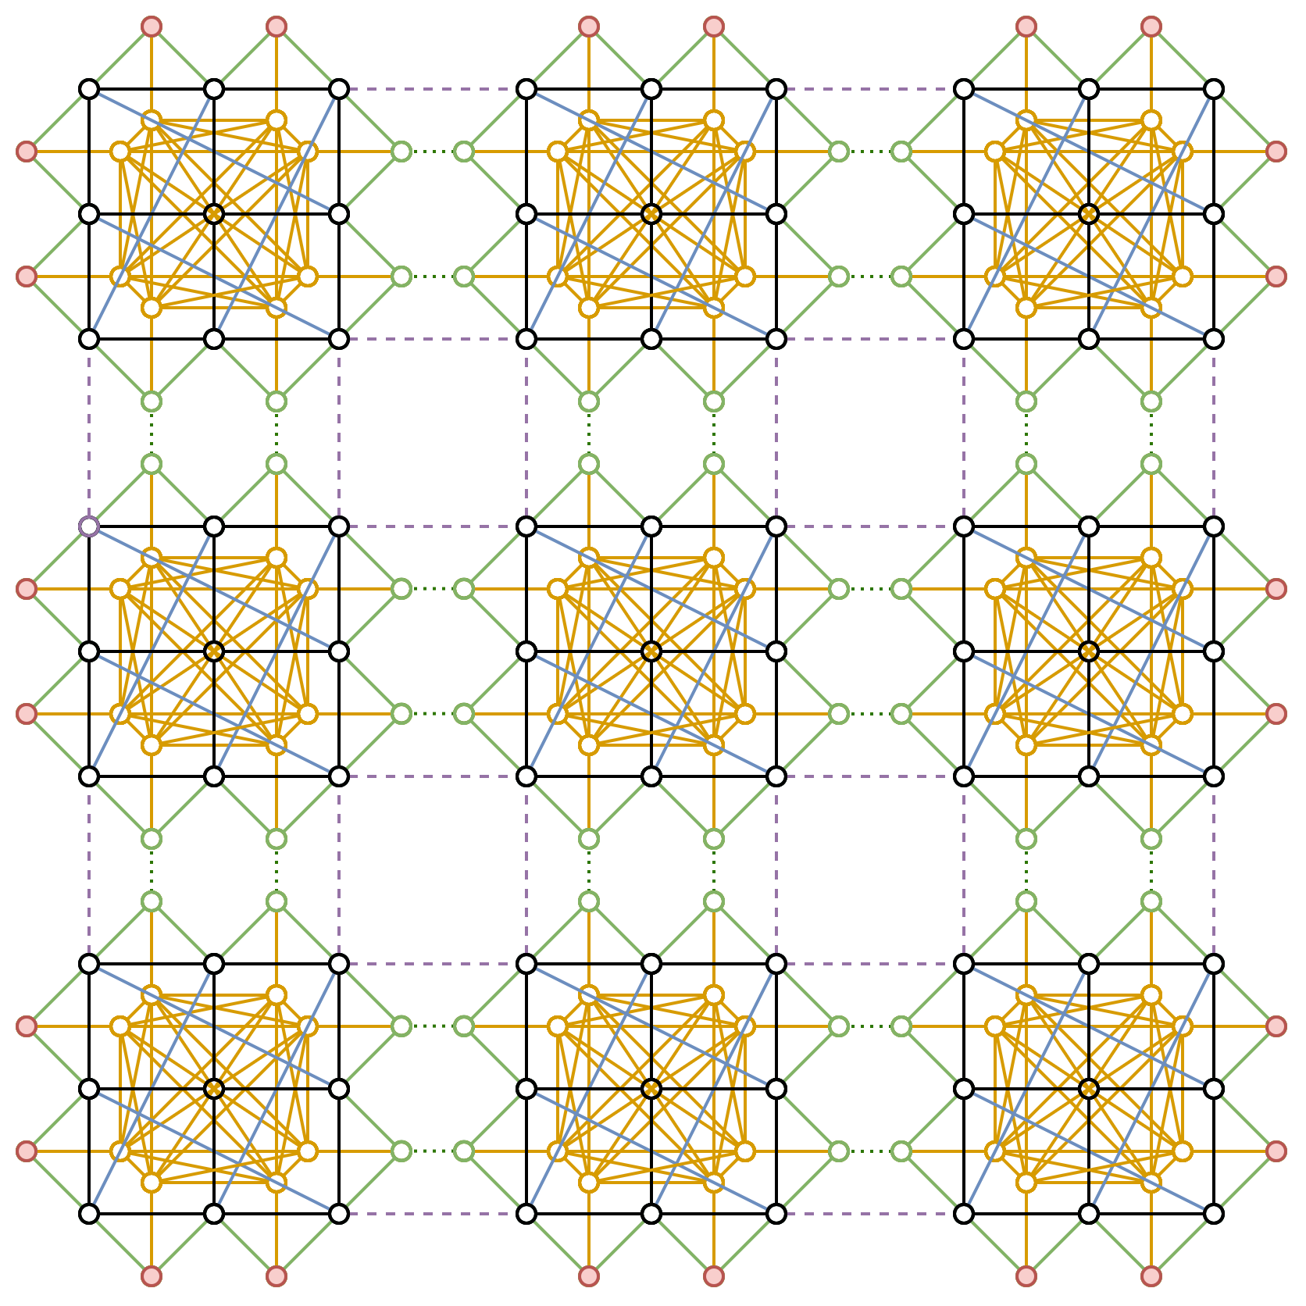
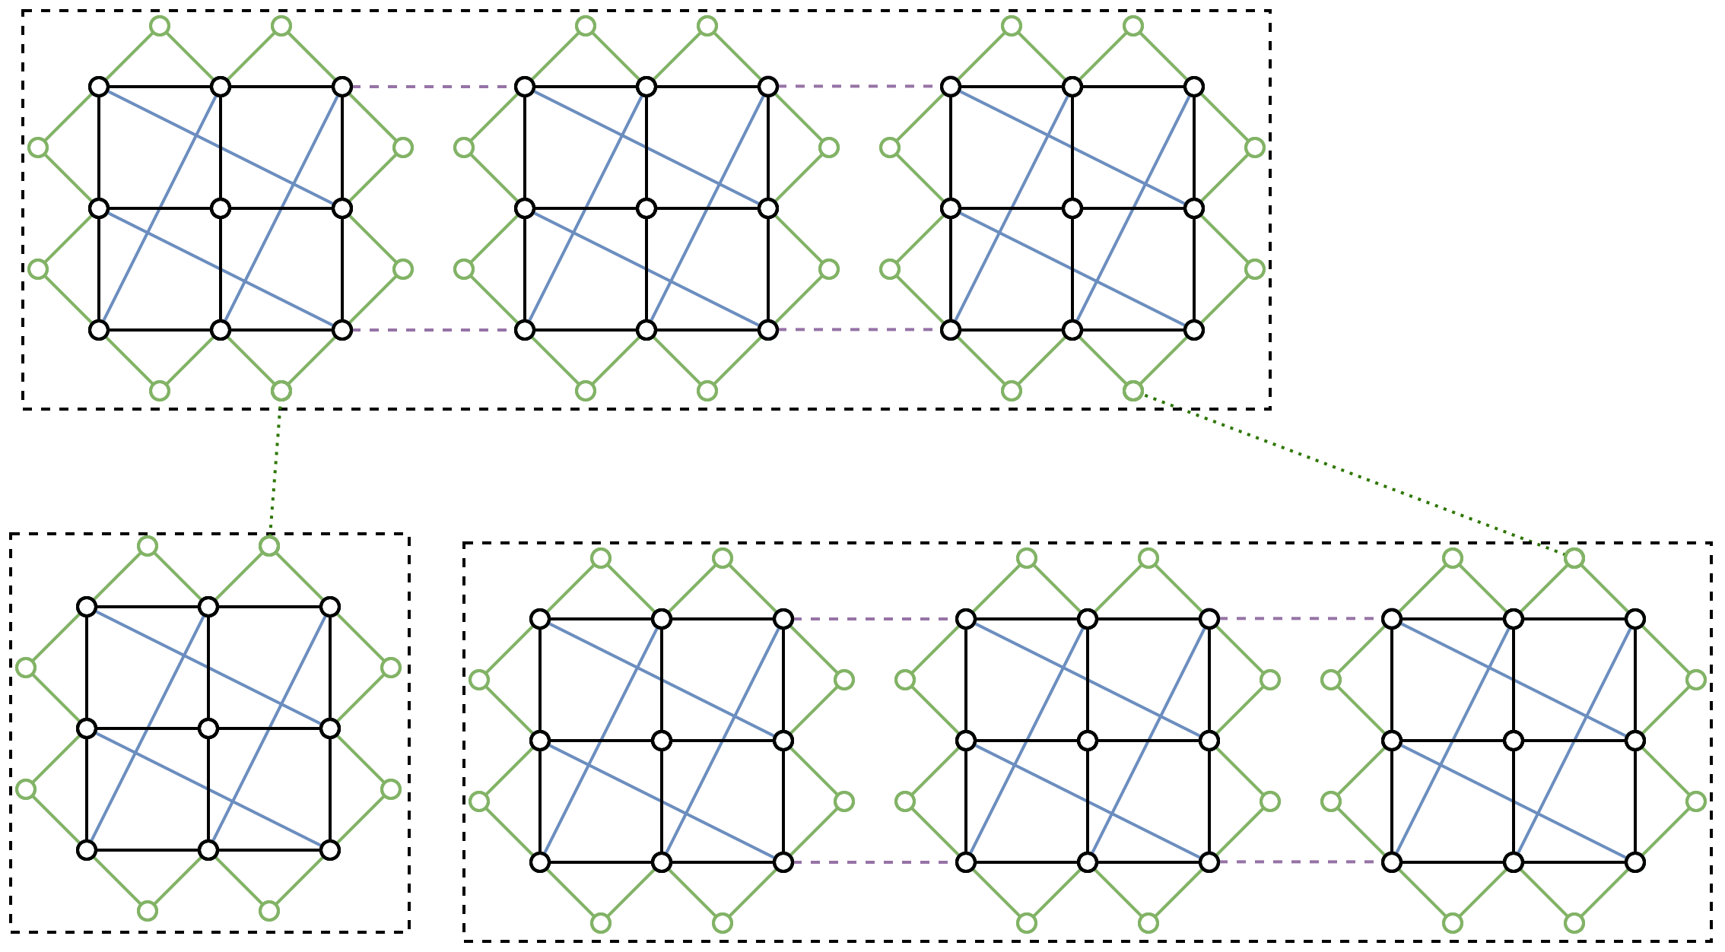
Mapping Procedure
If monomorphism check fails, it means unplaceable.
Notes:
If the monomorphism check fails, it means the problem is unplaceable.
For example, here we see an obvious case where there will be a collision. As a result, the problem graph will not be a monomorphic subgraph to the interposer graph.

Slide 40
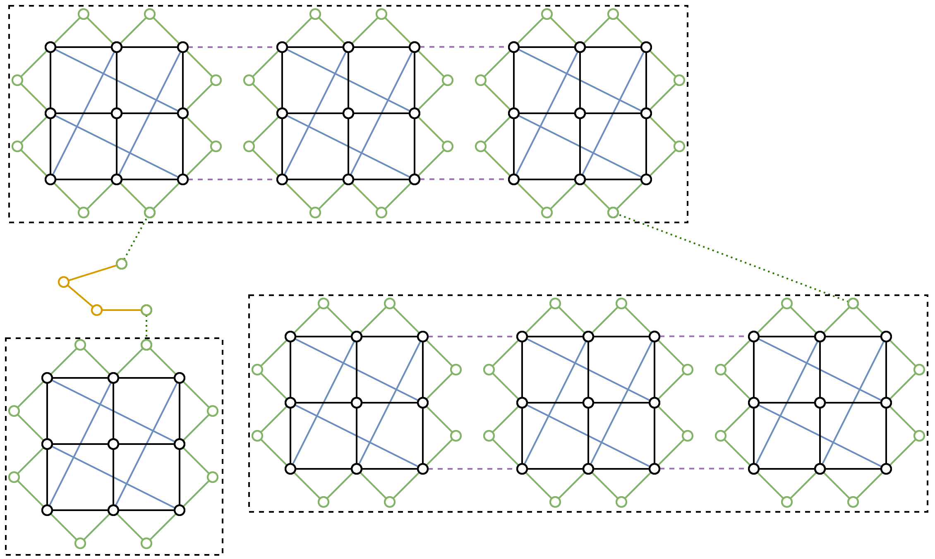
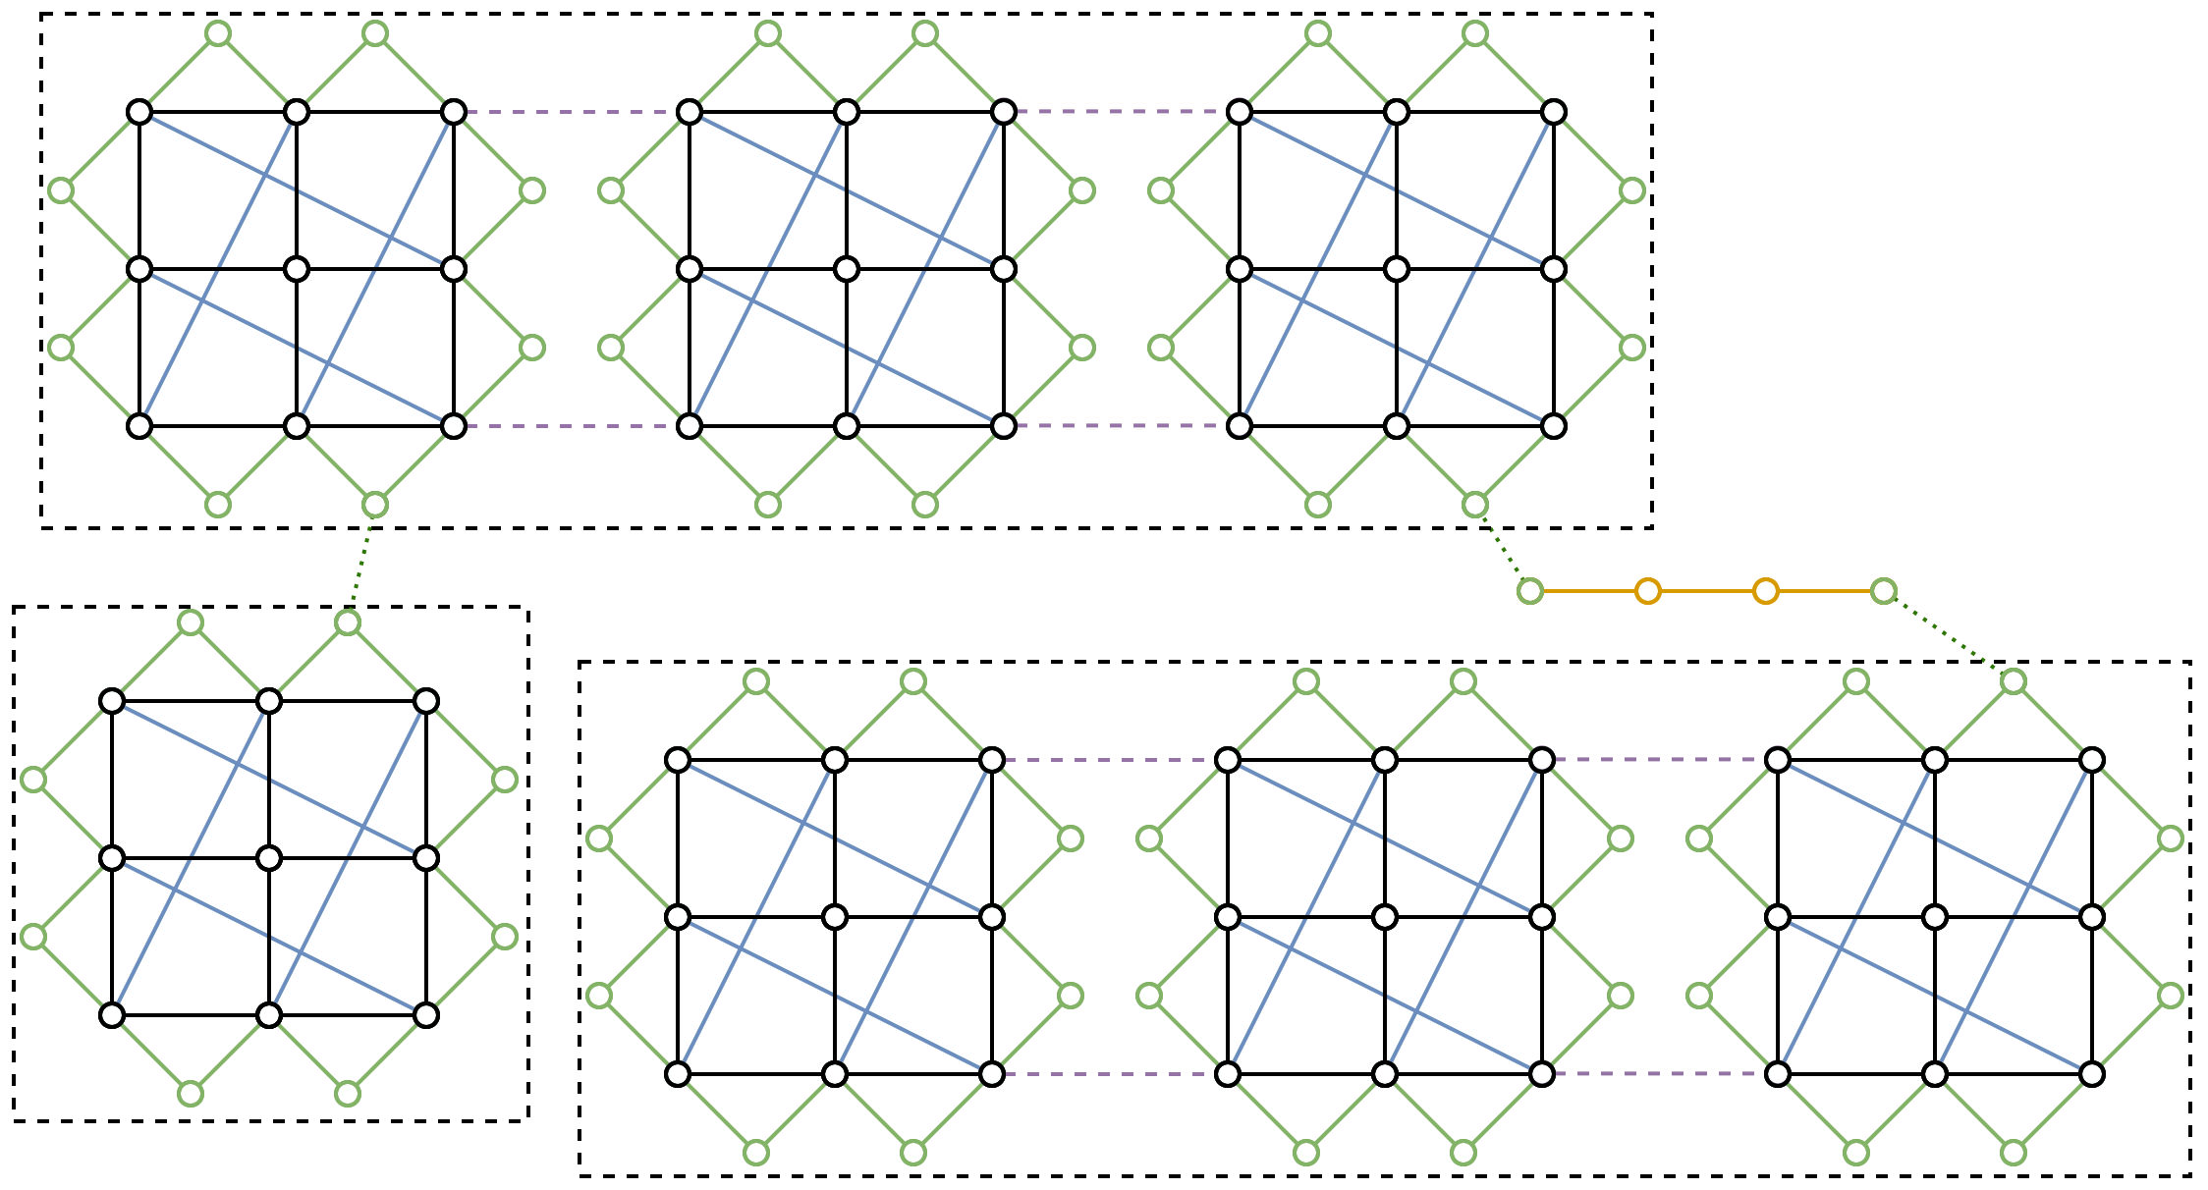


Mapping Procedure
If monomorphism check fails, it means unplaceable.
The placement tool will try to generate connection chiplets
Connection Chiplet
Notes:
In such cases, the placement tool will try to generate connection chiplets.
Here is the abstraction of a connection chiplet.
The placement tool will try to place connection chiplets on all communication links like this, so there will be two possibilities
And we will see the left one is still unmappable, while the right one is.

Slide 41

The placement tool:
Convert the placement problem to a subgraph monomorphism problem.
Match the graphs, extract layout from the mapping.
Intuitive problem reduction, flexible on topology.
Notes:
Here is an example of how a mapping process goes.
The background shows the interposer graph. The foreground shows a possible way to map the problem graph onto the interposer graph.
Connection Chiplets are mapped into a path in the interposer graph, as shown.
(The popup)

Slide 42
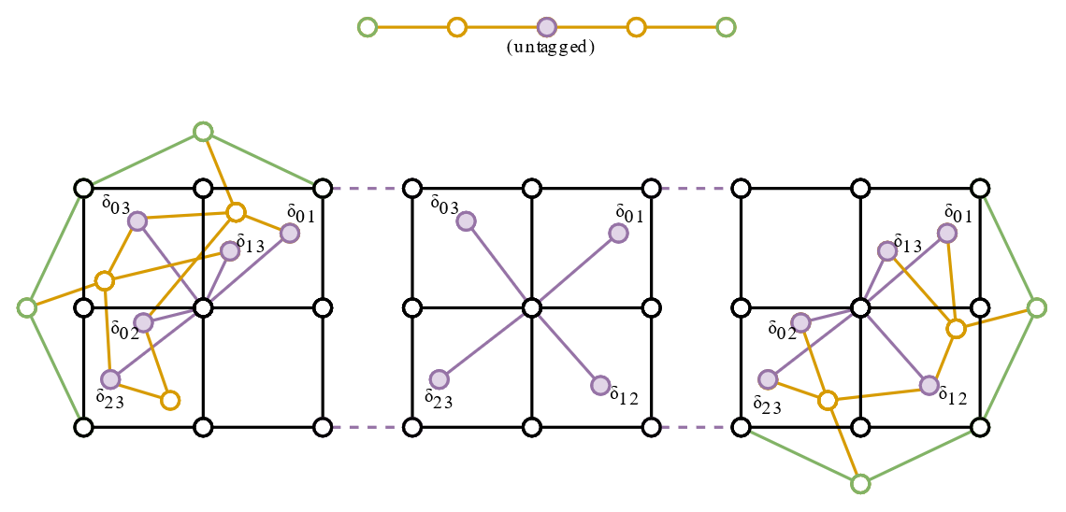
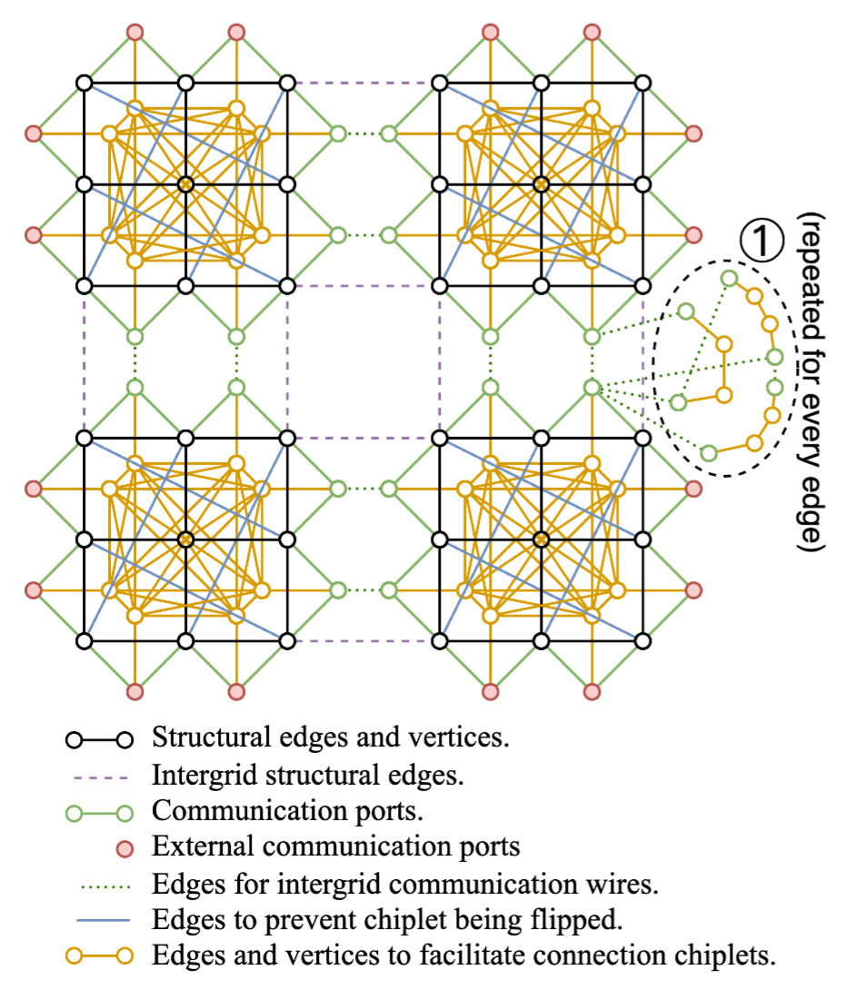
Further Augmentations
Embedded Connection Chiplets
One-shot connection chiplet generation
In the paper …
Notes:
We also have some further augmentations to the placement tool that allows generation for connection chiplets embedded into functional chiplets, and a one-shot, non-iterative method of generating longer connection chiplets. You may find the details and augmentations in the paper.

Slide 43
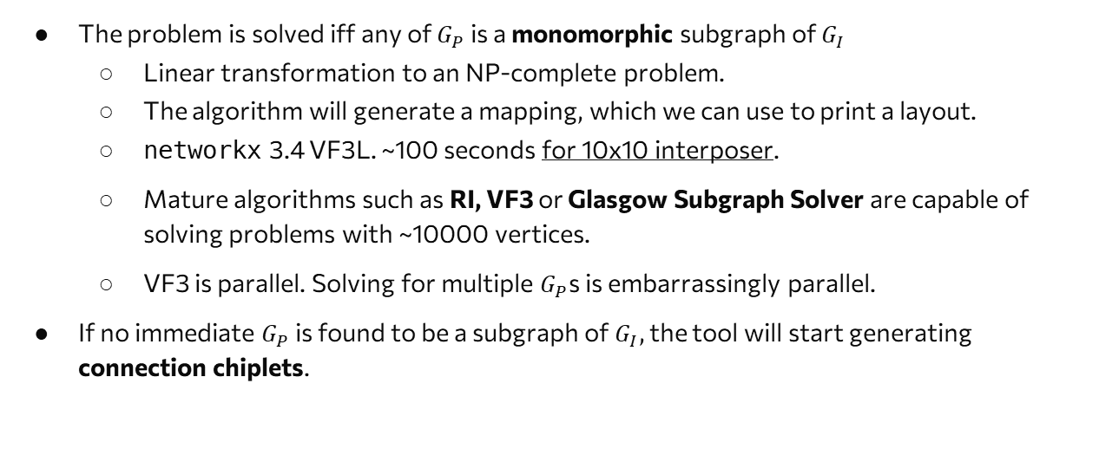
Mapping Procedure (Concl.)
The problem is solved iff any of $G_{P}$ is a monomorphic subgraph of $G_{I}$
  Linear transformation to an NP-complete problem.
  The algorithm will generate a mapping, which we can use to print a layout.
  networkx 3.4 VF3L. ~100 seconds for 10x10 interposer.
  Mature algorithms such as RI, VF3 or Glasgow Subgraph Solver are capable of solving problems with ~10000 vertices.
  VF3 is parallel. Solving for multiple $G_{P}$s is embarrassingly parallel.
If no immediate $G_{P}$ is found to be a subgraph of $G_{I}$, the tool will start generating connection chiplets.
Notes:
Let’s recap on the placement tool.
We use subgraph monomorphism to look for possible mappings. Mature algorithms such as VF2, VF3 and Glasgow Subgraph Solver are capable of solving such problems with millions of nodes. Our test cases can all finish within minutes.
And if the problem is not directly mappable, the placement tool will generate connection chiplets.

Slide 44
04
Performance Evaluation
Notes:
Now let’s talk about the performance of the LUCIE interposer.

Slide 45
Parameter Exploration
Find a geometry with the best performance
Criteria:
  20-30% power bumps
  H, W > 1mm
  Pitch > 20um
  8mm² < Grid Area < 16mm²
Look for the best performance under these criteria.
W
H
Notes:
Firstly, we discovered parameters that balances bandwidth, manufacturing difficulty and configurability.

Slide 46

Parameter Exploration
8.10 mm² grid area
2878.33 Gbit/s/mm beachfront
4045.30 Gbit/s/mm² areal
777.6 um
2846.1um
Notes:
Firstly, we discovered parameters that balances bandwidth, manufacturing difficulty and configurability, and arrived at these theoretical numbers for our estimations.
This graphs shows all available designs, their shore bandwidth with respect to pitch size.
The best design has a 8.1mm^2 grid area, around 3Tbits beachfront communication density, and around 4Tbits areal communication density

Slide 47
Performance Analysis
End-to-end with applications
  Fine-Grained Accelerator – barnes with gem5-duet
  Manycore across multiple chips – MuchiSim
  Large Accelerators (4xA100) – LLMCompass
System | Latency | Bandwidth | Notes
Monolithic SoC | 1-cycle | 1000 Tbytes/s (~∞)
Custom Interposer | 4ns | 30 Tbytes/s
LUCIE | 5ns | 2.8 Tbps/mm
Network-on-Package | 30ns | 512 Gbps/mm | ~ZeroASIC
Board-to-Board | 8.92ms | 300 GB/s | ~NVLink
Notes:
We included three workloads over five possible system configurations
----------------------------------------
Here are the results of end-to-end simulations.
We have five systems here: Monolithic SoCs, custom interposer systems, LUCIE, and network-on-package designs. We also included board-to-board results for comparison.
Shown here are runtimes normalized to monolithic SoC, smaller is better.
We can see that in all benchmarks, monolithic, custom interposer and LUCIE performed similarly to each other.
In manycore applications, NoP approaches could be be 20% to 2 times slower due to longer latency, and uses around 20% more power for communication.

Slide 48

Performance Analysis
$\frac{Runtime([System])}{Runtime(Monolithic)}$, smaller is better
On-par with Monolithic SoC/Custom SIP
20% - 2x speedup over NoC-on-NoP in manycore applications
Notes:
And here are the numbers we arrived at.
----------------------------------------------------
Here are the results of end-to-end simulations.
We have five systems here: Monolithic SoCs, custom interposer systems, LUCIE, and network-on-package designs. We also included board-to-board results for comparison.
Shown here are runtimes normalized to monolithic SoC, smaller is better.
We can see that in all benchmarks, monolithic, custom interposer and LUCIE performed similarly to each other.
In manycore applications, NoP approaches could be be 20% to 2 times slower due to longer latency, and uses around 20% more power for communication.

Slide 49

Energy Analysis
$\frac{Energy([System])}{Energy(Monolithic)}$, smaller is better
~20% less communication/routing energy consumption compared to NoC-on-NoP
Notes:
Here are the results of end-to-end simulations.
We have five systems here: Monolithic SoCs, custom interposer systems, LUCIE, and network-on-package designs. We also included board-to-board results for comparison.
Shown here are runtimes normalized to monolithic SoC, smaller is better.
We can see that in all benchmarks, monolithic, custom interposer and LUCIE performed similarly to each other.
In manycore applications, NoP approaches could be be 20% to 2 times slower due to longer latency, and uses around 20% more power for communication.

Slide 50
05
Cost &
Time-to-Market

Slide 51
Manufacturing Analysis
Case: You have a chip to make.
  Some parts of the design can be found elsewhere (such as RISC-V CPUs)
  Some parts are IPs that can be found elsewhere (such as RAM controllers)
  Some parts are unique to your design
Scenarios:
  Monolithic SoC: Buy IPs, tapeout everything
  Custom Interposer: Buy parts, tapeout a custom interposer and the unique part.
  LUCIE: Buy parts and LUCIE interposer, tapeout the unique part only.
100mm² total design area; 200mm² (5x5) LUCIE; 120mm² Custom SIP
12nm chiplets, 65nm SIPs; 10K Units
Notes:
The first scenario is that we are making a chip.
Some parts and IPs can be found elsewhere, and some parts are unique.
We have three scenarios.
Monolithic SoC where we tapeout everything by ourselves.
Custom Interposer where we buy other parts, tapeout an interposer and the unique part
And LUCIE, where we tapeout the unique part only.

Slide 52

Non-Recurring Engineering Cost w.r.t Custom Area
  Small advantage over Custom SIP;
    i.e. No need to design an interposer.
  Big advantage over SoC;
    i.e. Smaller designs, smaller mask, less IP cost, …

Slide 53

Recurring Engineering Cost w.r.t Custom Area
  Slight advantage over SoC at smaller custom areas
    i.e. Less custom area to tape out
  Big advantage over Custom SIP
    i.e. Interposer cost

Slide 54

Manufacturing Analysis
Time-To-Market
  Slight benefit over Custom SIP
  Large benefit over SoC
Large benefit when custom area is zero
Notes:
As for time-to-market, LUCIE has a slight advantage over custom interposer designs and a large benefit over monolithic SoCs.
The biggest advantage comes when the custom area is zero, in which case we are just integrating things from others. While custom interposer will still take months, the time needed for LUCIE is practically zero.

Slide 55
Upgrading Analysis
Case: You made a chip. You want to replace/add something to it.
Scenarios:
  Monolithic SoC: Replace the entire chip
  LUCIE:
    Buy the upgrade part
    Send the chip to a reworking plant
    Get it back
    (similar to an RMA process)
Notes:
For the second scenario, we have already made a chip, and we want to replace or add something to it.
LUCIE is all about making an ecosystem, and what you can with an ecosystem is that you can upgrade parts in it in place.

Slide 56

Case of a large user (such as datacenter)
$\frac{Cost(Upgrade)}{Cost(Replace)}$, smaller is better. Upgrade is beneficial when ratio < 1.

Slide 57
Conclusion
LUCIE is a universal, modular, and reconfigurable framework for plug-and-play chiplet integration.
A placement tool based on novel algorithms aids LUCIE configuration and helps it achieve full potential.
LUCIE's performance, which is on par with custom interposers, is further enhanced by its advantage over NoP-based designs in many applications.
LUCIE can significantly reduce design complexity and costs.
LUCIE can potentially accelerate chiplet-based design adoption and enable new opportunities in large-scale silicon integration.
LUCIE's approach represents a significant step toward realizing the full potential of the chiplet paradigm.

Slide 58
Thanks!
Zixi Li
zl1111@princeton.edu

Slide 59
Targets
Interchangeable
Compatible
Lightweight
Components can be swapped with compatible parts
Suitable for big and small, all sizes of logic designs
Does not enforce many rules on chiplets
Versatile
Inexpensive
Performant
Support as many configurations as possible
Cheap to manufacture and easy to assemble
Does not compromise on performance
Notes:
Here are some targets we aim to achieve
Firstly, we want our design to be interchangeable and compatible. Our layout should allow chiplets in the system to be swapped with compatible parts.
Secondly, we want a wide compatibility with different chip sizes. All sizes, large or small, should be welcome. Chiplets with different manufacturing technologies are also accepted.
Then we want our design to be lightweight. Chiplets that want to join this ecosystem should not be required to implement additional logic on their design. In some cases they may not even be able to, since they are not made with traditional silicon process.
Perhaps most importantly, our design should be versatile. The user should have many options of configure it to their likings
Finally, we want our system to be inexpensive and performant. Avoid expensive manufacturing techniques or additional assembly steps, and provide communication efficiency similar to custom interposers.

Slide 60



Why two transceivers per edge?
One transceiver per edge limits connectivity potential. 2D neighbor mesh is the only thing you can do.
If you try to do anything else, you risk segmenting the interposer or losing external ports.
No electrical connection between even and odd grids
Folded Torus
No link to external world

Slide 61
Why two transceivers per edge?
Why not more?
  1) Each additional transceiver needs additional clocking, link training, buffering, and queueing logic, which means an additional die area.
  2) Further dividing the perimeter leads to fewer wires, therefore, less channel width per transceiver, hurting bandwidth.
  3) For chiplet designers, it may become difficult to choose which transceiver to use when designing their chiplets.
  4) May run out of space for sidebands

Slide 62
My connection pattern is not available. What do I do?
Use the placement tool to find one that suits your needs the best, and use connection chiplets.
Or, design and tapeout your interposer with LUCIE bumps. Thank you for contributing to the ecosystem! Somebody else may also find your connection pattern useful.

Slide 63
Traditional Algs for Placement Tool
Each chiplet: (x, y, rotation)
No objective function.
Subject to:
  Port relationships, for each chiplet
  Geometry exclusions, between each pair of each slot of chiplets
Port relationships for each connection, for each rotation possibility, depending on the interposer wiring layout.
Benefits:
  SMT/ILP Solvers are even more mature.
  It may support more types of constraints, such as “port must not be connected.”
Downsides:
  Complicated problem formulation.
  Not trivial to implement long connection chiplets.

Slide 64
(0, 0)
(1,3)

Slide 65
Limited Connection Chiplets
What if there is only a limited selection of connection chiplets available on the market?
The graph is designed this way because of programmable connection chiplets.
  Connection chiplets made with MUX/reprogrammable logic may connect any port to any other port.
If we do not have such flexible connection chiplets
  Edges can be removed if none of the connection chiplets implement that link.
  A post-run analysis can be used to find connection chiplets that are unavailable.
If we want to prevent connections overlapping altogether
  Add a common node in between all edges to create exclusion.

Slide 66
Does the placement tool help designers with chiplet sizing?
Yes!
The placement tool supports a construct called “MetaChiplet”, which represents logic designs with no fixed shape.
The tool will go through possible width, height and port locations, and generate placements.

